Slide 1
The language of Mondrian divisions of the plane by computer: another way of looking at his non-figurative compositions
Loe Feijs
Eindhoven University of Technology
l.m.g.feijs@tue.nl
“Teaching in IDI Hangzhou 2011”

Slide 2
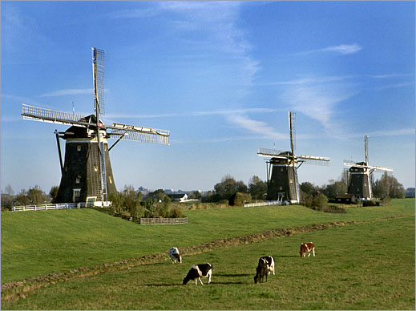
The Netherlands, 1913
1914-1918
Early constructivism
Cubism
Der Blaue Reiter movement
Futurism

Slide 3
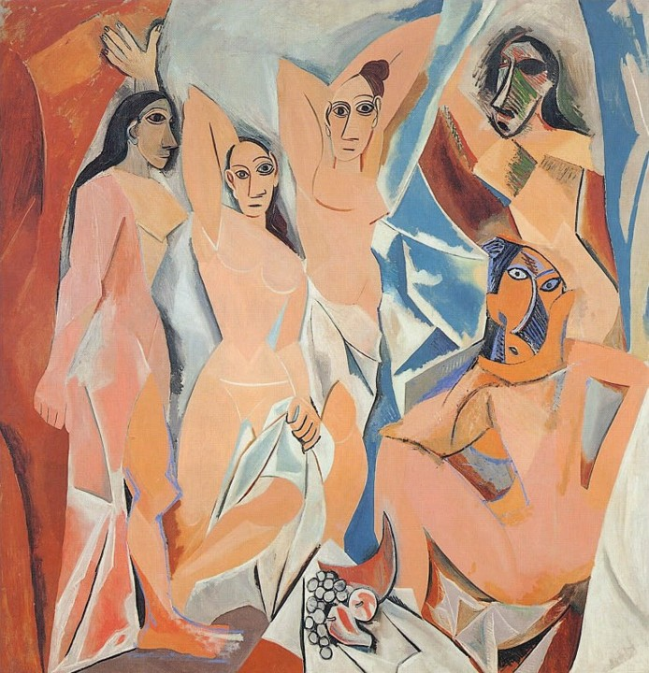
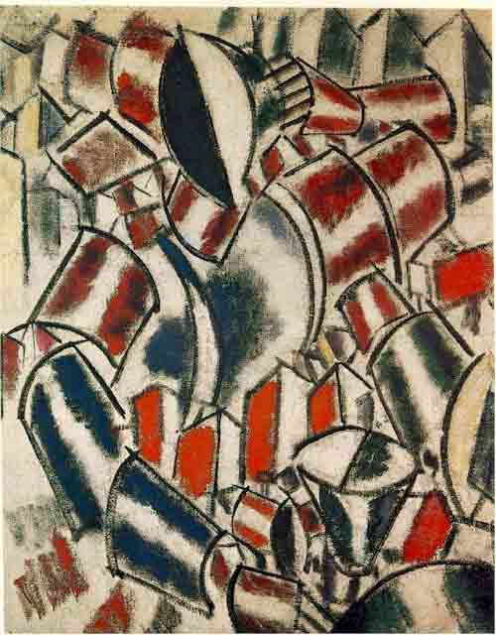
Cubism
Futurism
Early Constructivism
Der Blaue Reiter movement
Picasso : les demoiselles d’Avignon 1913, Leger: seated woman 1913

Slide 4
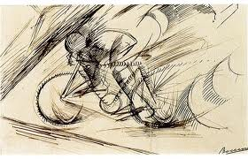
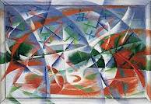
Cubism
Futurism
Early Constructivism
Der Blaue Reiter movement
Bocciomi, dynamism of a cyclist, 1913, Giacomo Balla: abstract speed and sound, 1913-1914,

Slide 5
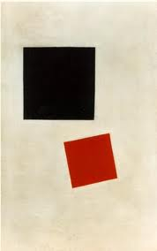
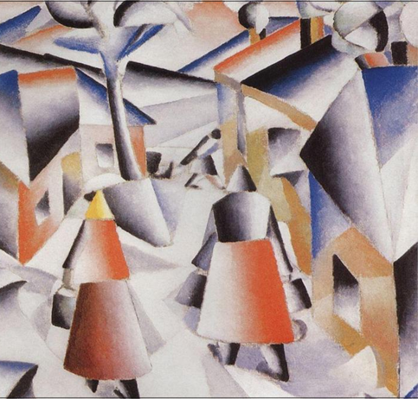
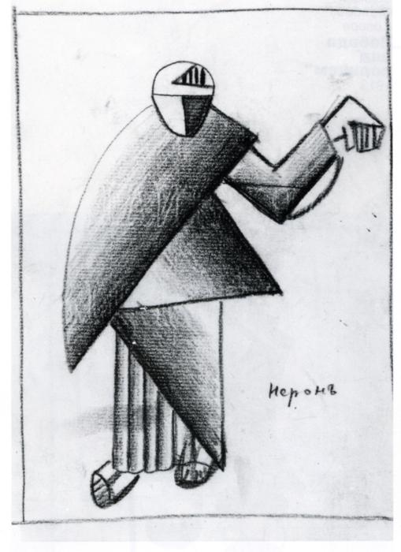
Cubism
Futurism
Early Constructivism
Der Blaue Reiter movement
Malevich: morning in the village after snowstorm , neron, black and red squares,

Slide 6
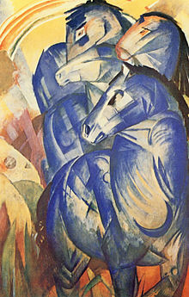
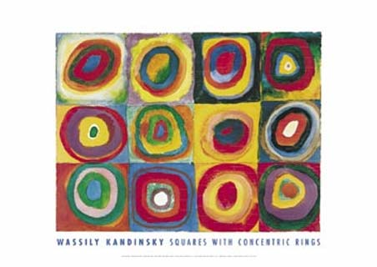
Cubism
Futurism
Early Constructivism
Der Blaue Reiter movement
Franz Marc: the tower of blue horses, Kandinsky: Colorstudy Squares with concentric rings 1913

Slide 7
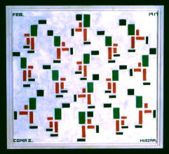
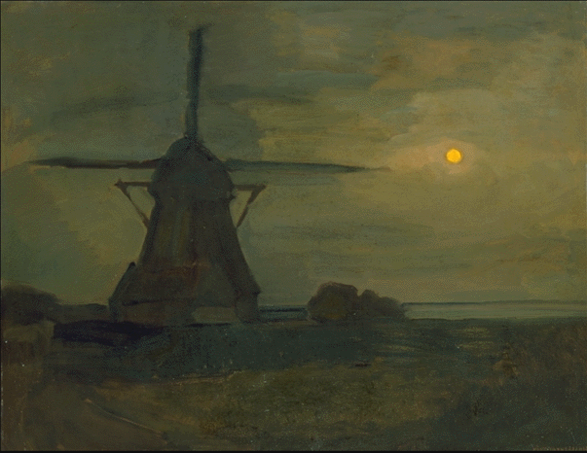
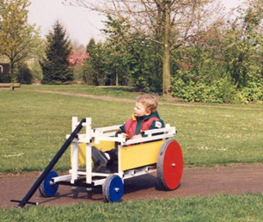
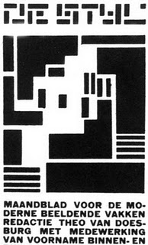
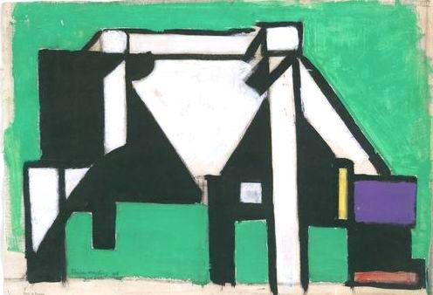
Earl constructivism
Cubism
Futurism
Mondriaan, Van Doesburg, Huszar, Rietveld

Slide 8
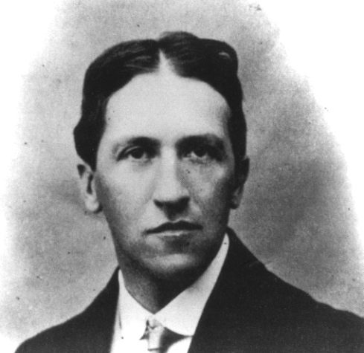
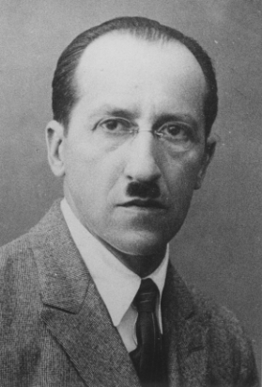
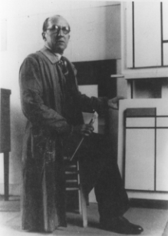
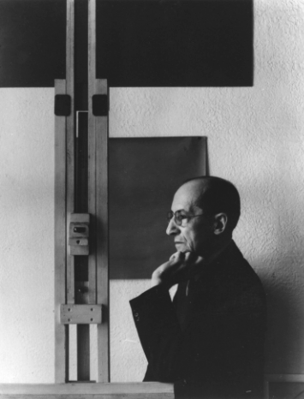
Mondrian: the man
Netherlands (*1872)
Paris
London
New York (+1944)

Slide 9
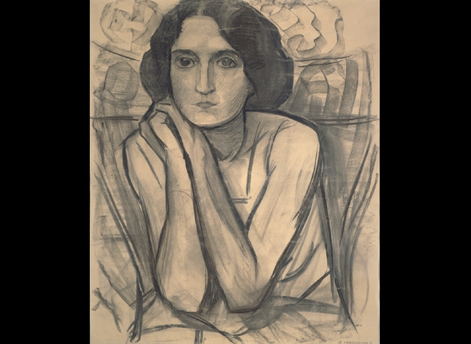
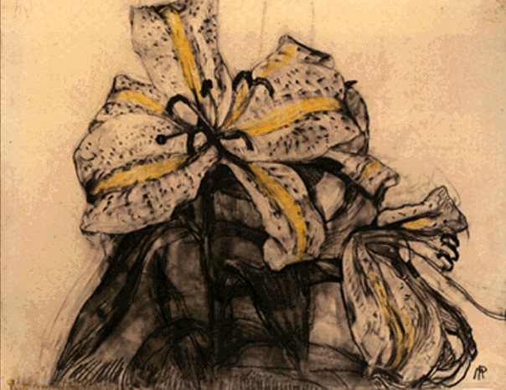
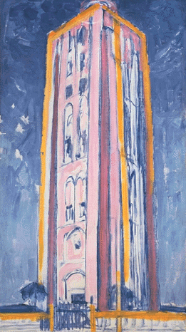
Mondrian: his work
from figuration…

Slide 10
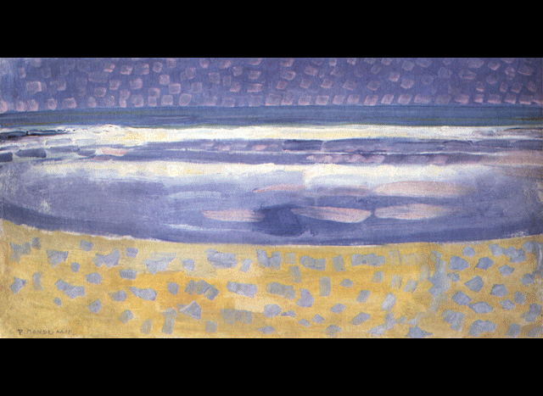
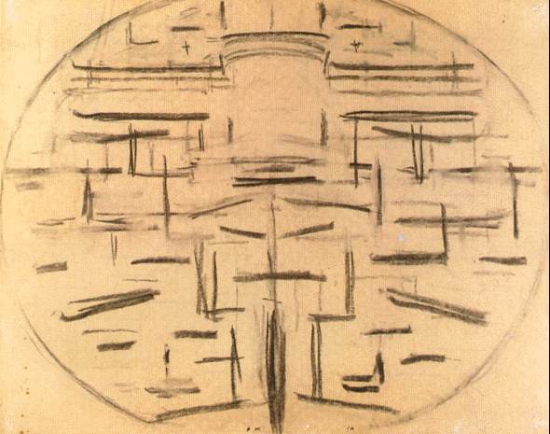
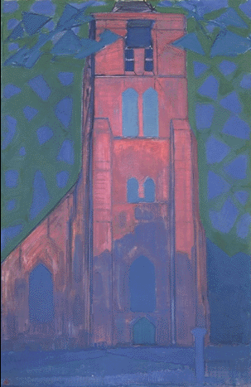
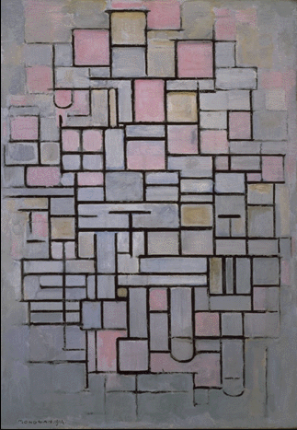
to abstraction …
(coast lines, church towers, windmills, trees)

Slide 11
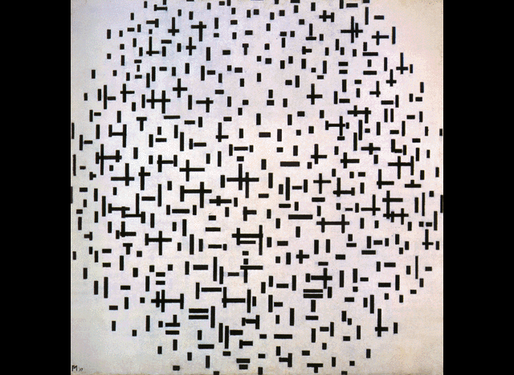
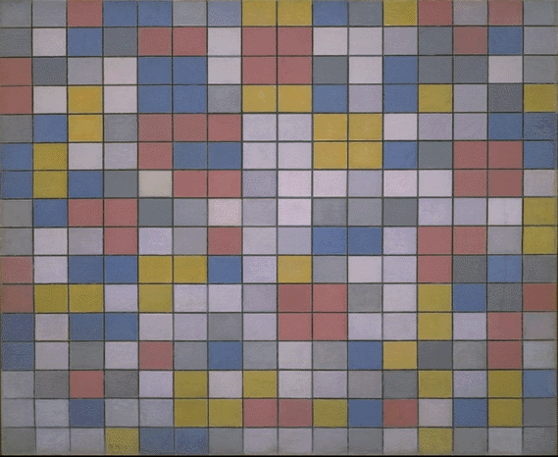
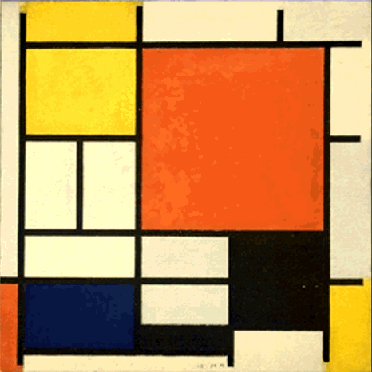
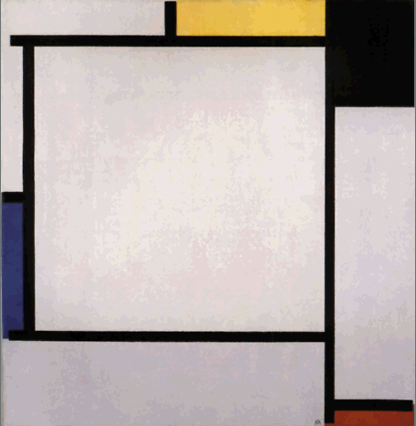
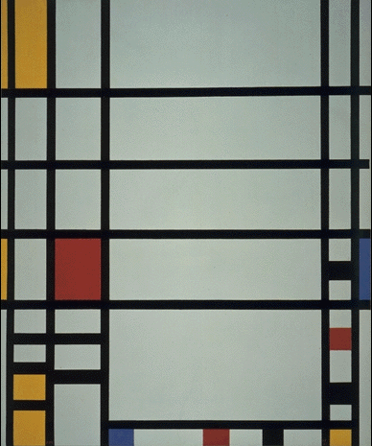
…and beyond

Slide 12
Topics

Slide 13
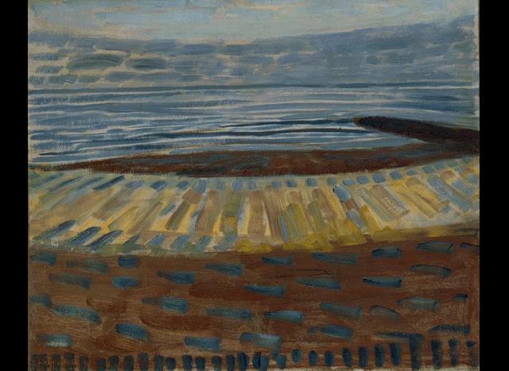

Slide 14
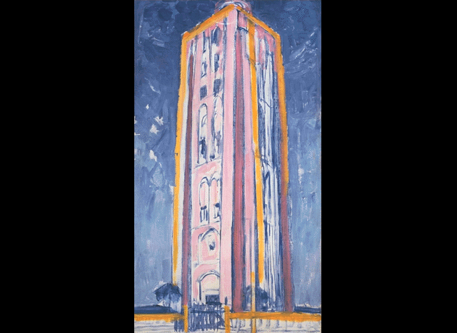

Slide 15
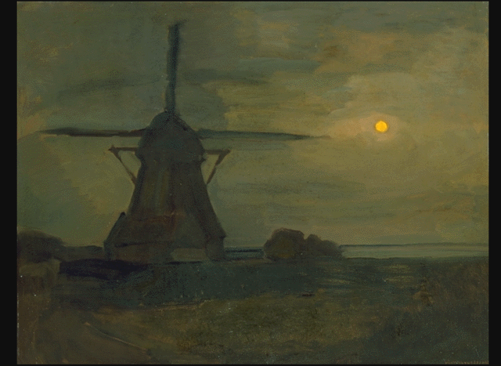

Slide 16
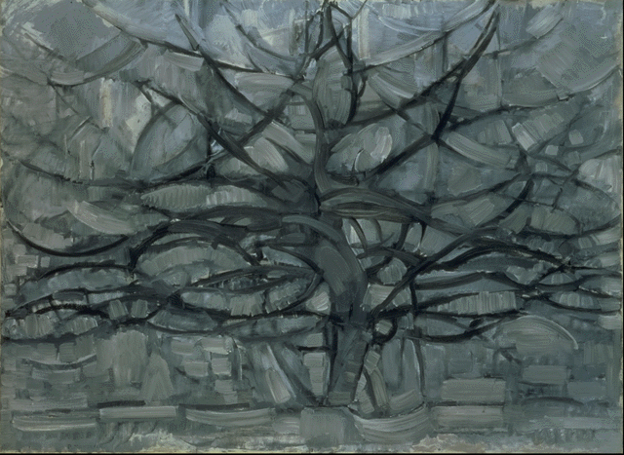

Slide 17
Planes

Slide 18
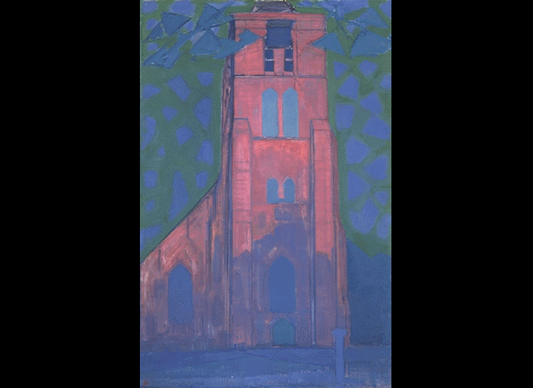

Slide 19
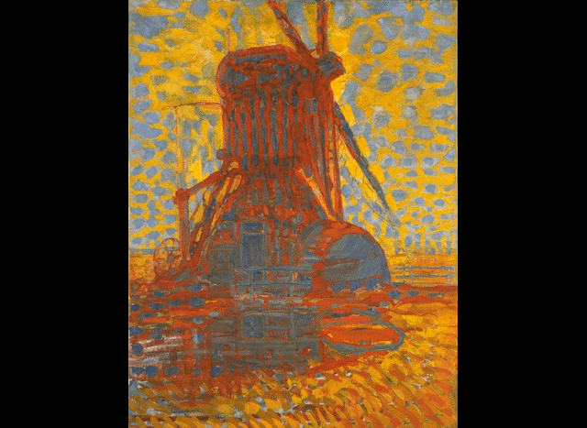

Slide 20
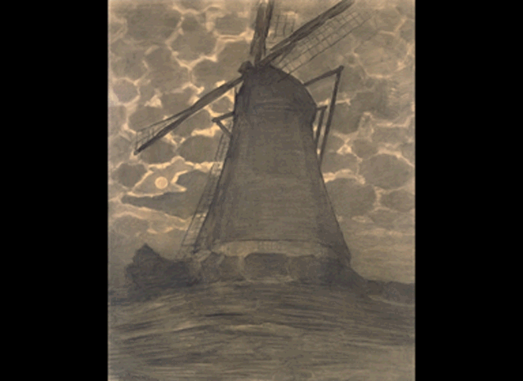

Slide 21
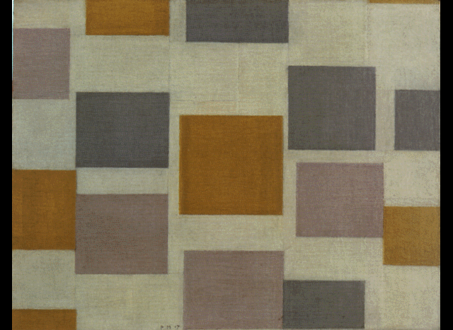

Slide 22
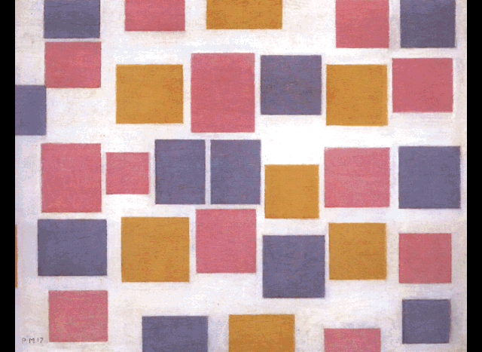

Slide 23
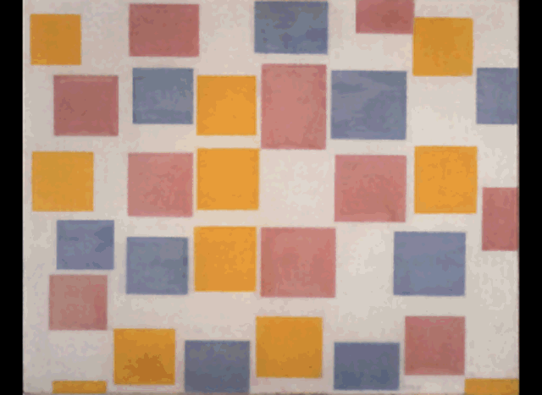

Slide 24
Lines

Slide 25
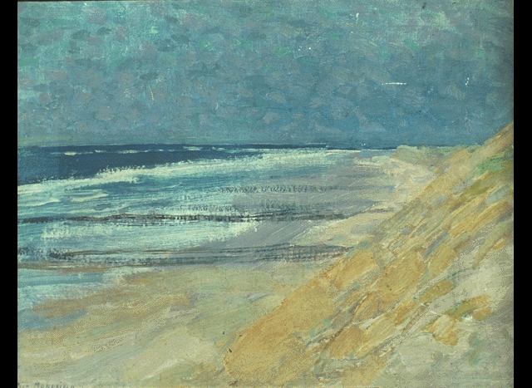

Slide 26
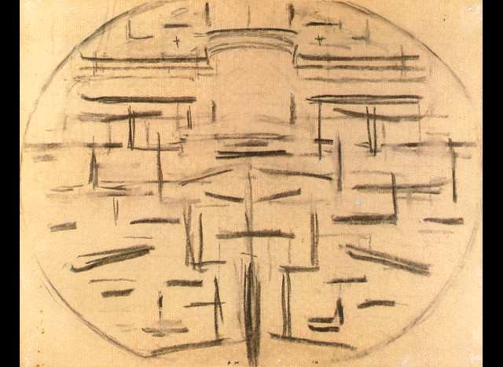

Slide 27
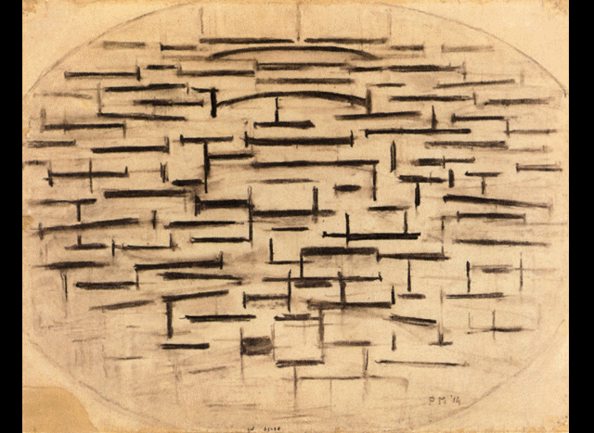

Slide 28
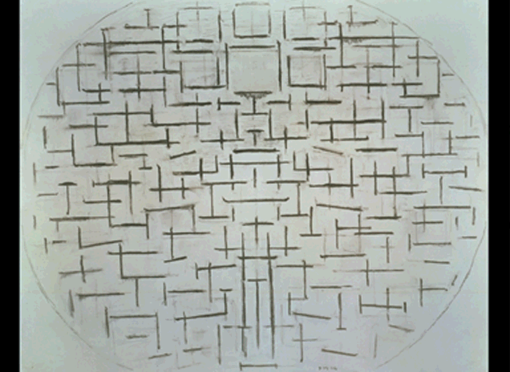

Slide 29
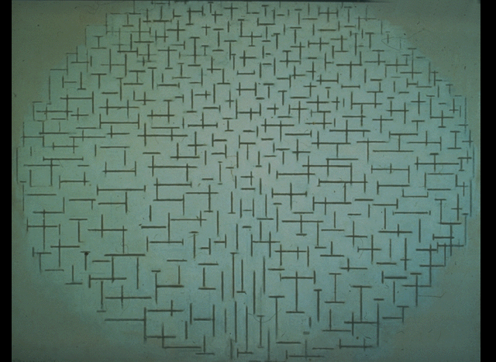

Slide 32
Planes and lines (1)

Slide 33
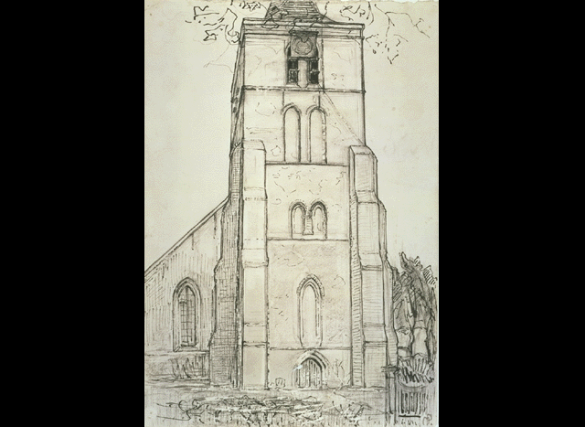

Slide 34
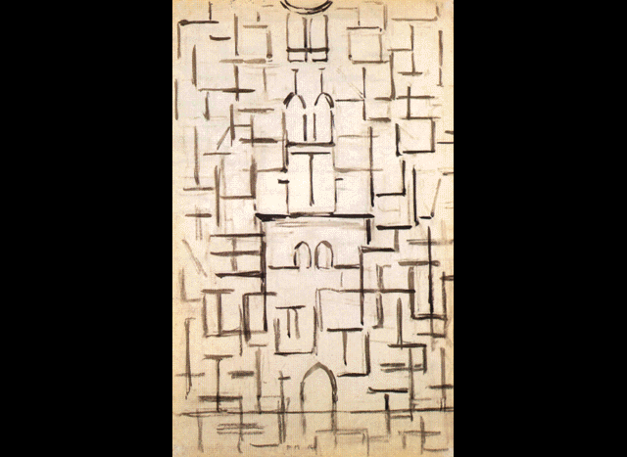

Slide 35
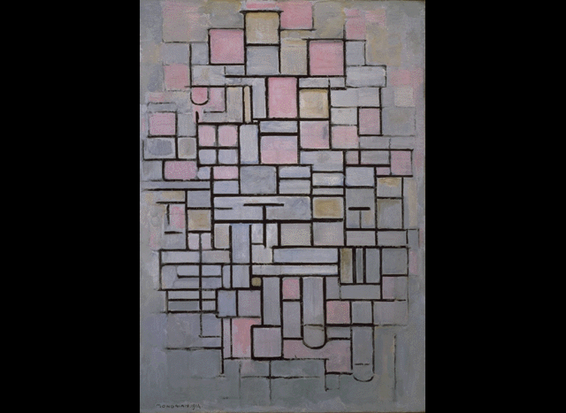

Slide 36
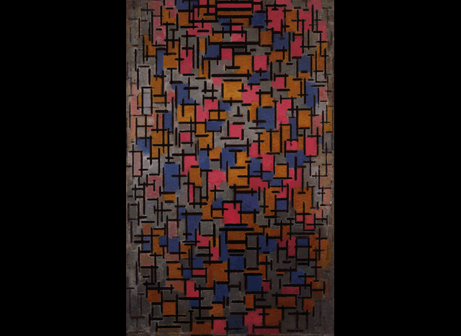

Slide 39
Planes and lines (2)

Slide 43
Composition

Slide 48
Periphery

Slide 53
Partial periphery

Slide 56
Quadrants

Slide 60
Quadrants and doubled lines

Slide 64
More doublings: Londen

Slide 70
Colour planes: the “square”

Slide 76
Colored lines: New York

Slide 79
Boogie woogie

Slide 82
thank you

Slide 83
An algorithmic approach
Turbo Pascal
3800 lines
first version 1993
restrictions & limitations
demo

Slide 84
Model
unification of types
unification of planes and lines
growth of cells
information in kernels
interaction between cells

Slide 85
Cel
color
position and size

Slide 86
Kernel
color
direction(s) of growth
collision behavior
maximal length
development phase
behavior near boundary
Color = red
xInc = true
Crossing = true

Slide 87
Kernel
color
Color = red
Color = blue
Color = yellow
Color = black
etc.

Slide 88
Kernel
color
direction(s) of growth
xInc = false yInc = false
xInc = true yInc = false
xInc = false yInc = true
xInc = true yInc = true

Slide 89
Kernel
color
direction(s) of growth
collision behavior
crossing = true
crossing = false

Slide 90
Type
color distribution of kernels
probability distribution of # kernels
distribution of kernel positions
line/plane distribution of kernels
other properties of kernels

Slide 91
Development
choosing the composition type
choosing the number of kernels
choosing the kernel properties
phased development

Slide 92
Kernel = object
X : integer;
Y : integer;
D : integer;
xInc : Boolean;
yInc : Boolean;
Color : ColorVal;
PRagged : boolean; {ragged at boundary of Painting}
ORagged : boolean; {ragged when meeting Other cell}
Crossing : boolean;
Phase : 0..MaxPhase;
MaxLen : integer;
Cell = object (kernel)
xMIN : integer;
yMIN : integer;
xMAX : integer;
yMAX : integer;
Painting = object
Width : integer;
Height : integer;
xMIN : integer;
yMIN : integer;
xMAX : integer;
yMAX : integer; Color : ColorVal;
MaxCell : integer
Cells : array[0..MaxCellLimit] of PCell;

Slide 93
procedure Painting.ColorPlanes;
var
A,B,i : integer;
k : PKernel;
begin
self.color := white;
A := 0;
B := 50 + random(50);
MaxCell := A + B;
for i := 0 to MaxCell do begin
k := mkKernelB([rose,sky,gold]);
with k^ do begin
Maxlen := ((xMAX - xMIN) div 5);
k^.ORagged := true;
end;
Cells[i] := mkCell(k);
end; {for}
end;

Slide 94
procedure Painting.Peripheral;
var
A,B,i : integer;
k : PKernel;
begin
color := white;
A := 1 + Random(4);
B := 1 + Random(3);
MaxCell := 4 + A + B - 1;
for i := 1 to 4 do begin
repeat
k := mkKernelA([black]);
until (i=1) AND inLHStrip(k,0.3)
or (i=2) AND inUHStrip(k,0.3)
or (i=3) AND inLVStrip(k,0.3)
or (i=4) AND inRVStrip(k,0.3);
with k^ do begin
d := 5;
xInc := (i=1) OR (i=2);
yInc := NOT xInc;
PRagged := (Random(10) = 0);
Crossing := (Random(20) = 0);
{Phase = 0}
end; {with}
self.Cells[i - 1] := mkCell(k)
end;

Slide 95
for i := 4+1 to 4+A do begin
repeat
k := mkKernelA([black]);
until inLHStrip(k,0.03)
or inUHStrip(k,0.03)
or inLVStrip(k,0.03)
or inRVStrip(k,0.03);
with k^ do begin
d := 5;
yInc := inLHStrip(k,0.03)
or inUHStrip(k,0.03);
xInc := NOT yInc;
PRagged := (Random(5) = 0);
Crossing := (Random(20) = 0);
Phase := 1;
end; {with}
self.Cells[i - 1] := mkCell(k)
end;
for i := 4+A+1 to 4+A+B do begin
repeat
k := mkKernelB([red,blue,yellow,black])
until inLHStrip(k,0.04)
or inUHStrip(k,0.04)
or inRVStrip(k,0.04);
self.Cells[i - 1] := mkCell(k);
end;
end

Slide 96
case Year of
1914 : PierOceanSym ;
1915 : PierOceanAsym ;
1916 : PlusMinus ;
1917: if random(3) = 0
then CompositionInColor
else ColorPlanes ;
1918 : ColorPlanesGrayContours ;
1919 : CompositionBlackGrey ;
1920..1921: RedYellowBlue20 ;
1922..1923: Peripheral ;
1924..1927: CentralRedOrBlue ;
1928..1930: CorneredPeripheral ;
1931..1932: BigPlus ;
1933..1935: DoubledBigPlus ;
1936..1937: Ladder ;
1938..1939: GeneralisingLadder ;
1940 : GeneralisedLadder ;
1941 : Place ;
1942..1944: NewYorkCity ;
end {case}

Slide 97
Mondrian’s “axiomatic” approach
looking for a minimal set of concepts
looking for beauty and balance
finding constructions that
do not represent reality
don’t even have real-world perceptual qualities
syntax
depth, lines, planes
real world meaning
Blotkamp’s book: the art of destruction

Slide 98
A minimal set of concepts
only primary colors
only two directions
lines, planes, canvas
lines and planes are essentially the same concept
cf. algorithm
in “Boogy woogies” even canvas and plane are unified

Slide 99
Finding constructions
that do not represent reality

Slide 100
Finding constructions
without real-world perceptual qualities
Seeing depth
problem
solution

Slide 101
Seeing “line” objects
solution(1)
solution(2)
Seeing “plane” objects
solution(1)
solution(2)
solution(3)

Slide 102
Further unifications
line ≠ plane
solution
object ≠ canvas
solution

Slide 103
thank you

Slide 104
Thank you again

Slide 105
Michael Noll 1964

Slide 107
keramiek 1999

Slide 109
replica’s

Slide 110
Thank you again

