Slide 1
Hello You
The Middle Path

Slide 2
Processing: After the course
Use the processing environment and:
- create programs … that run
- … that draw pictures
- … that display animations
- … that display interactive animations
- … that animate interactive objects
last but not least: make all of these work together as
you like … great freedom to create
/Department of industrial design

Slide 3
Assignors
Peter Peters
Jun Hu
Loe Feijs
Mathias Funk
/Department of industrial design

Slide 4
After this 1st lesson: what can you do
Start processing.
run your first program in processing
write programs that create various static objects i.e. “pictures”
change these programs to change the pictures.
understand how the pictures change when you change the program.
have a first idea about creating interactive objects.
/Department of industrial design

Slide 5
After 1st lesson:
What should you understand ?
Why processing (and programming in general) is
interesting and important for you as a designer
what syntax is ?
what expressions are?
what (basic) types and variables are ?
what semantics is ? How to look it up?
how to think about programs. (a little)

Slide 6
Downloading processing…
Go to wiki created for the assignment:
http://wiki.id.tue.nl/creapro
go there and click on:
Prepare your computer for the assignment
then click on the link:
Download processing. (a stable release)
create a directory "Programs" on the C: disk, in the root. If "C:\Programs" exists already, skip this step.
extract the entire directory to C:\Programs (note, not "C:\Program Files"). if you are reinstalling Processing, remove the entire processing directory first.

Slide 7
Before you start … Experience some Examples
Open menu:
File | Examples | Basics | Transform |
run: Rotate
Open menu:
File|Examples|Topics|Interaction|
run: Follow 1
run: Follow 2
run: Follow 3

Slide 8
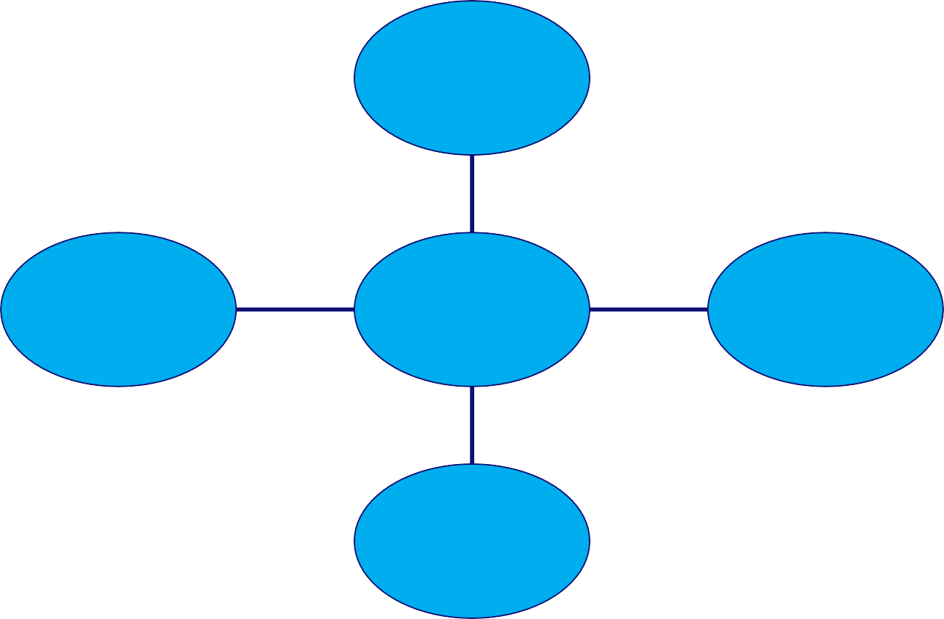
Design Process: integrate various skills
•
envisioning transforming
sensing perceiving doing
analysing& abstracting
Integrating realising
validating quality
Hummels & Frens: Reflective Transformational Design model

Slide 9
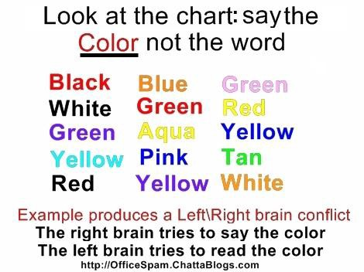
A little experiment …

Slide 10
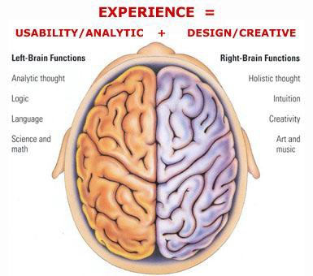
Need to integrate Left & Right brain
Source: http://www.tunghai74.org/letters/Brain-left-right.htm

Slide 11
Left versus Right
abstract objects that are represented in language are easy to change and to duplicate but are not immediately graspable or visible, and cannot be placed in the relevant context
concrete objects that are created in matter can be inspected and manipulated easier, but are more difficult to change and to duplicate.

Slide 12
We want best of both worlds
define and create objects through language
grasp and inspect objects through senses.
Processing can execute abstract instructions in a computer language and translate these into something that you can experience through the senses.

Slide 13
Programming languages : How does it work?
processing is an imperative language: that means
you use the language to give commands
The computer creates the application by executing the commands one after the other … it is a sequential language
compare with written music : parallel (orchestra)
can also be done in programs …very difficult.

Slide 14
Lets Start Programming…
Click on the processing icon …
Window opens with: Run, Stop, New, Open, Save,Export Application (makes applets).

Slide 15
First program “Hello you”
print(“hello you”);
print(“hello ”);
print(“you”);
println(“commands are separated by semicolons”);
• print(5*3);
print(“We count”+ 2+1+5+10 + “characters”);
print(“We count”+ (2+1+5+10) + “characters”);

Slide 16
Correctness : 3 Levels
Syntax (language form) : wellformed grammatical expressions: orders of brackets, semicolons, operators, letters and numbers.
Types (kinds of things) : distinghuish apples from oranges
Semantics (meaning) : does the program do what
you want ?

Slide 17
Syntax : wellformed or not ? Try some examples …
print(“hhhh
print(“a”) ; print(“b”)
print(8); {print(8) ; }
print(“hello you)” ;
ggg”);
;
; {{{print(8); }}} ;
➔ syntax error: expecting RPAREN, found ;
// this is just a comment …..
print( “ jjjhhh ) ” ) )
•
print(“a”) print(“b”)
➔ syntax error: unexpected token: null
➔ syntax error: maybe a missing semicolon
commands can contain expressions ….

Slide 18
Expressions can be nested …
• 3*4
• sin(3*4)
• sin(3* tan(5) / exp( sin(cos(0.45454))))
“abcd”+”efgh”
• “abcd” + ( “ef” + “gh”)

Slide 19
Types
String
“hhhheeeee” + “aaa” + “nnbn99 bnb”
int
8 9* 97978787
1-9988989
• float 2333.5555
• sin( -3 * 5677.455)
• 3.4e+38
basic types are: String, float,int, boolean, char, byte,
(to be continued … can do)

Slide 20
variables
A variable is a named location where a certain type
of value can be stored
declare; initialize, use, scope.
String anExample;
anExample = “fghjkl”;
anExample = anExample + anExample;

Slide 21
Variable 2
int multiplier = 5;
multiplier = multiplier + 4;
• float pi = 3.1415926535897932;
print( multiplier * pi) ;

Slide 22
SEMANTICS
The meaning of the command; this may depend on type.
int myAge;
myAge = 8;
print(myAge * 8 );
• print(“ 8 + 8 “);
print(“I count”+ 1+1+5+10 + “characters”);
• print(myAge+ (1+1+5+10) );
(to be continued)

Slide 23
How to think about commands:
setting up a picture, or later a stage, using predefined primitives
first start with a static picture:
create empty picture with command “size”:
• size(200,200);
Next: specify what you put where:
you can use various standard primitives with parameters:
• point(20,45)
• line( 0,0,100,150)

Slide 24
Example …
go to menu:
Example|Basics|Form|
run: PointsLines
what is semantics (meaning)
•
•
of : stroke( 153) ?
: background( 0 ) ?

Slide 25
Semantics
To find the meaning look for the (informal)
specifications ..
Select and right click on “stroke” to find out …
choose : find in reference
Idem on “background” to find out …
these commands specify drawing parameters

Slide 26
Specify drawing parameters …
stroke(255);
255 = white, 0 = black in between are
shade of gray ..
• background(200,23,130) ;
color)
(e.g. you can also use
nostroke() …etc various primitives
C:/Programs/processing-2.0b6/modes/java/reference/index.html

Slide 27
Also two dimensional shapes are possible …
• rect(20,20,60,120);
• ellipse( 50,50,30,99);
Example|Basics|Form|
run: ShapePrimitives

Slide 28
Interactive drawings …
create a stage with :
void setup() {
• size(200, 200);
• }
the you can draw … continuously …with the draw command ..
For example …

Slide 29
Interactive drawings …
void setup() {
size(200, 200);
smooth();
// makes forms smoother
strokeWeight(2); // how thick lines are stroke(255); // color of lines (white)
}
void draw() {
background(mouseX,mouseY, 80); // background color line(200, 0, mouseX, mouseY);
line(mouseX,mouseY, 0, 200);
}

Slide 30
Remark on style …
proper indentation
comprehensible comments
(using Auto Format in Tools menu, if you like it, ^T)
balanced pictures …
beautiful movements …

Slide 31
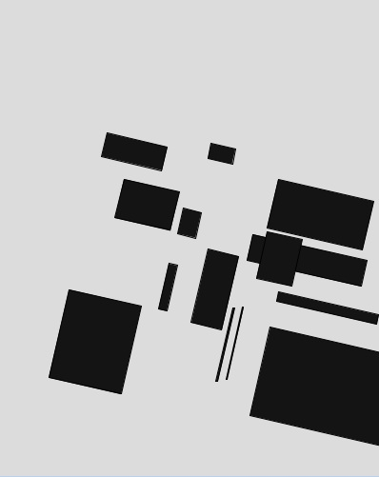
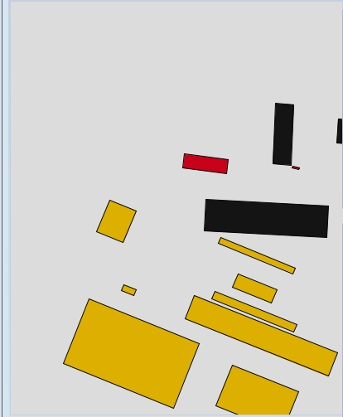
Where we will be in three weeks?
Computer Generated 2012
Computer Generated 2012

Slide 32
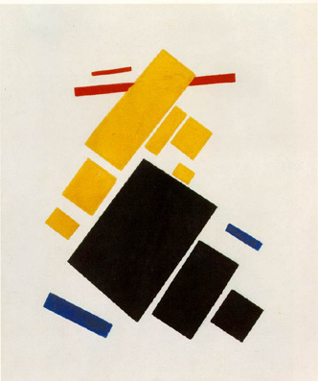
Kasimir Malevich, Suprematist Painting: Airlane Flying, 1915.
Kasimir Malevich, Suprematist Painting: eight red rectangles, 1915.

Slide 33
Some getting-started homework for you
Statistics:
Make a program with variables containing the ages of you and some of your friends
Let the program calculate the average and the standard deviation and print it orderly using print and println
Geometry:
Make a program with at least five int or float variables to be used as parameters
Let the program create an abstract geometric composition using these parameters
Play with the parameters to optimise aesthetic balance

