Slide 1
Arduino

Slide 2
Arduino Hardware
Blink an LED
Digital Input
Analog Input
Analog Output
Serial Communication
Using Serial Libraries
Using Firmata

Slide 3
Why Arduino?
Physical Computing
uses electronics
to prototype new materials
for designers and artists.
Tinkering
Patching
Community
Blog, Forum, Playground (wiki)

Slide 4
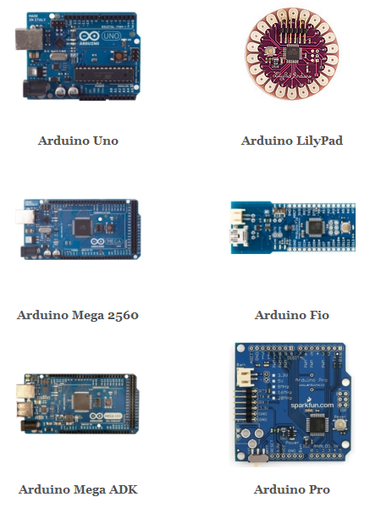
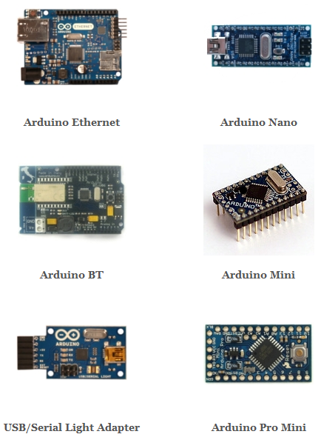
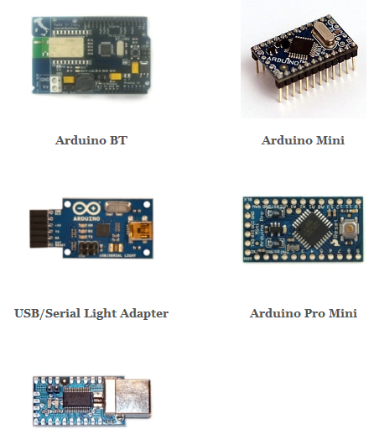
Hardware

Slide 5
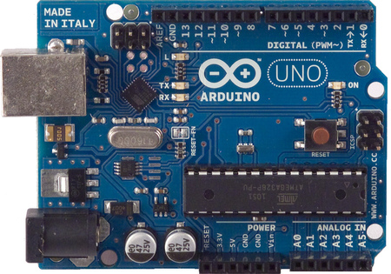
UNO

Slide 6
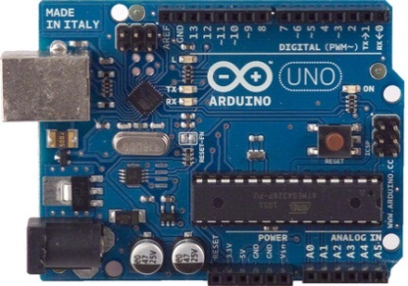
UNO
Microcontroller | ATmega328
Operating Voltage | 5V
Input Voltage (VIN) (recommended) | 7-12V
Input Voltage (limits) | 6-20V
Digital I/O Pins | 14 (of which 6 provide PWM output)
Analog Input Pins | 6
DC Current per I/O Pin | 40 mA
DC Current for 3.3V Pin | 50 mA
Flash Memory | 32 KB (ATmega328) of which 0.5 KB used by bootloader
SRAM (Static RAM) | 2 KB (ATmega328)
EEPROM (Electrically erasable programmable ROM) | 1 KB (ATmega328)
Clock Speed | 16 MHz

Slide 7
UNO
Power: USB Power supply (5V)
VIN

Slide 8
UNO
Power: external power supply (7V-12V)
VIN

Slide 9
UNO
Power: VIN, input or supply, depending on external power source. (7-12V)
VIN

Slide 10
UNO
Power: 5V supply
VIN

Slide 11
UNO
Power: 3.3V supply
VIN

Slide 12
UNO
Power: GND pins
VIN

Slide 13
UNO
Digital I/O Pins 14 (of which 6 provide PWM output)

Slide 14
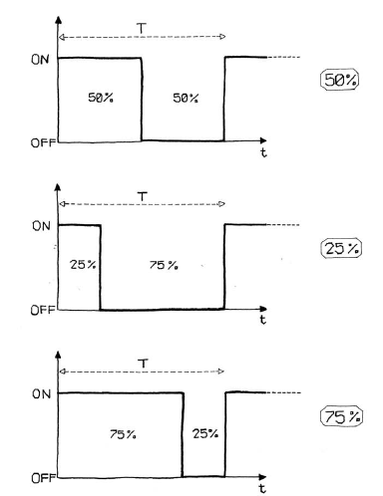
UNO
Digital I/O Pins 14 (of which 6 provide PWM output)
PWM (Pulse-width modulation)

Slide 15
UNO
Serial: 0 (RX) and 1 (TX)

Slide 16
UNO
LED: 13

Slide 17
UNO
6 analog inputs, 10 bits of resolution (i.e. 1024 different values)

Slide 18
UNO
AREF: Reference voltage for the analog inputs

Slide 19
UNO
Reset. LOW to reset the microcontroller

Slide 20
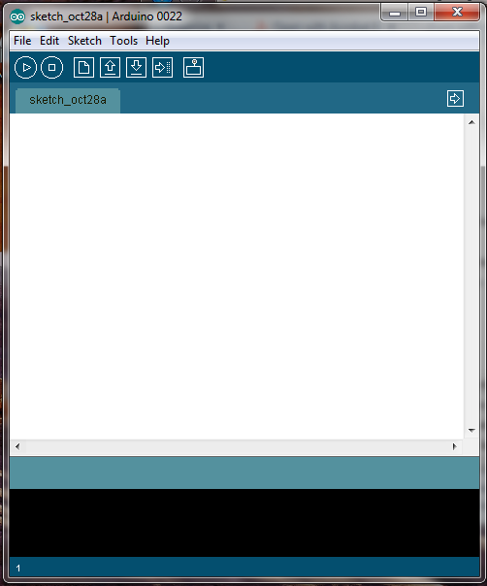
Software: IDE
http://arduino.cc/en/Main/Software

Slide 21
Driver Installation and Port Identification
Refer to the instructions in
“Getting Started with Arduino”, page 23-26

Slide 22
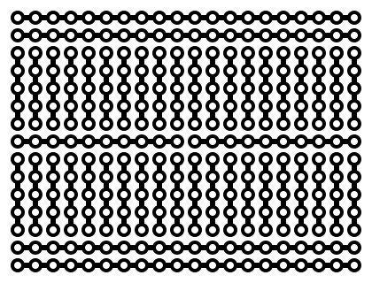
Breadboard

Slide 23
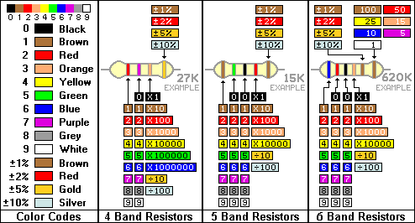
Color coding of the resistors

Slide 24
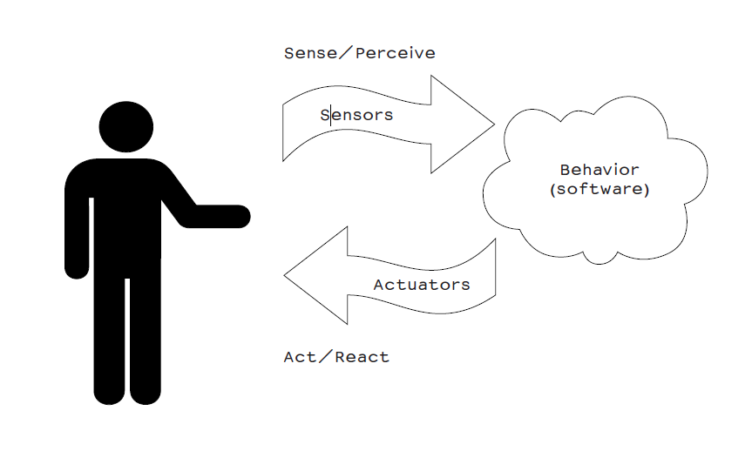
Really getting started

Slide 25
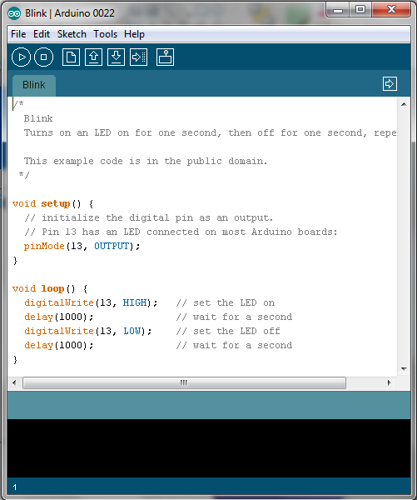
Blinking an LED
File>Examples>Basics>Blink
LED: light-emitting diode

Slide 26
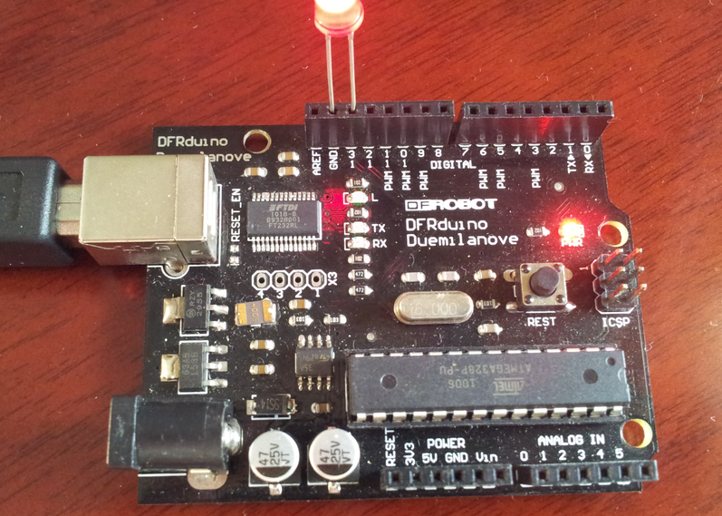
Blinking an LED

Slide 27
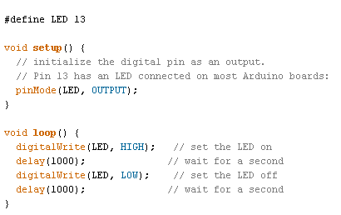
Blink an LED
#define LED 13

Slide 28
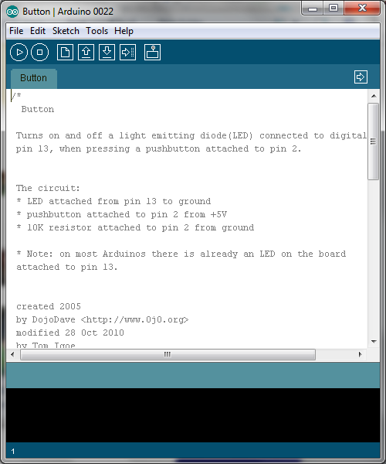
Button to control the LED
File>Examples>Digital>Button

Slide 29
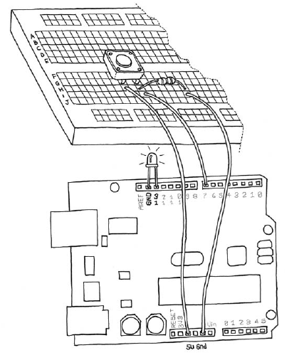
Button to control the LED

Slide 30
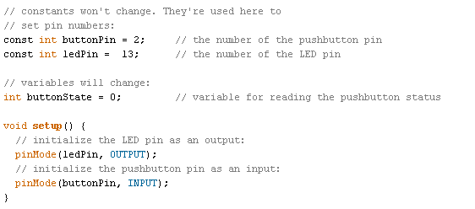
Button to control the LED

Slide 31
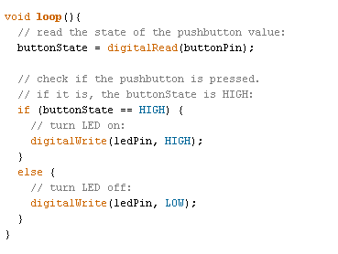
Button to control the LED

Slide 32
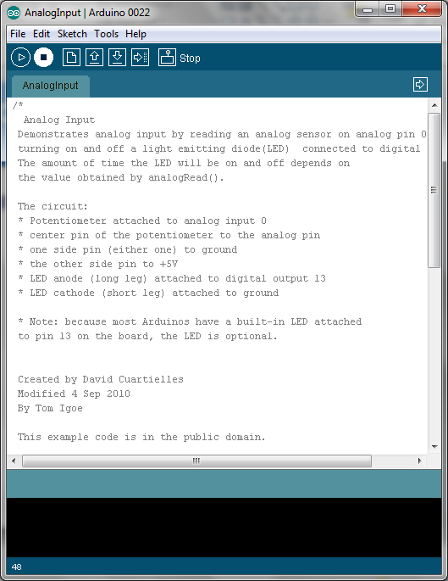
Analog I/O
File>Examples>Analog>AnalogInput
Instead of a potentiometer, we use a light sensor

Slide 33
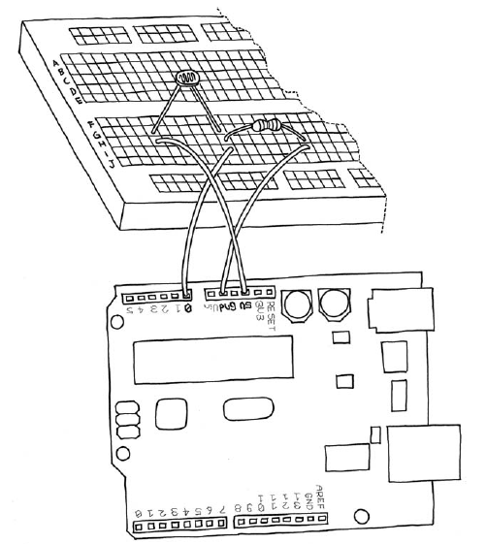
Analog I/O

Slide 34
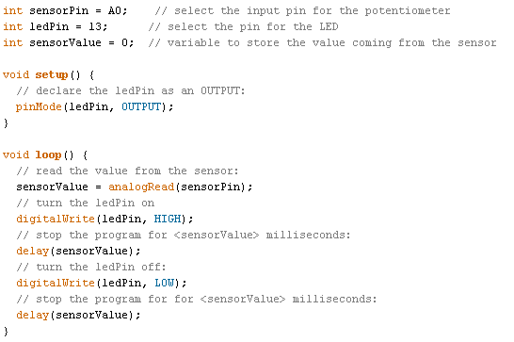
Analog I/O

Slide 35
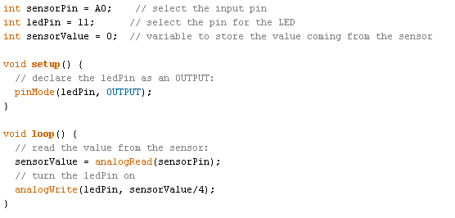
Analog I/O

Slide 36
Serial Communication
We are going to use the Serial library from Processing to talk to Arduino
http://processing.org/reference/libraries/serial/index.html
In Processing
File>Examples>Books>Getting Started>Ex_11_06
You can not run this program in Processing
Copy the code to Arduino software, upload to Arduino.

Slide 37
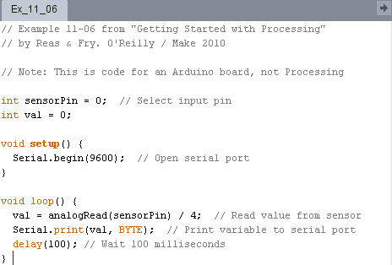
Serial Communication

Slide 38
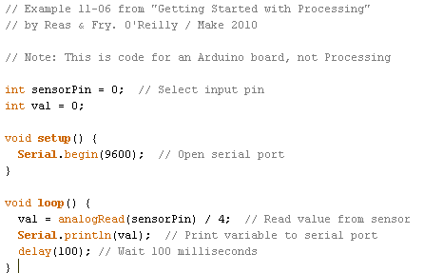
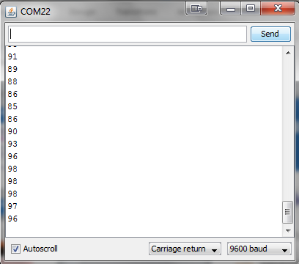
Serial Communication

Slide 39
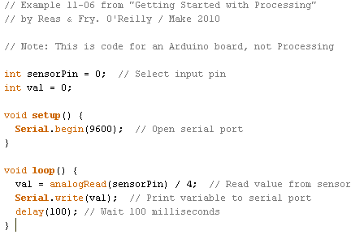
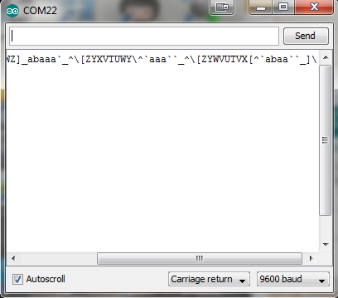
Serial Communication

Slide 40
Serial Communication
In Processing
File>Examples>Books>Chapter 11>Ex_11_07

Slide 41
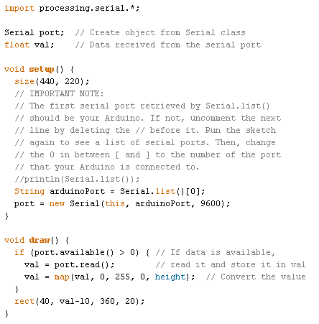
Serial Communication

Slide 42
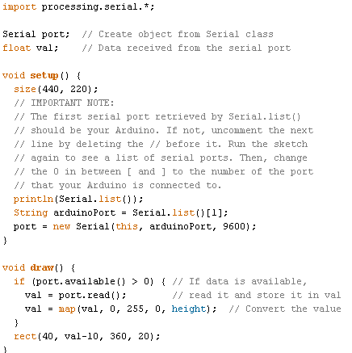
Serial Communication

Slide 43
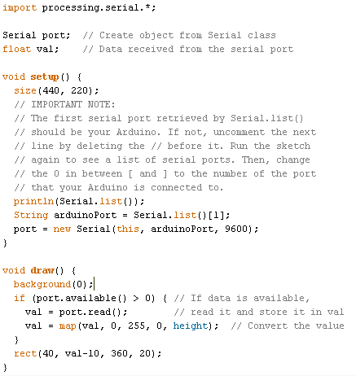
Serial Communication

Slide 44
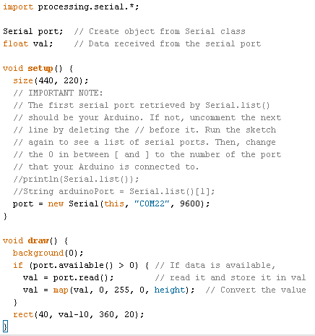
Serial Communication

Slide 45
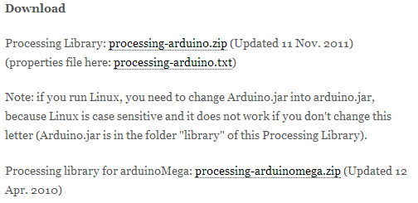
Serial Communication
Introducing Firmata
http://playground.arduino.cc/Interfacing/processing

Slide 46
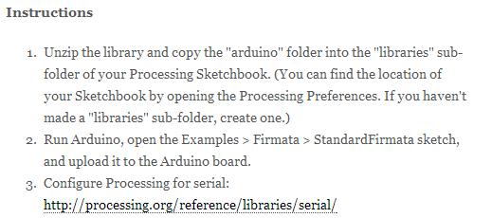
Serial Communication
Introducing Firmata
http://playground.arduino.cc/Interfacing/processing

Slide 47
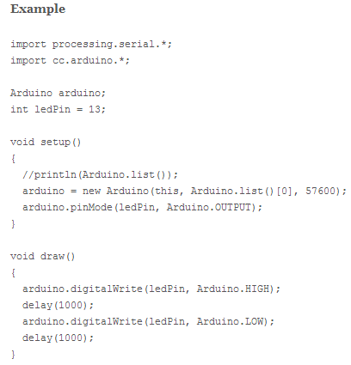
Serial Communication
Introducing Firmata
http://playground.arduino.cc/Interfacing/processing

Slide 48
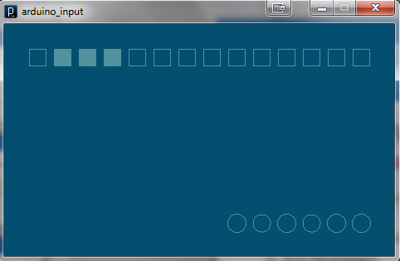
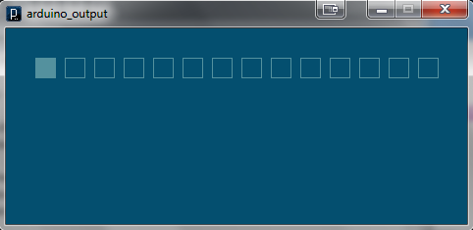
Serial Communication
Introducing Firmata
http://playground.arduino.cc/Interfacing/processing

Slide 49
That was Arduino.

