Slide 1
Object Orientation

Slide 2
Object Oriented Programming
a revolutionary extension of programming
extends earlier programming abstractions
is the leading programming paradigm
similar to techniques of thinking about problems in other domains e.g. architecture

Slide 3
Object Oriented Programming
Program consist of many “things” (objects)
there are different kinds of “things”
objects are created as instances of classes
objects can have an internal state and components.
objects exchange messages
if object A sends message to B then B does something (and returns a result to A)
results can be boolean, int, float or string
or they can be an object themselves or there is no result (void).
there is some main object with a loop that starts everything off

Slide 4
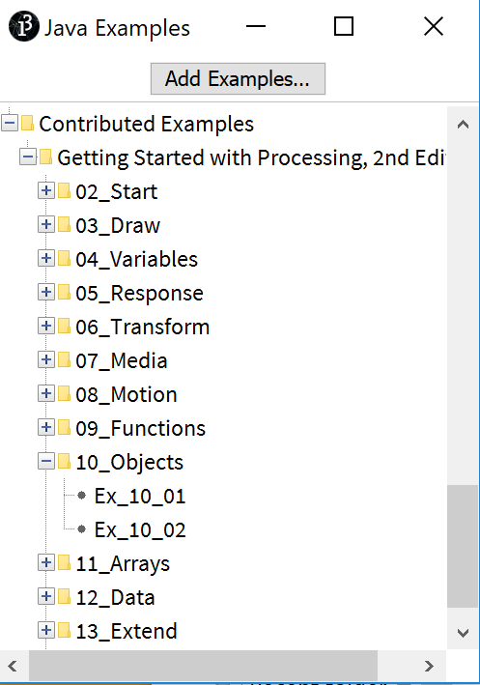
Encapsulation
objects encapsulate state as a collection of instance variables
objects encapsulate behavior via methods invoked by messages
JitBug
float x float y int diameter float speed
void move() void display()

Slide 5
Encapsulation
creating for objects with encapsulated state
and encapsulated behaviour
hiding implementation details
protecting the state information of objects
putting objects in control
facilitating modularity, code reuse and maintenance

Slide 6
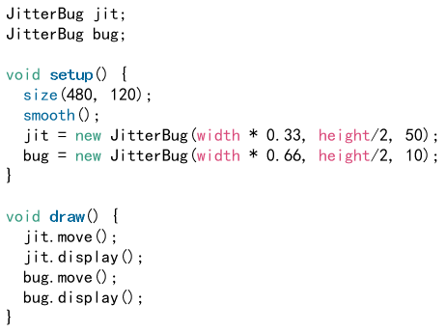
Encapsulation
creating for objects with encapsulated state
and encapsulated behaviour
hiding implementation details
protecting the state information of objects
putting objects in control
facilitating modularity, code reuse and maintenance

Slide 7
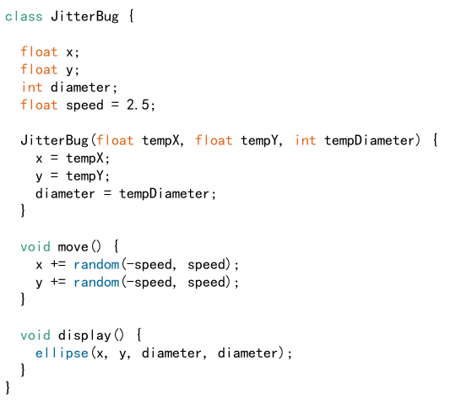
Class definition
state attributes
constructor
methods

Slide 8
Challenge: add a third jitbug

Slide 9
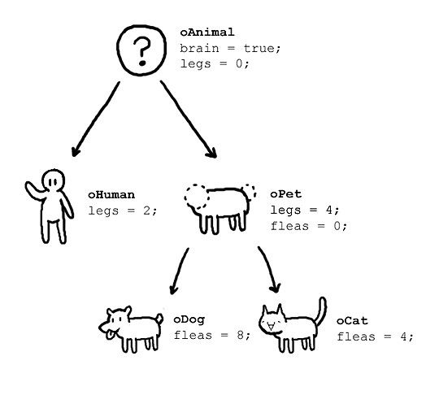
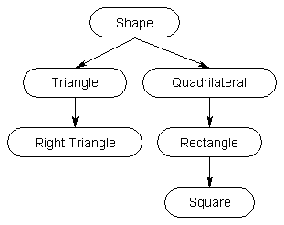
Inheritance / Extension
Classes form a hierarchy
superclass is the parent and subclass is a child
subclasses “extend” (i.e. specialize) their superclass

Slide 10
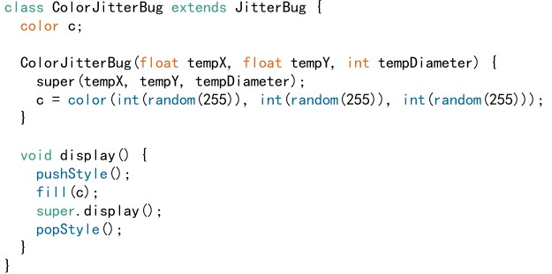
ColorJitBug extends JitBug

Slide 11
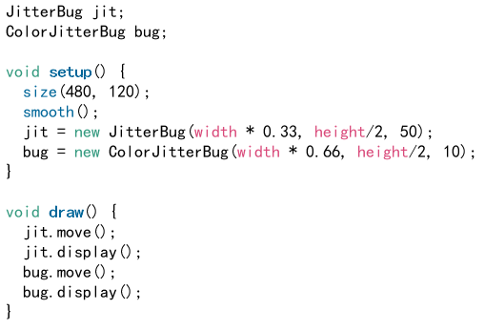
ColorJitBug extends JitBug

Slide 12
Object Orientation
Encapsulation
Inheritance

