Slide 1
Workshop Arduino

Slide 2
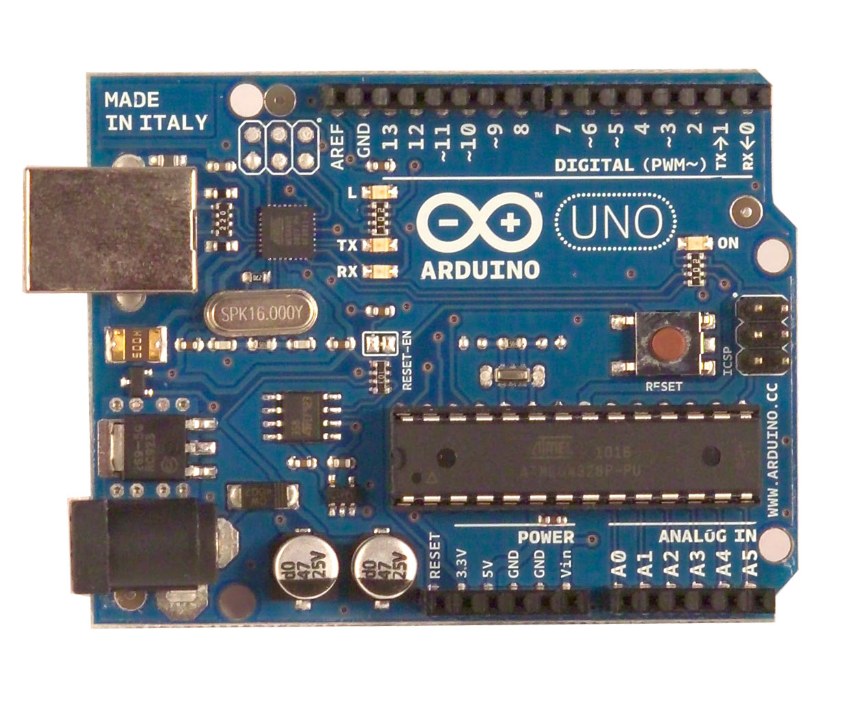
Arduino Workshop
• Background on microcontrollers
Writing a program
Connecting hardware
Actions:
Making a LED blink
Read a button
Read a sensor
Send text to computer

Slide 3



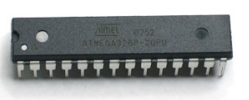



“Microcontrollers are not scary”

Slide 4


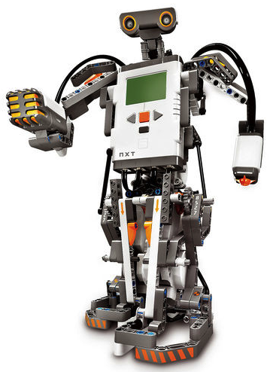
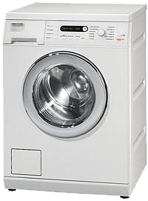

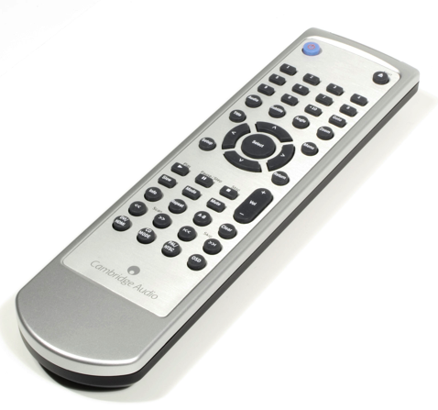
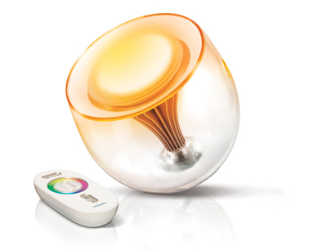
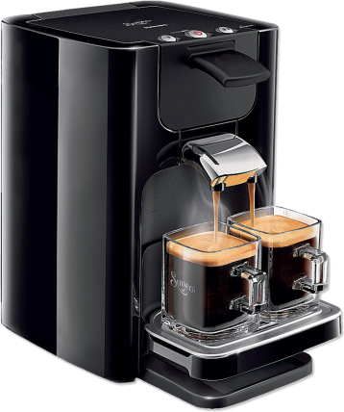
Products with microcontrollers
Workshop Arduino

Slide 5
Why microcontrollers for ID?
They enable you to turn your concepts into working interactive prototypes
Can be used for many purposes in your career at low cost
Arduino is supported by a huge community; you can build upon existing code and hardware designs (your own or by others)

Slide 6


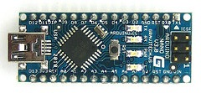
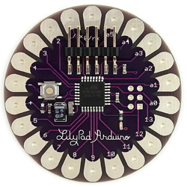
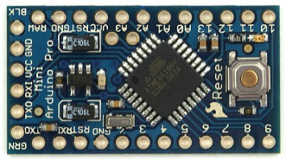
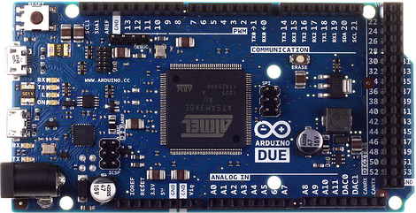
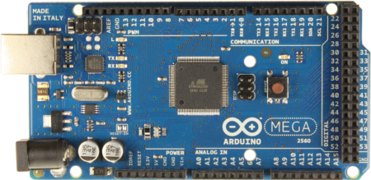
Arduino Nano
Arduino Uno
Arduino Pro Mini
Arduino Lilypad
Arduino DUE (ARM based)
Arduino MEGA

Slide 7
Digital input and output pins
Power indicator
Reset button
USB connector
Atmel AVR
Microcontroller
Power in
Analog input pins
Clock
“ heartbeat”
Power out

Slide 8

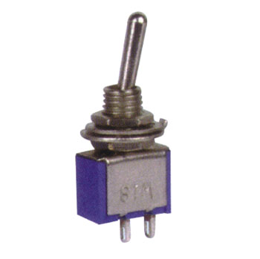
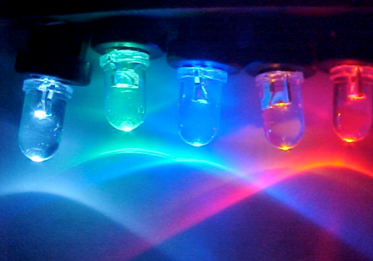
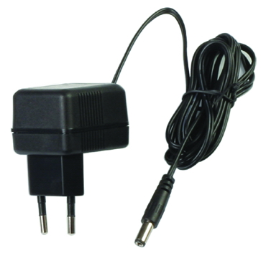
The development system
Computer
USB port
Arduino board
Input
Output
Microcontroller
Stabilized
power supply
Clock

Slide 9
A microcontroller . .
Is a processor with
Low power
Low cost
Dedicated for a single task
On-board program memory
On-board data memory
I/O pins (digital and/or analog)
(Timer/counter circuits)
(Bus protocols: RS232, USB, I²C, SPI, …))

Slide 10
Electronics: Digital Inputs
Digital input:
0 Volt: Low
5 Volt: High
2.5 Volt or floating?:
  Undefined !!

Slide 11
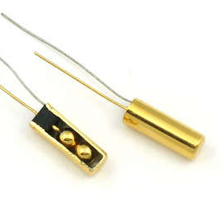
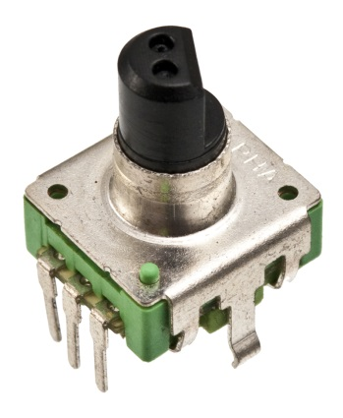
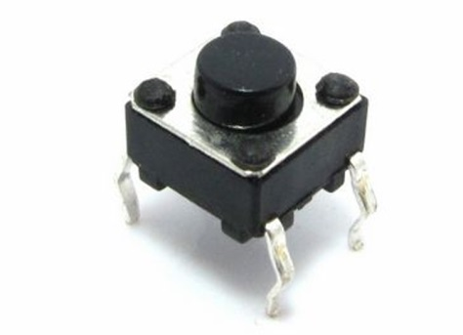
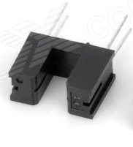
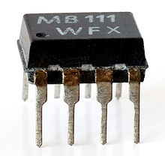
Electronics : Digital sensors
Notes:
Button, Tilt switch, rotation sensor, IR photo gate , Optocoupler

Slide 12
Electronics: Digital Inputs
External pull up Internal pull up Internal pull up (new)
pinMode(12, INPUT); pinMode(12, INPUT); pinMode(12,INPUT_PULLUP);
digitalWrite(12, LOW); digitalWrite(12, HIGH); int a = digitalRead(12);
int a = digitalRead(12); int a = digitalRead(12);
5V
5V
Arduino
Arduino
100K
20K
switch
switch
GND
GND

Slide 13
Electronics: Analog Inputs
Analog input:
Default:
  0..5 Volt to 0..1023
  0 => 0
  2,5 => 512
  5 => 1023

Slide 14
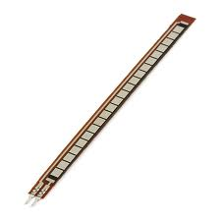
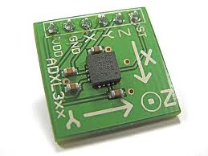
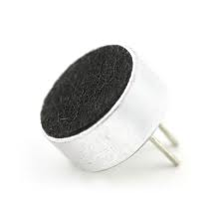
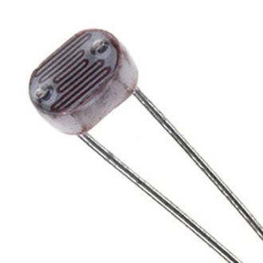
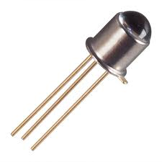
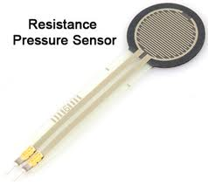
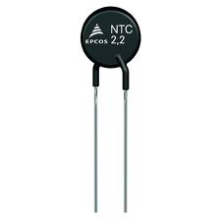
Electronics : Analog sensors
Notes:
Accelerometer, microphone, LDR, Flex sensor, Photodiode, FSR, NTC

Slide 15
Electronics: Analog Inputs
pinMode(A0, INPUT);
Int a = analogRead(A0);
5V
Arduino
10K
A0
GND

Slide 16
Electronics: Digital Outputs
Digital output:
0 Volt: Low
5 Volt: High
2.5 Volt? NO
(“PWM” : ~ pins)
PWM and average voltage for a number of duty cycles

Slide 17
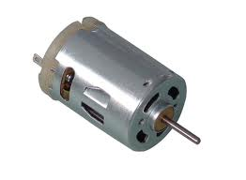
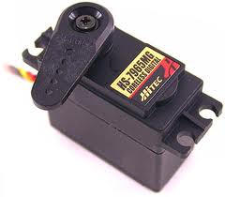
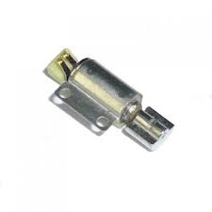
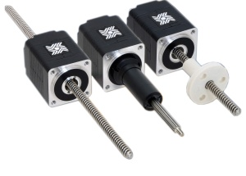
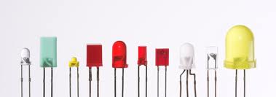

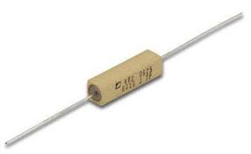
Electronics : Actuators

Slide 18
Electronics: Digital Outputs
pinMode(13, OUTPUT); pinMode(11, OUTPUT);
digitalWrite(13, LOW); analogWrite(11, 186);
digitalWrite(13, HIGH);
Arduino
330Ω
LED
GND

Slide 19


Electronics: Digital Outputs
Digital output:
0 Volt: Low
5 Volt: High
Bang

Slide 20
Electronics: Digital Outputs
Digital output:
0 Volt: Low
5 Volt: High
External Power
< 20mA
Amp

Slide 21
Some Hardware Limitations
(Arduino Uno)
The Uno can be powered via USB or external power supply; power source is selected automatically. Usually a PC USB port is power limited to 100 mA max.
External (non-USB) power can come from an AC-to-DC adapter or battery. The adapter can be connected into the board's power jack. Leads from a battery can be inserted in the Gnd and Vin pin headers of the POWER connector.
Operating Voltage 5 V
Input Voltage (recommended) 7-12 V, (limits) 6-20 V. If the Uno is supplied with less than 7 V, the 5 V pin may supply less than five volts and the board may be unstable. If using more than 12 V, the voltage regulator may overheat and damage the board
DC Current per I/O pin max. 40 mA
DC Current for 3.3 V pin max. 50 mA
Depending on supply voltage and current usage (including the current for the processor) the voltage regulator may overheat and stop working until it has cooled down. Generally driving one servo or a few normal LEDs is the maximum.

Slide 22
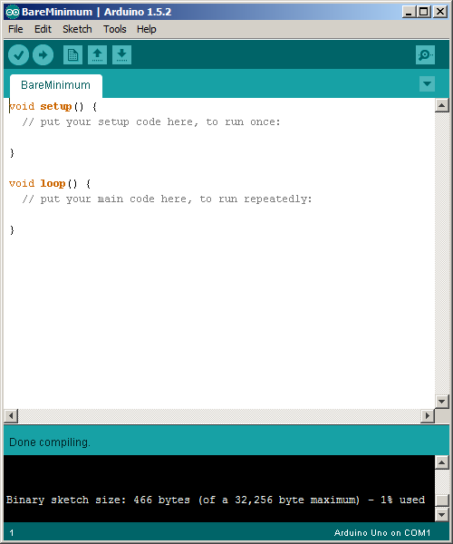
The IDE program
USB port
Arduino board
Acts as serial
A compiled “hex”-file is
sent to the program
memory of the Arduino board

Slide 23
The program
First, tell Arduino what it is:
Declare pins as input or output
Set global variables
This is done only once
immediately after reset
Then tell it what to do:
Read inputs
Do calculations
Set outputs
This is done continuously,
in a loop after setup is finished

Slide 24
The program
/* Configuration:
First, tell Arduino what it is */
void setup() {
// initialize the digital pin as an output.
// Pin 13 has a LED connected on most Arduino boards: pinMode(13, OUTPUT);
}
/* Then loop:
Tell Arduino what to do */
void loop() {
digitalWrite(13, HIGH); // switch LED on
delay(1000); // wait for a second
digitalWrite(13, LOW); // switch LED off
delay(1000); // wait for a second
}

Slide 25
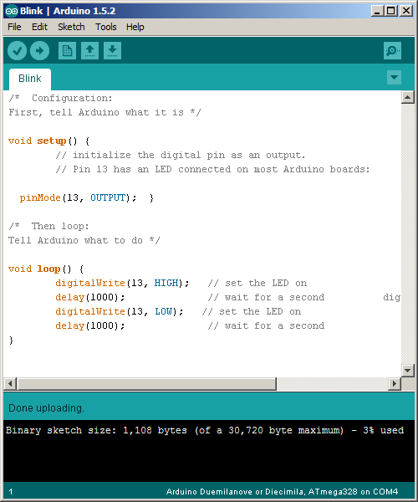
Compiling and uploading code
Type code in text window
Push ‘upload’ button
Check if TX and RX Leds are blinking rapidly
If the ‘Done uploading’ message displays, the Arduino is ready.
2
1
3
4

Slide 26
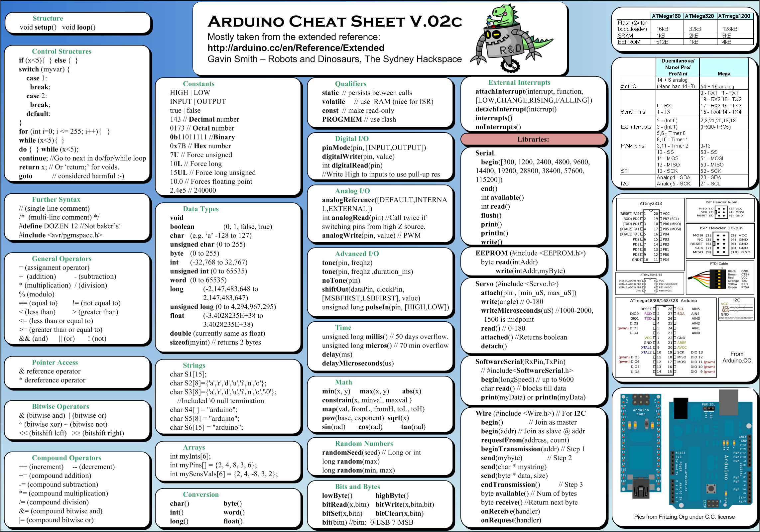
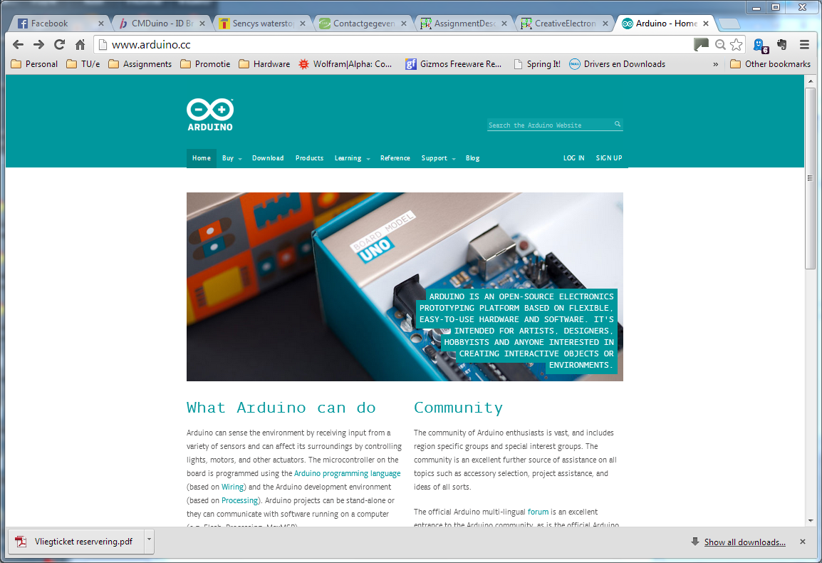
www.arduino.cc
Everything you need is www.arduino.cc
Getting started
Reference
Tutorials
Hardware examples
Software examples

Slide 27
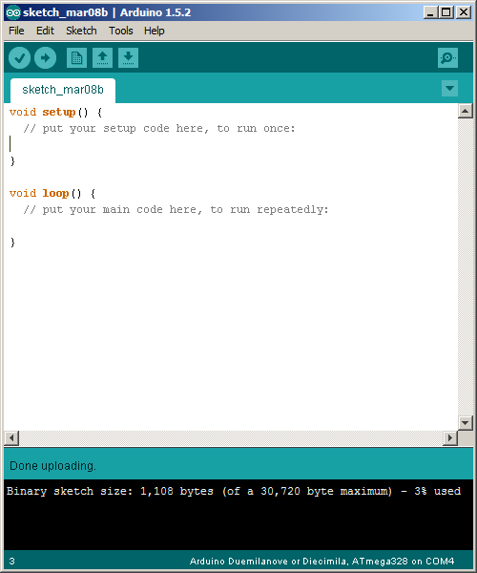
The Arduino Programming Environment
Save Sketch
Open Sketch
(old: *.pde, new: *.ino)
New Sketch
Compile and Upload
Verify (Compile)

Slide 28
Settings
Let the Arduino programming environment know which board you have
  “Tools” menu ➔ “Board”
Let the Arduino programming environment know to which port the board is connected
  “Tools” menu ➔ “Serial port”

Slide 29
Blink
/* comment */
void setup() {
// initialize the digital pin as an output.
// Pin 13 has a LED connected on most Arduino boards: pinMode(13, OUTPUT);
}
void loop() {
digitalWrite(13, HIGH); // switch LED on
delay(1000); // wait 1000 ms
digitalWrite(13, LOW); // switch LED off
delay(1000); // wait 1000 ms
}

Slide 30
Blink with button
The period of “Blink” is 2 x 1000 ms = 2 s
Now we want: if we push a button, the period should become 0.5 s
To do:
  Connect a button
  Read a button
  Change the “1000” in “delay” depending on the button state

Slide 31
Blink and read button
/* comment */
void setup() {
// initialize digital pin 13 as an output.
// Pin 13 has a LED connected on most Arduino boards: pinMode(13, OUTPUT);
pinMode(12, INPUT); // initialize digital pin 12 as input.
digitalWrite(12, HIGH); // activate pull-up resistor
}
void loop() {
digitalWrite(13, HIGH); // switch LED on
delay(1000); // wait one second
digitalWrite(13, LOW); // switch LED off
delay(1000); // wait one second
}

Slide 32
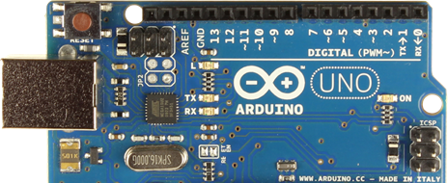
Possible hardware for Blink with button
Switch
LED

Slide 33
void setup() {
// initialize the digital pin 13 as an output.
// Pin 13 has a LED connected on most Arduino boards: pinMode(13, OUTPUT);
pinMode(12, INPUT); // initialize digital pin 12 as input.
digitalWrite(12, HIGH); // activate pull-up resistor
}
void loop() {
if (digitalRead(12) == HIGH) {
// Do something
}
else {
// Do something else
}
digitalWrite(13, HIGH); // switch LED on
delay(1000); // wait one second
digitalWrite(13, LOW); // switch LED off
delay(1000); // wait one second
}

Slide 34
int wait = 1000;
void setup() {
…
}
void loop() {
if (digitalRead(12) == HIGH) {
// Do something
}
else {
// Do something else
}
digitalWrite(13, HIGH); // switch LED on
delay(wait); // wait for wait msec
digitalWrite(13, LOW); // switch LED off
delay(wait); // wait for wait msec
}

Slide 35
int wait = 1000;
void setup() {
…
}
void loop() {
if (digitalRead(12) == HIGH) {
wait = 1000; // Wait 1 sec
}
else {
wait = 250; // Wait 0.25 sec
}
digitalWrite(13, HIGH); // switch LED on
delay(wait); // wait for wait msec
digitalWrite(13, LOW); // switch LED off
delay(wait); // wait for wait msec
}

Slide 36
Create some interaction: The “Physical Pixel” example
const int ledPin = 13; // the pin that the LED is attached to
int incomingByte; // a variable to read incoming serial data into
void setup() {
Serial.begin(9600); // initialize serial communication
Serial.println(”Good morning”); // Send text to computer
pinMode(ledPin, OUTPUT); // initialize LED pin as output
}
void loop() {
if (Serial.available() > 0) {
incomingByte = Serial.read();
if (incomingByte == 'H') digitalWrite(ledPin, HIGH);
if (incomingByte == 'L') digitalWrite(ledPin, LOW);
}
}

Slide 37
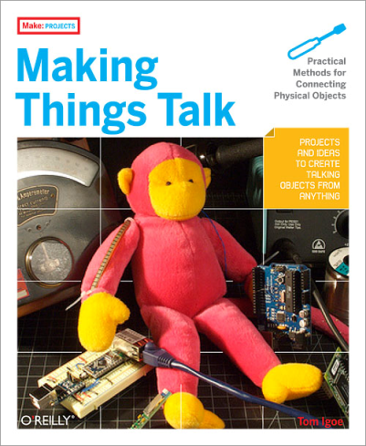
How to proceed?
Find new functions in the reference (http://arduino.cc/en/Reference/HomePage)
Arduino playground Manuals and Curriculum (also downloads) (http://playground.arduino.cc/Main/ManualsAndCurriculum)
Don’t be scared by “Making things talk”: the book is about connecting to the internet and less to interfacing with electronics

Slide 38
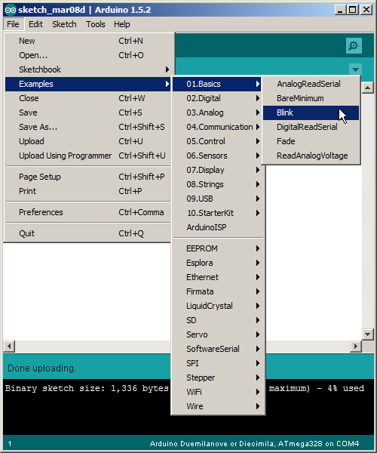
Available examples
For descriptions see http://arduino.cc/en/Tutorial/HomePage

Slide 39
The mini project
Session Dec 8 team presents mini project proposal (HG 4.24 Group1 / HG 4.57 Group2)
Session Dec 11 and Dec 15 no lecture, but support in and around e-Atelier/ID-Café for mini project development
Session Dec 18 (HG 4.57) team presents mini project result (demo + mini poster) to assignor

Slide 40
The mini project
You are free to choose your project, but:
  Use Arduino if possible
  Use at least one sensor and one actuator
  Report on design choices (transistor, configuration, etc.)
  Draw schematics
  Present it as a prototype (user experience, packaging) !

Slide 41



Slide 42
Suggestions
Make the central heating system with Arduino
Temp.
Set
Heater
μC

Slide 43
Suggestions
Dim a LED
Make application / context
Set
μC

Slide 44
Suggestions
Egg timer
Soft
μC
Middle
Hard

Slide 45

Spaghetti in code, schematics and circuits
Code:
Use comments /* like this */ or // this
Use functional variable names
Use functions
Schematics:
Draw the complete circuit (correctly!!)
(component names, values)
Circuit (soldered or breadboard)
Should be structured
Use color coding in wires
Think about component placement
Otherwise:
Debugging becomes difficult
You lack evidence in your report

Slide 46
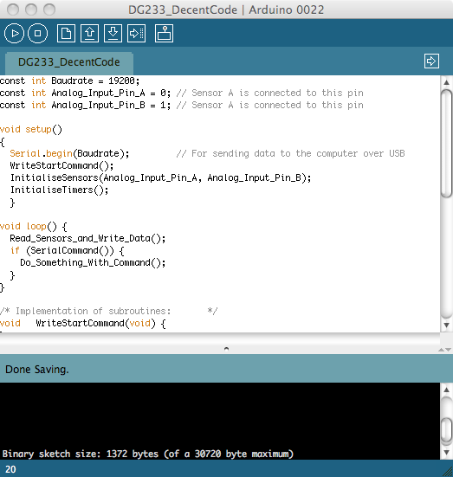
Code
Code:
Clear variable names
Proper use of local and global variables
Functions setup() and loop() are self-explaining
Proper function names
Comments (Header)
Examples
  Bad example
  Good example

Slide 47
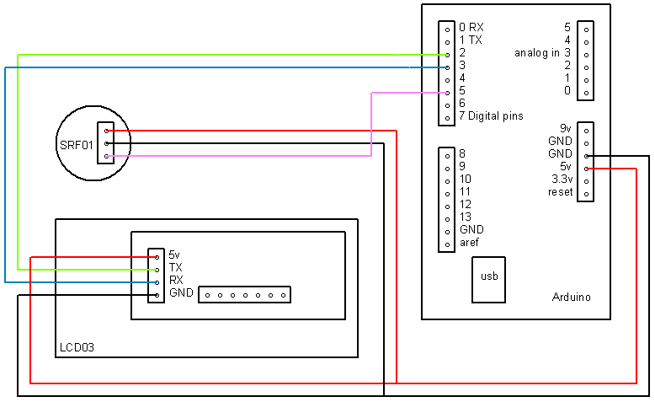
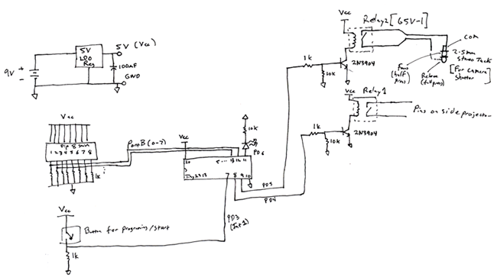
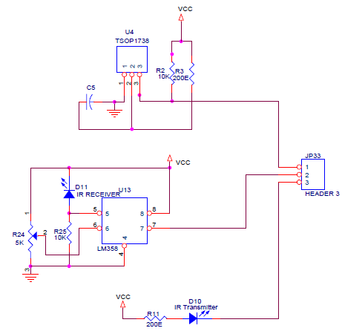
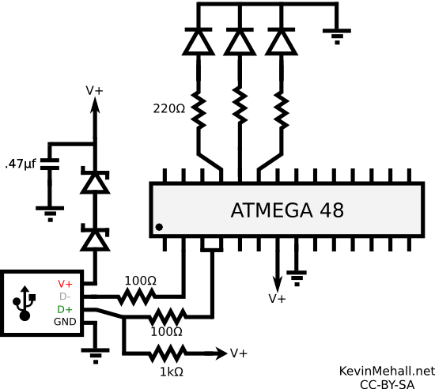
Schematics

Slide 48
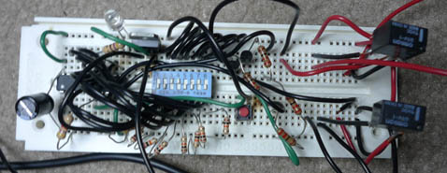
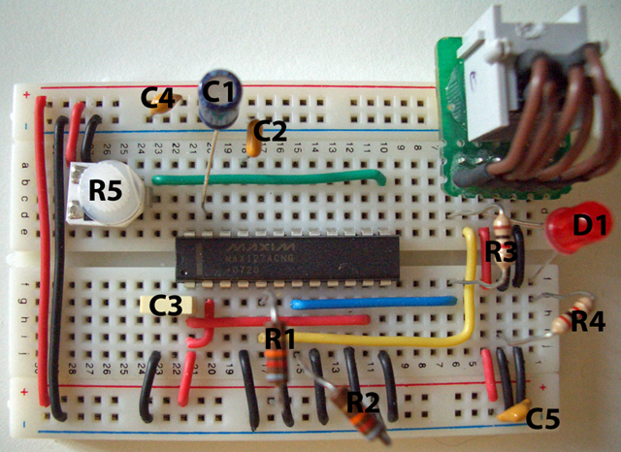
Circuits

Slide 49
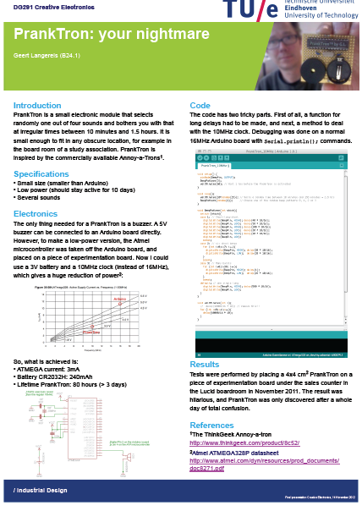
Poster
Explanation
Schematic
Code
Pictures

Slide 50
Resources
Look at wiki page:
  http://wiki.id.tue.nl/ce/AssignmentDescription
  (and checkout the “Resources” section)
Installation
  http://arduino.cc/en/Guide/Windows
  http://arduino.cc/en/Guide/MacOSX

