Slide 1
Golden Ratio and
Generative Arts
examples, expectations
Loe Feijs (today)
Jun Hu,
Mathias Funk,
1
TU/e Ecosystem

Slide 2
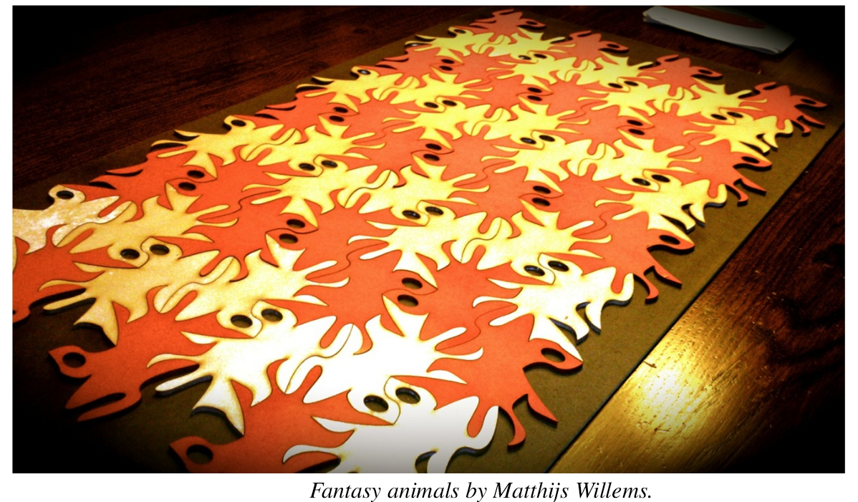

Slide 3
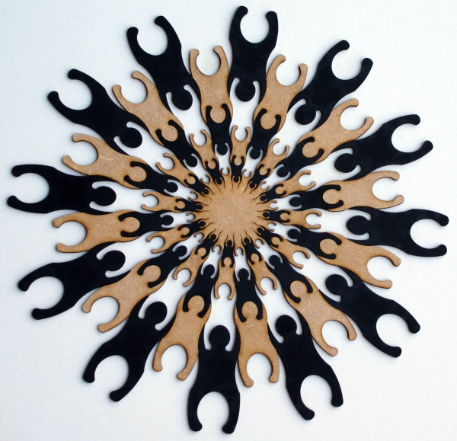
Thomas Lankveld, presented Towson, Berkely, Colorado (BO), Illinois, Columbia, MIT, Nebraska (on tour)

Slide 4
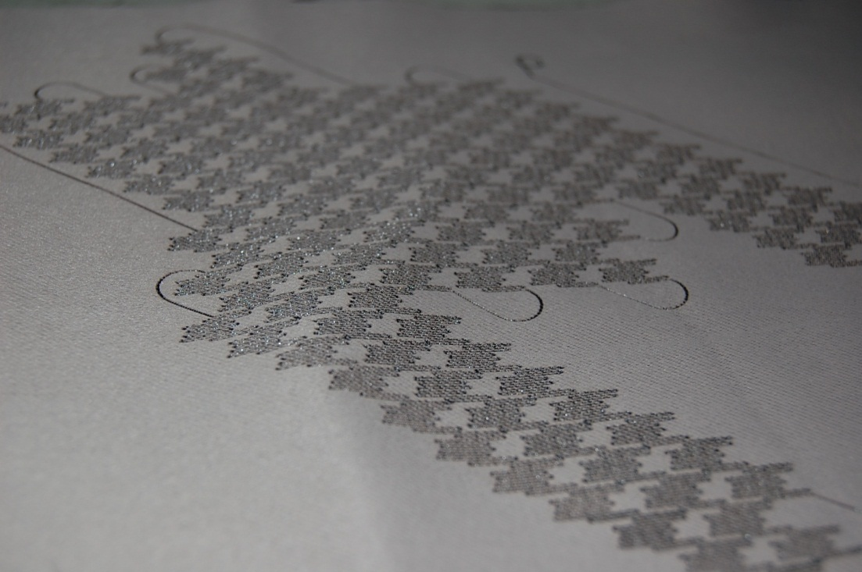

Slide 5
Joint work with Marina Toeters exposition Baltimore

Slide 6
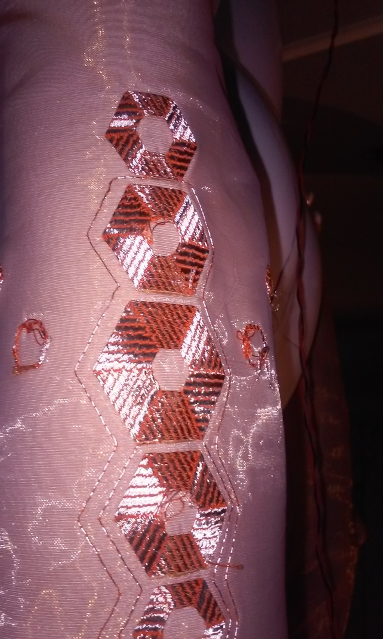
Joint work with Kristin Neidlinger and Bin Yu, exposition MU Strijp-S

Slide 7
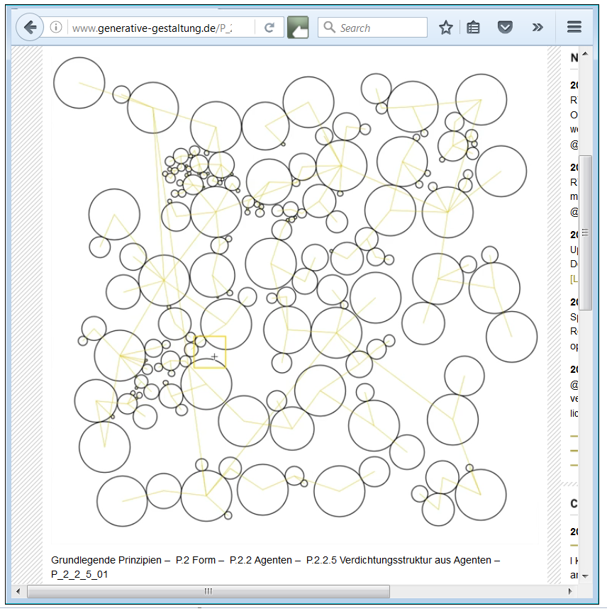
Circle packing from “Generative Gestaltung” by Hartmut Bohnacker et al.

Slide 8
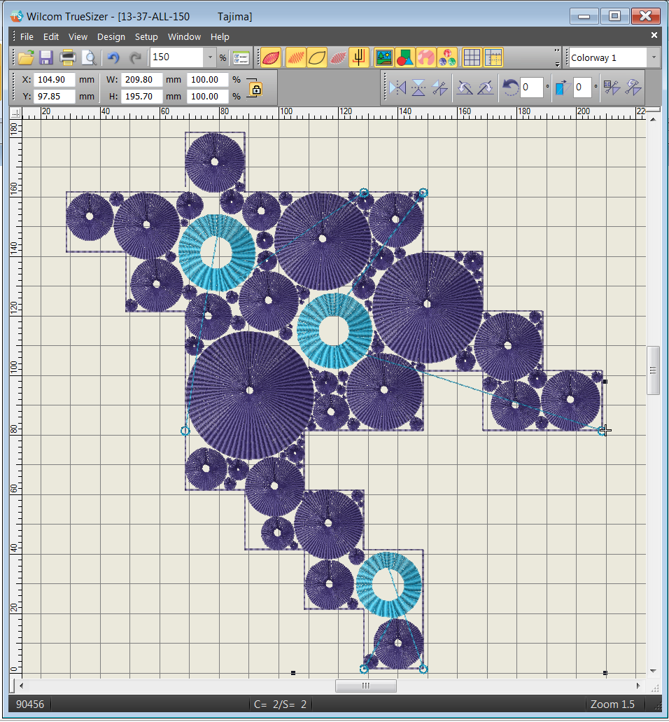
Wilcom simulation of turtle-graphics generated file in Tajima format.

Slide 9
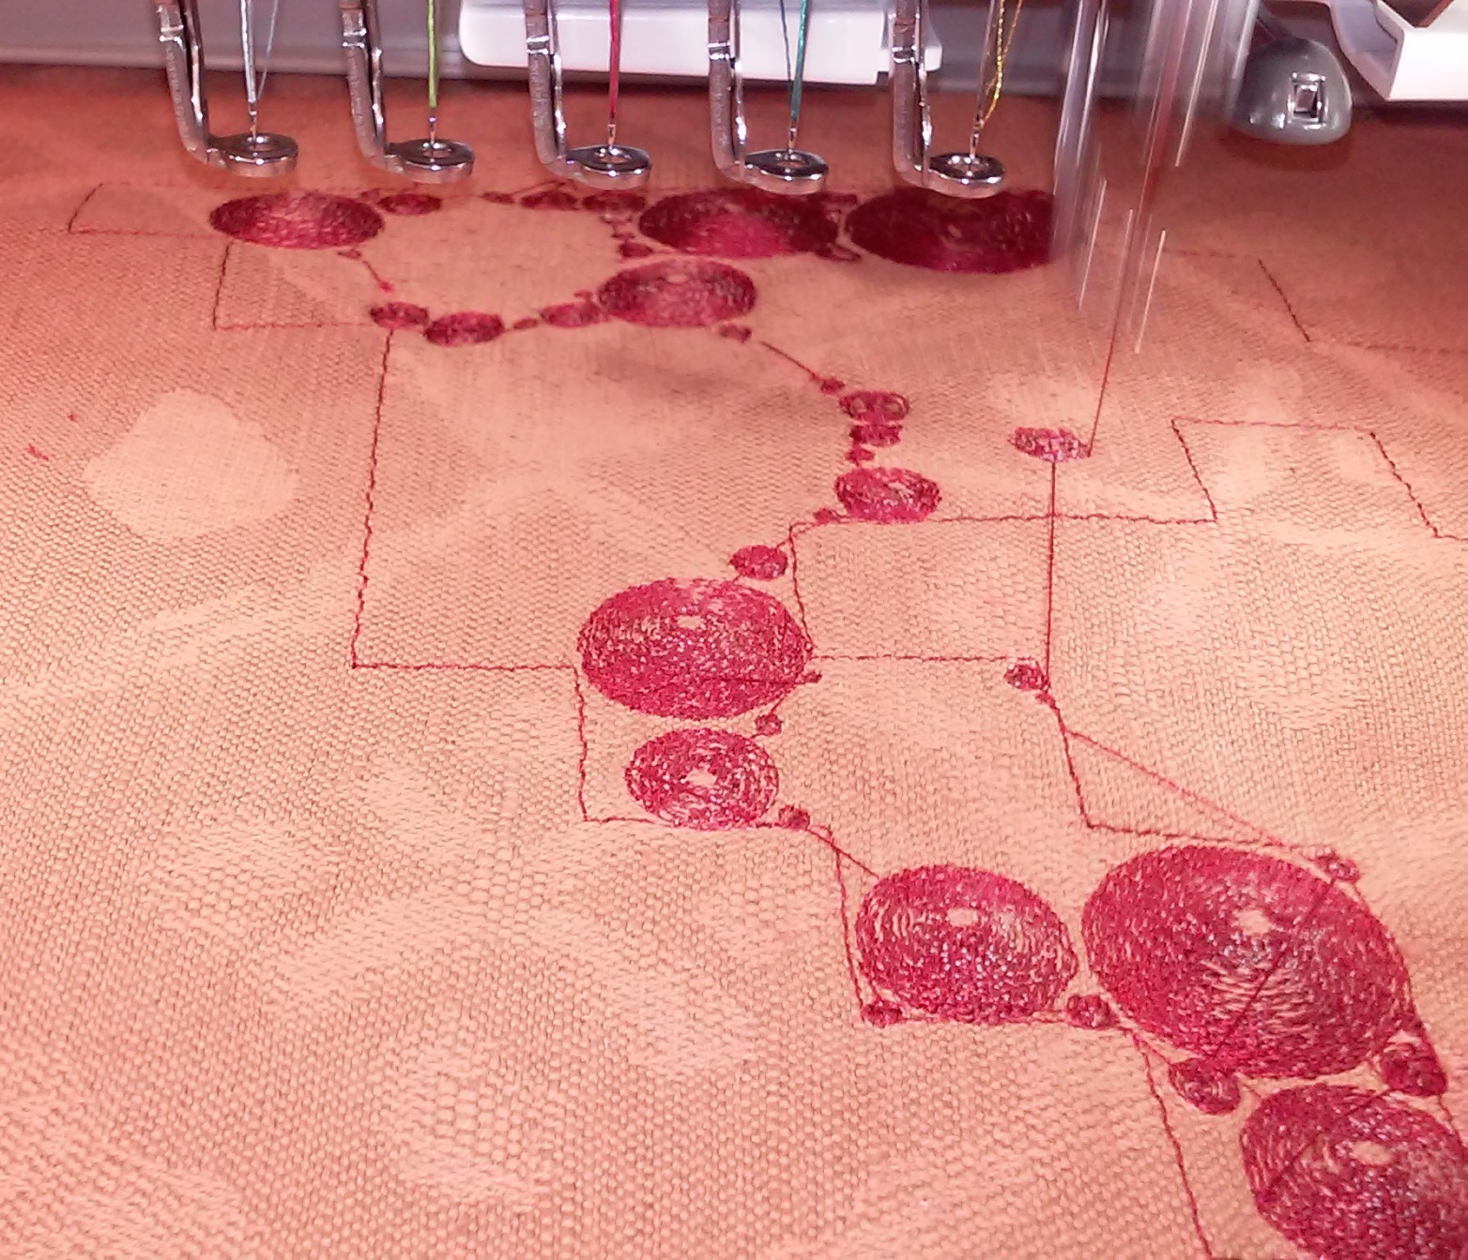
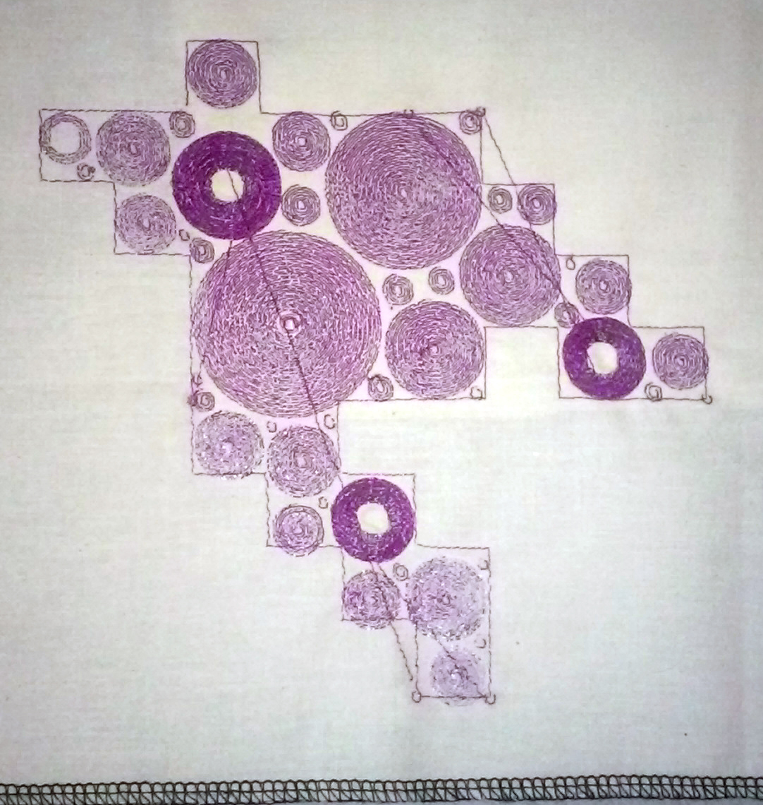
Joint work with Marina Toeters

Slide 10
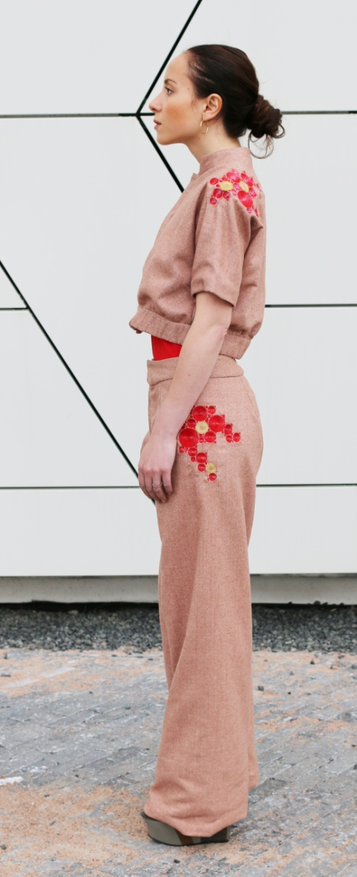
Pied de Pulse
Concept & Design:
Loe Feijs & Marina Toeters
Technology:
Anna Pagano & Geert van den Boomen
Embroidery:
Anna Pagano & Lucia van den Hoven
Styling:
Giorgia Presti
Photos & Video:
Flora Macleod
Model:
Anna Pagano
More info:
by-wire.net/pied-de-pulse/

Slide 11
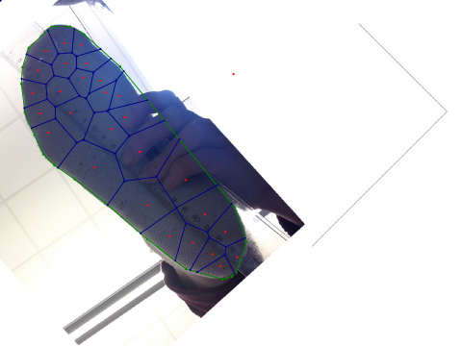
Joint work in progress with Troy Nachtigall

Slide 12
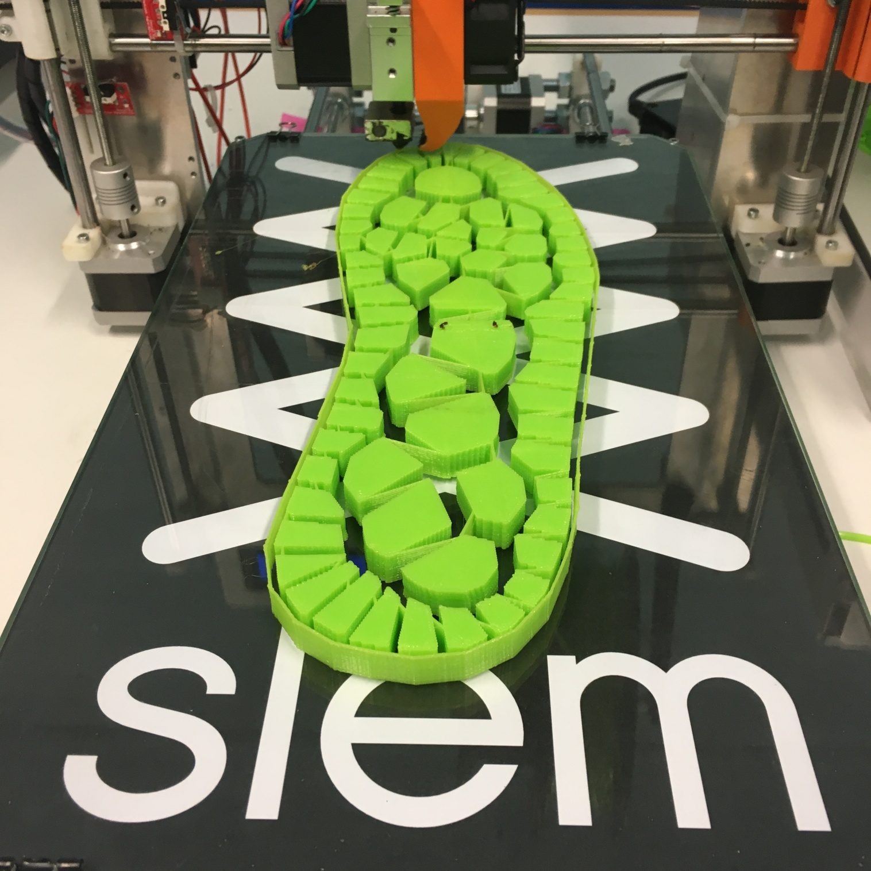
Joint work in progress with Troy Nachtigall

Slide 13
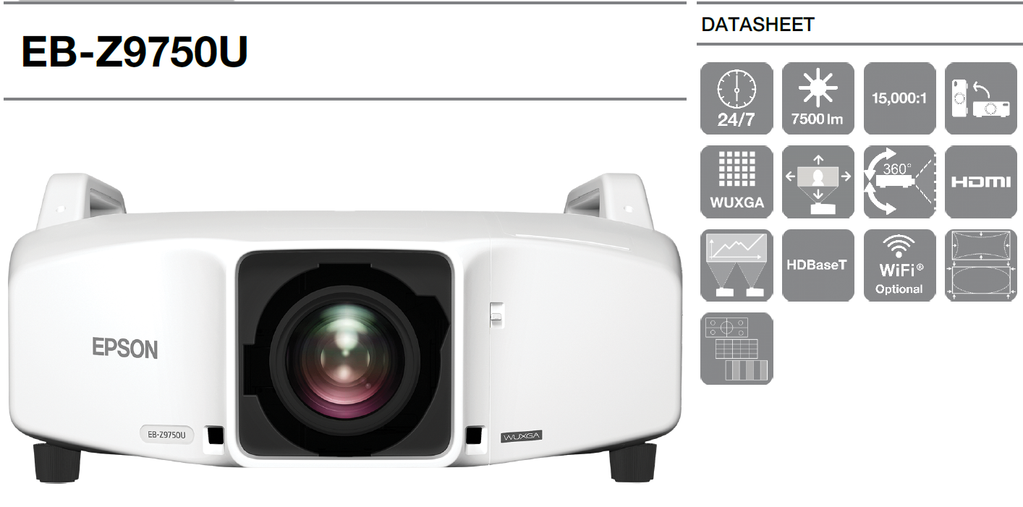
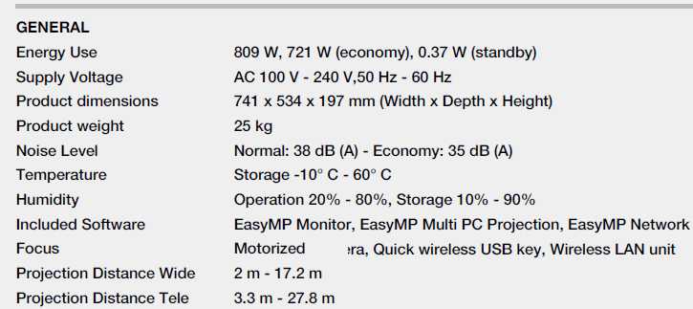

Slide 14
http://www.geometrysummit.org/proceedings/fase2016/index.html

Slide 15
