Slide 1
Coordinate systems
Popular coordinate systems:
Cartesian: (x,y)
polar: (r,ϑ)
turtle graphics: forward(L), right(ϑ)
In three dimensions:
right-handed Cartesian: (x,y,z)
spherical: (r,ϑ,φ)
cylindrical: (r,φ,z)

Slide 2
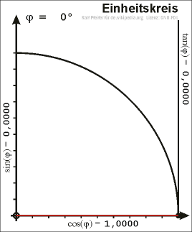
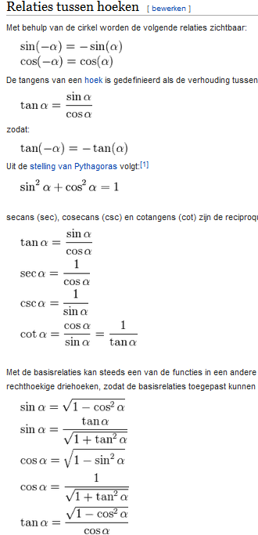
Coordinate systems
Refresh Trigoniometry:
sin
cos
tan
Einheitskreis Ani.gif, wikimedia commons
wikipedia

Slide 3
Coordinate systems
Popular coordinate systems:
Cartesian: (x,y)
polar: (r,ϑ)
turtle graphics: forward(L), right(ϑ)
In three dimensions:
right-handed Cartesian: (x,y,z)
spherical: (r,ϑ,φ)
cylindrical: (r,φ,z)

Slide 4
Coordinate systems
Aproach to indicate angles:
degrees: 0 .. 360º
radians: 0 ..2 π

Slide 5
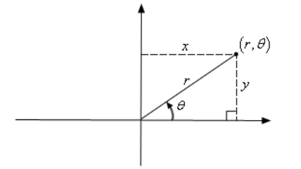
Coordinate systems
Notes on coordinate systems:
Paul's Online Math Notes
http://tutorial.math.lamar.edu/Classes/CalcII/PolarCoordinates.aspx

Slide 6
Coordinate systems
Exercises on coordinate systems:
Ex. 1(a) convert (-4,2π/3) into Cartesian coordinates
Ex. 1(b) convert (-1,-1) into polar coordinates
Ex. 2(a) convert 2x - 5x³ = 1 + yx into polar coordinates
Ex. 2(b) convert r = -8 cos ϑ into Cartesian coordinates.
Source: http://tutorial.math.lamar.edu/Classes/CalcII/PolarCoordinates.aspx

Slide 7
Coordinate systems
Your exercises on coordinate systems:
convert (-2,-2) into polar coordinates
convert (6,-2π/3) into Cartesian coordinates
convert 2x - 5x² = 1 - yx into polar coordinates.
convert sin ϑ = -4r into Cartesian coordinates.

Slide 8
Classic curves
Ellipse
Parabola
Hyperbola
Cardioid
Cycloid
Lissajous
Catenary
Lemniscate
Entropy curve
Cassinian ovals
Piet Hein super ellipse
Want more? https://elepa.files.wordpress.com/2013/11/fifty-famous-curves.pdf

Slide 9
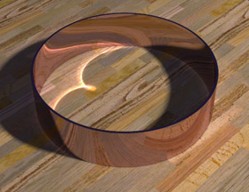
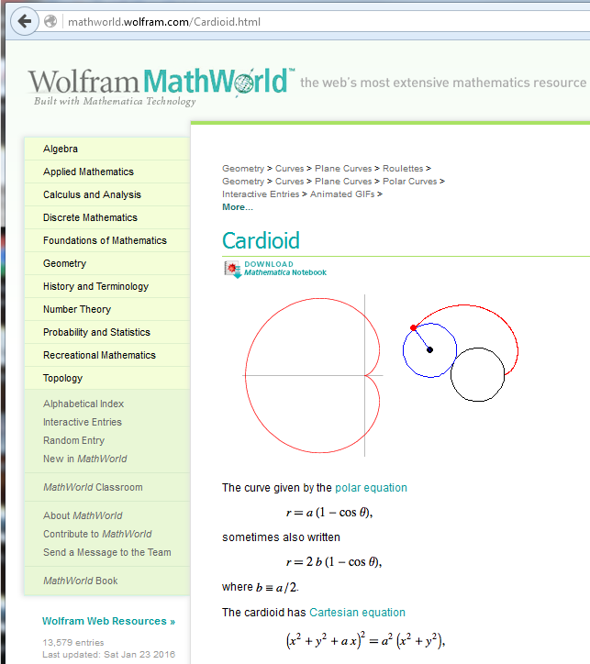
Classic curves
Source: www.world-science.net/othernews /090416_coffee.htm Photo by Henrik Wann Jensen, UCSD; home­page image © L. Usi

Slide 10
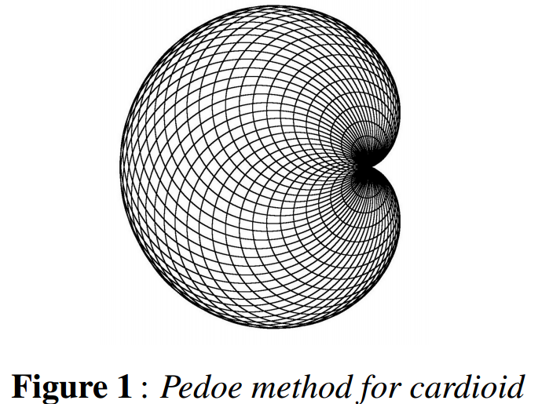
Source: De Comité, F. Cardioidal Variations. Proceedings of Bridges 2014: Mathematics, Music, Art, Architecture, Culture, pp. 349 - 352.
Cardioidal Variations
Francesco De Comite

Slide 11
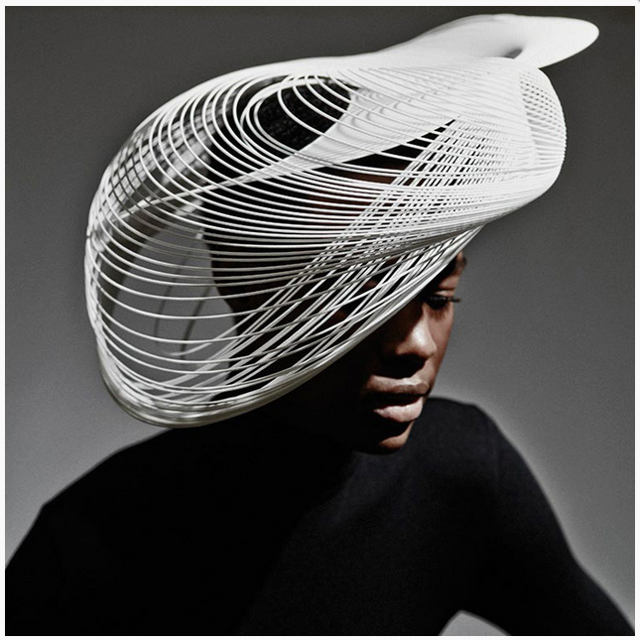
Gabriela Ligenza (2014)

Slide 12
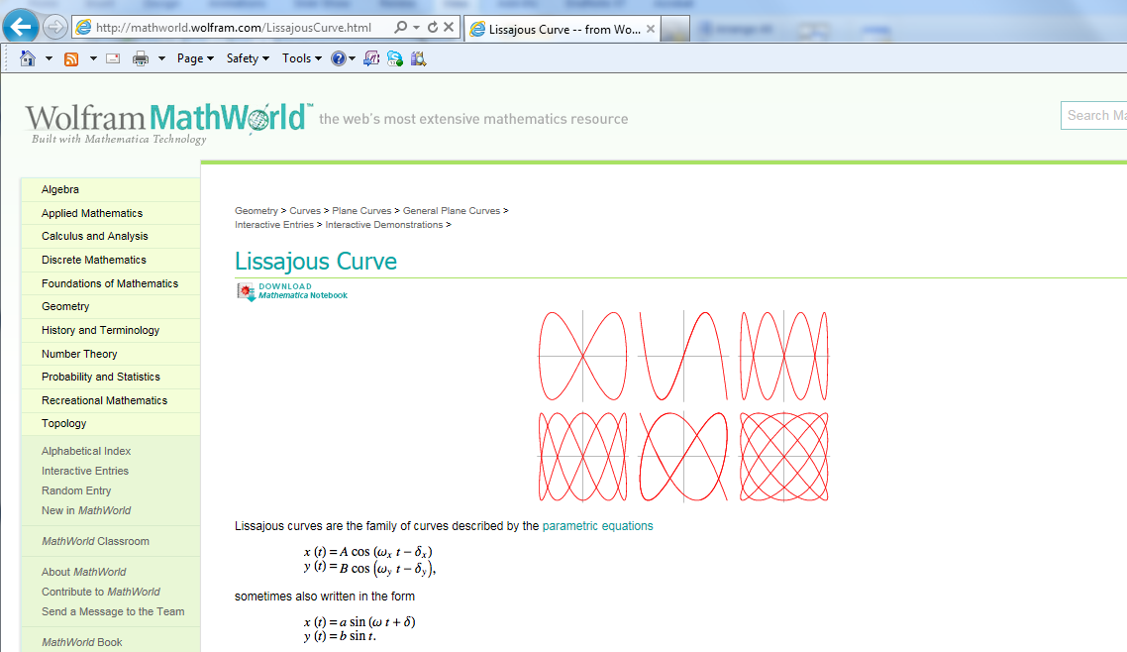
Classic curves

Slide 13
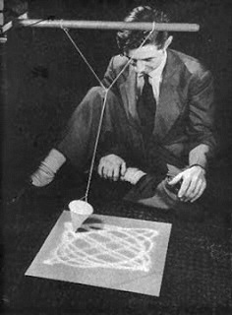
Classic curves
Max Ernst making Lissajous Figures 1942.jpg, wikimedia

Slide 14
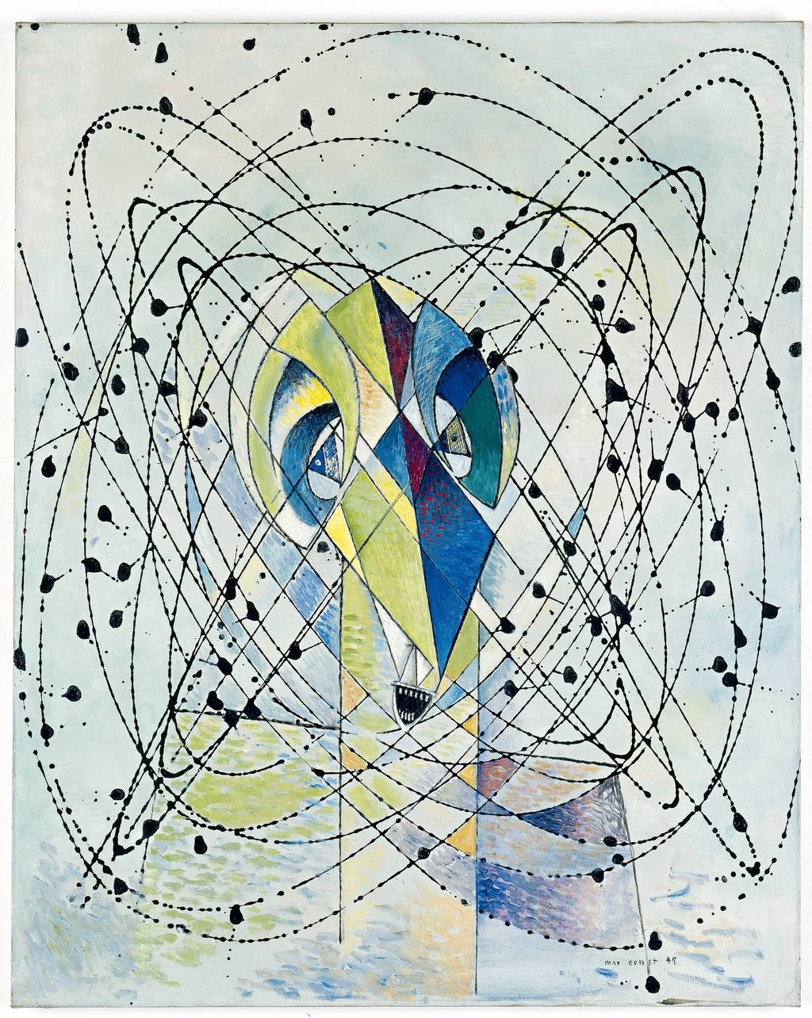
Classic curves
Young Man Intrigued by the Flight of a Non-Euclidean Fly, 1942 and 1947
Oil and enamel on canvas, 82x66cm. Private Collection, Zürich (from plumedeplombe.blogspot.co.uk/2012/04/ max-ernst-levity-and-gravity-in-his.html)

Slide 15
Classic curves
Steps to program interesting curves:
find a curve on mathworld.wolfram.com
decide upon a coordinate system
translate the formula into Processing
embed it in a for loop
draw the curve by connecting points
embed it in a function with parameters
call the function while varying parameters
play with tangent lines

Slide 16
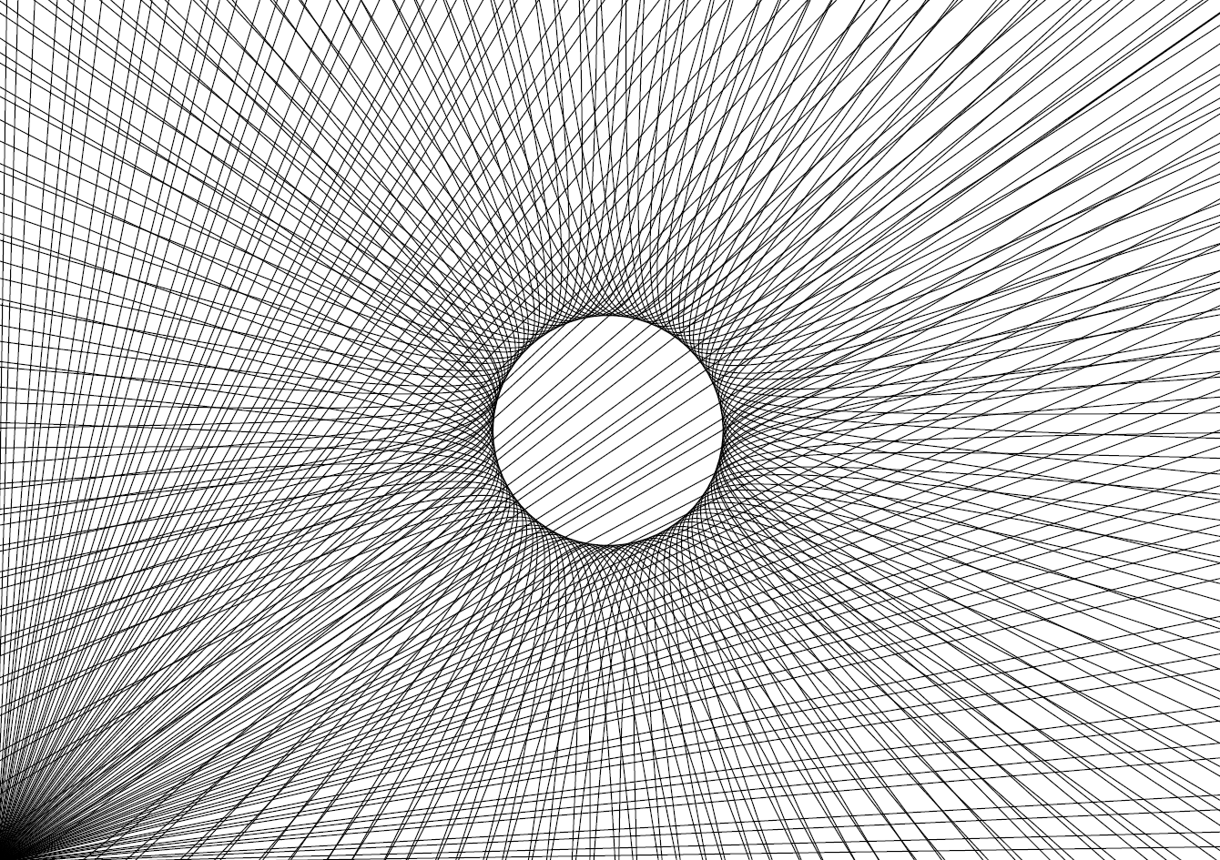
Classic curves

Slide 17
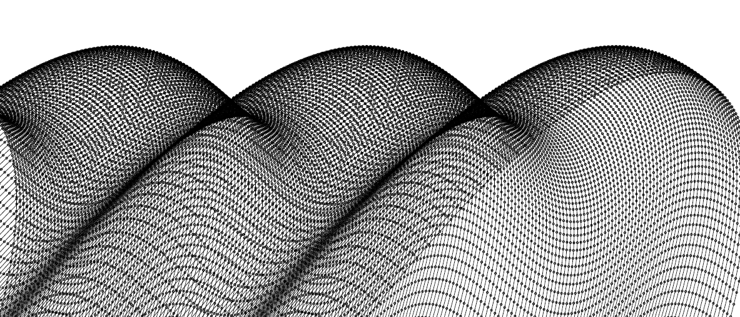
Classic curves

Slide 18
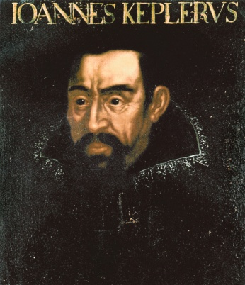
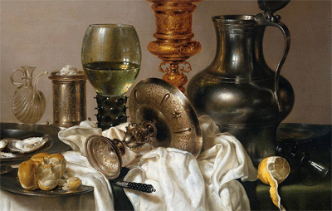
Classic curves
http://mathworld.wolfram.com/Ellipse.html
physics,
aesthetics
x = a cos(φ)
y = b sin(φ)
coding
Willem Claesz Heda, detail from a masterpiece painted still life uitsnede uit een meesterwerk stilleven vol geschilderd met ellipsen. ca 1635, Rijksmuseum Amsterdam.
Kepler, wikimeda commons

Slide 19
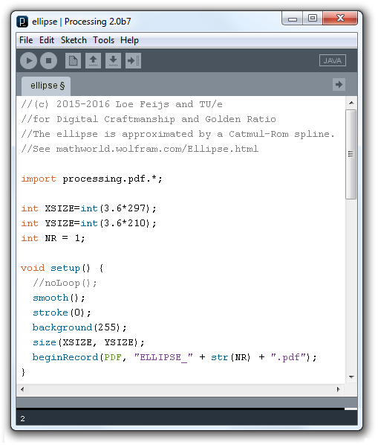
Classic curves

Slide 20
//(c) 2015-2016 Loe Feijs and TU/e
//for Digital Craftmanship and Golden Ratio
//The ellipse is approximated by a Catmul-Rom spline.
//See mathworld.wolfram.com/Ellipse.html
import processing.pdf.*;
int XSIZE=int(3.6*297);
int YSIZE=int(3.6*210);
int NR = 1;
void setup() {
//noLoop();
smooth();
stroke(0);
background(255);
size(XSIZE, YSIZE);
beginRecord(PDF, "ELLIPSE_" + str(NR) + ".pdf");
}

Slide 21
void ellipse(float xc, float yc){
//xc,yc coordinates of centre
int steps = 500;
float a = 20; //half-diameter horizontally
float b = 100; //half-diameter vertically
float dphi = 2*PI/steps;
noFill();
beginShape();
curveVertex(xc + a, yc);
for (int i=0; i<steps + 1; i++){
float x = xc + a * cos(i * dphi);
float y = yc + b * sin(i * dphi);
curveVertex(x,y);
}
endShape();
}

Slide 22
float dx = 0;
float dy = 0;
void draw() {
float x = 200;
float y = height/2;
dx += 5;
dy = 50*sin(radians(dx));
ellipse(x + dx, y + dy);
delay(100);
}
void keyPressed() {
endRecord();
exit();
}

Slide 23
Classic curves
http://mathworld.wolfram.com/Parabola.html
physics,
aesthetics
x = d_{x} + t²/4a
y = d_{y} + t
coding

Slide 24
void parabola(){
int steps = 1000;
float a = 50;
float dx = 3;
noFill();
beginShape(); //draw the lower branch
curveVertex(xc, yc);
for (int i=0; i<steps + 1; i++){
float t = i*dx; //parametrix description
float x = (t*t)/(4*a); //mathworld eq (15),
float y = t; //mathworld eq (16)
curveVertex(xc + x,yc + y);
}
endShape();
beginShape(); //draw the upper branch
curveVertex(xc, yc);
for (int i=0; i<steps + 1; i++){
float t = i*dx;
float x = (t*t)/(4*a); //mathworld eq (15),
float y = t; //mathworld eq (16)
curveVertex(xc + x,yc - y);
}
endShape();
}

Slide 25
x = d_{x} + t²/4a
y = d_{y} + t

Slide 26
Classic curves: bundles
http://mathworld.wolfram.com/Parabola.html
physics,
aesthetics
x = d_{x} + t²/4a
y = d_{y} + t
coding
parameterization: subsequent (d_{x},d_{y}) values defined by a sin function

Slide 27
void parabola(float xc, float yc){
//xc,yc coordinates of centre
int steps = 1000;
float a = 50;
float dx = 3;
noFill();
beginShape(); //draw the lower branch
curveVertex(xc, yc);
for (int i=0; i<steps + 1; i++){
float t = i*dx; //parametrix description
float x = (t*t)/(4*a); //mathworld eq (15),
float y = t; //mathworld eq (16)
curveVertex(xc + x,yc + y);
}
endShape();
}

Slide 28
float dx = 0;
float dy = 0;
void draw() {
float x = 0;
float y = height/2;
dx += 10;
dy = 50*sin(radians(dx));
parabola(x + dx, y + dy);
delay(200);
keyPressed();
}

Slide 29
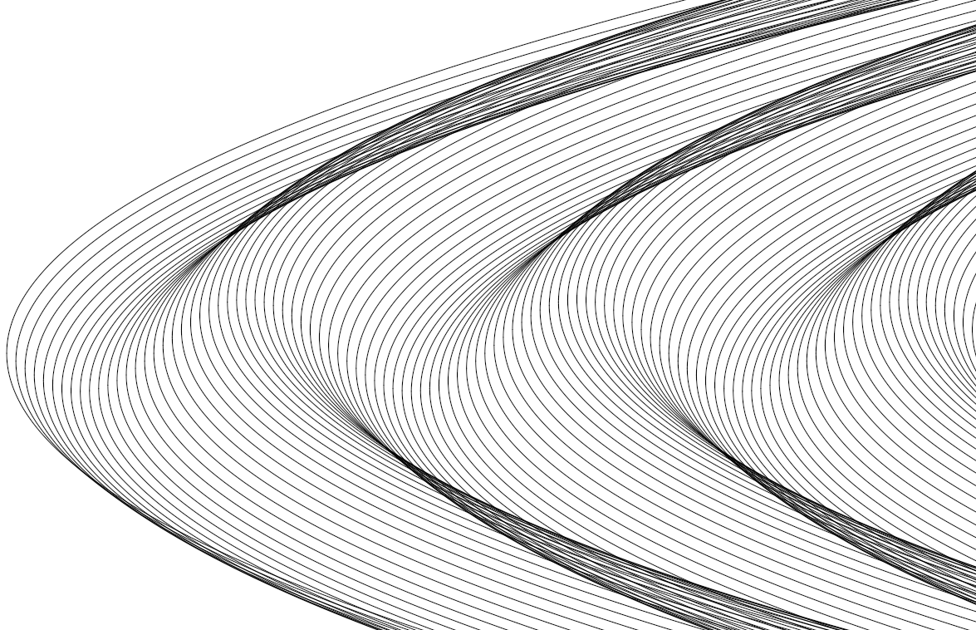
x = d_{x} + t²/4a
y = d_{y} + t
Classic curves
parameterization: subsequent (d_{x},d_{y}) values defined by a sin function
x = d_{x} + t²/4a
y = d_{y} + t

Slide 30
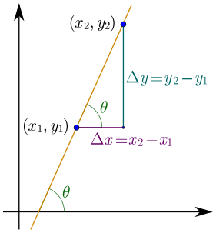
Classic curves: tangents
x = t²/4a
y = t
calculus: dy/dx = 2a/y
coding:
Source: Maschen, wikimedia
float t = i*dx; //parametrix description
float x = (t*t)/(4*a); //mathworld eq (15),
float y = t; //mathworld eq (16)
curveVertex(x,y); //extend parabola
float dydx = 2*a/y; //own derivation
stroke(255,0,0); //draw tangent in red
line(x,y,x + 1000,y + 1000*dydx); //from (x,y) to far-away pt

Slide 31
//(c) Loe Feijs and TU/e
//for Digital Craftmanship and Golden Ratio
//Parabola: pronounce pə'ræbələ
//The parabola is approximated by a Catmul-Rom spline.
//See http://mathworld.wolfram.com/Parabola.html
//The equation is (15) and (16), i.e. x = t^2/4a and y = t
//From which, abandoning (20),(21)derive dy/dt = 1, dx/dt = t/2a
//so the slope of the tangent is dy/dx = 2a/t = 2a/y.
//And the tangent vector is (1,dy/dx).
import nl.tue.id.oogway.*;
import processing.pdf.*;
int XSIZE=int(3.6*297);
int YSIZE=int(3.6*210);
int NR = 1;

Slide 32
void setup() {
noLoop();
smooth();
stroke(0);
background(255);
size(XSIZE, YSIZE);
beginRecord(PDF, "PARABOLA_" + str(NR) + ".pdf");
}
void parabola(float xc, float yc){
//xc,yc coordinates of centre
int steps = 1000;
float a = 50;
float dx = 3;
noFill();
beginShape(); //draw the lower branch
curveVertex(xc, yc);
//to be continued

Slide 33
for (int i=0; i<steps + 1; i++){
float t = i*dx; //parametrix description
float x = (t*t)/(4*a);//mathworld eq (15),
float y = t; //mathworld eq (16)
curveVertex(xc + x,yc + y);
float dydx = 2*a/y; //own derivation
stroke(255,0,0); //draw tangent in red
if (NR == 1)
line(xc + x,yc + y,xc + x + 1000,yc + y + 1000*dydx);
stroke(0);
}
endShape();
beginShape(); //draw the upper branch
curveVertex(xc, yc);
for (int i=0; i<steps + 1; i++){
float t = i*dx;
float x = (t*t)/(4*a);//mathworld eq (15),
float y = t; //mathworld eq (16)
curveVertex(xc + x,yc - y);
}
endShape();
}

Slide 34
float dx = 0;
float dy = 0;
void draw() {
float x = 0;
float y = height/2;
dx += 10;
dy = 50*sin(radians(dx));
parabola(x + dx, y + dy);
delay(200);
keyPressed();
}
void keyPressed() {
endRecord();
exit();
}

Slide 35
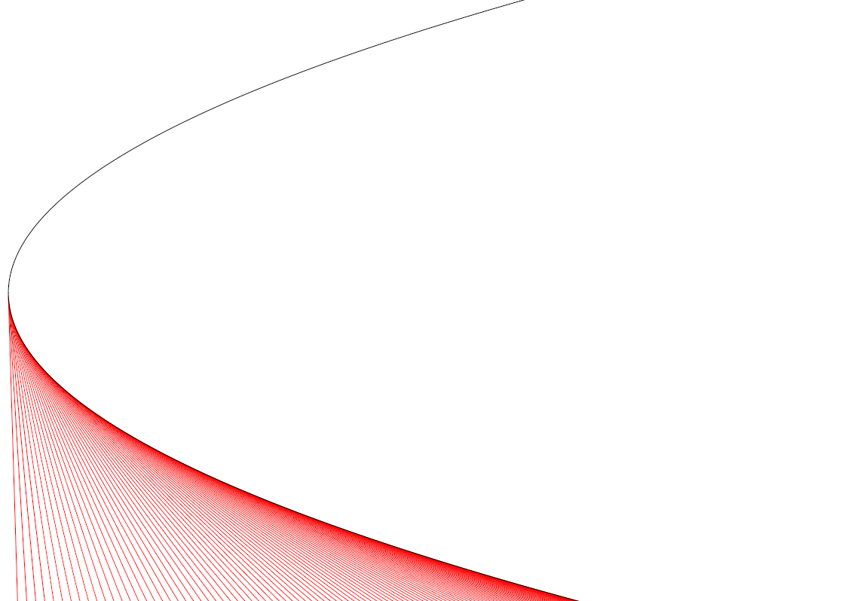
x₀ = t²/4a
y₀ = t
dy/dx = 2a/y
Classic curves

Slide 36
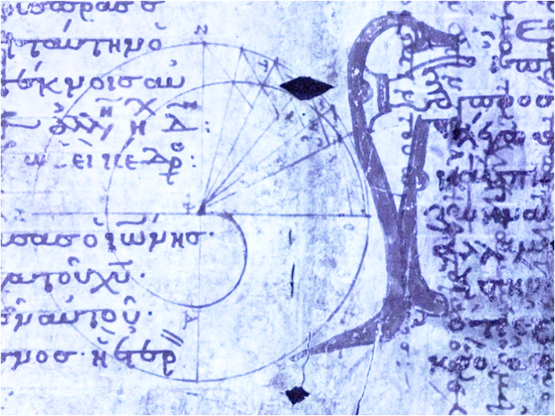
Classic curves tangents continued
From Archimedes palimpsest, Walters, Baltimore

Slide 37
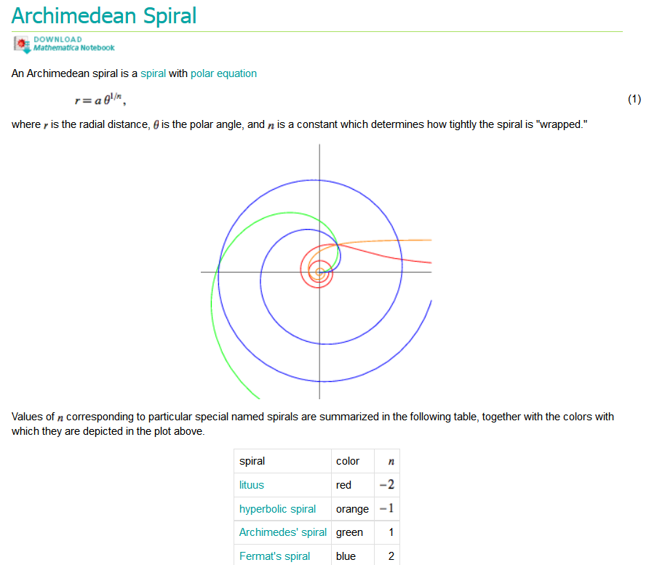
Classic curves tangents continued

Slide 38
Classic curv
x = a θ^{1/n} cos θ
y = a θ^{1/n} sin θ
0 ≤ θ ≤ 4π
n = 2

Slide 39
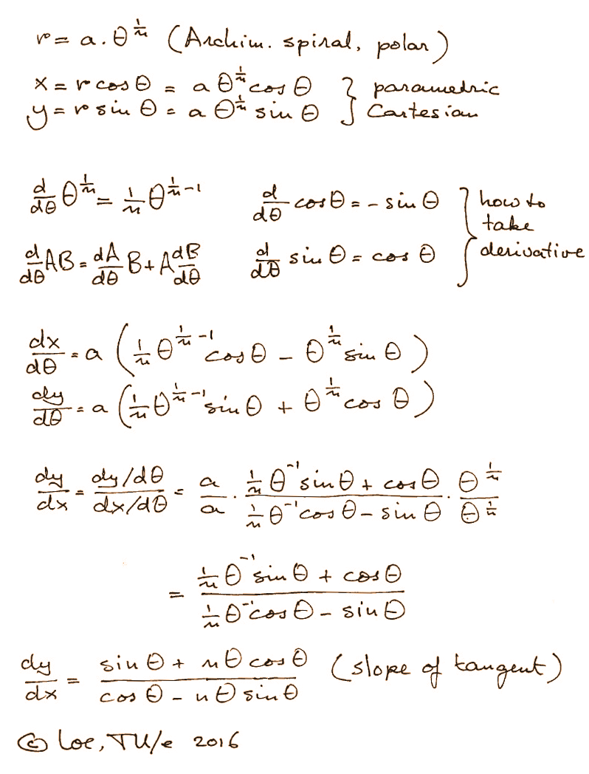
Classic curves

Slide 40
x = a θ^{1/n} cos θ
y = a θ^{1/n} sin θ
dy/dx = (sin θ + nθ cos θ)
/ (cos θ - nθ cos θ)
Classic curves

Slide 41
x = a θ^{1/n} cos θ
y = a θ^{1/n} sin θ
dy/dx = (sin θ + nθ cos θ)
/ (cos θ - nθ cos θ)
Classic curves

Slide 42
Exercises: your turn
To do:
find the curve in mathematics book
for example mathworld.wolram
study various equations
choose one equation
code it in processing
parameterize it
make a bundle
draw tangents
Want more? https://elepa.files.wordpress.com/2013/11/fifty-famous-curves.pdf

Slide 43
Exercises: your turn
Ellipse
Parabola
Hyperbola
Cardioid
Cycloid
Lissajous
Catenary
Lemniscate
Entropy curve
Cassinian ovals
Piet Hein super ellipse
you
he
she
next
etc
Want more? https://elepa.files.wordpress.com/2013/11/fifty-famous-curves.pdf

