Slide 1
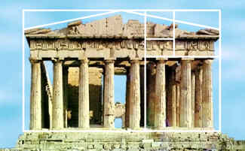
Golden ratio 2016:
About the golden ratio
Loe Feijs

Slide 2
Golden ratio (and relatives)
ISO 216
Golden ratio
Plastic number

Slide 3
Width to length ratio of A4 paper, say γ (gamma)
A0 | 841 × 1189
A1 | 594 × 841
A2 | 420 × 594
A3 | 297 × 420
A4 | 210 × 297
A5 | 148 × 210
A6 | 105 × 148
A7 | 74 × 105
A8 | 52 × 74
A9 | 37 × 52
A10 | 26 × 37
Source: Ramakrishnan Menon,
Square Root of 2: Irrational, Yes! Impractical, No!
http://pumas.jpl.nasa.gov/files/10_06_03_1.pdf

Slide 4
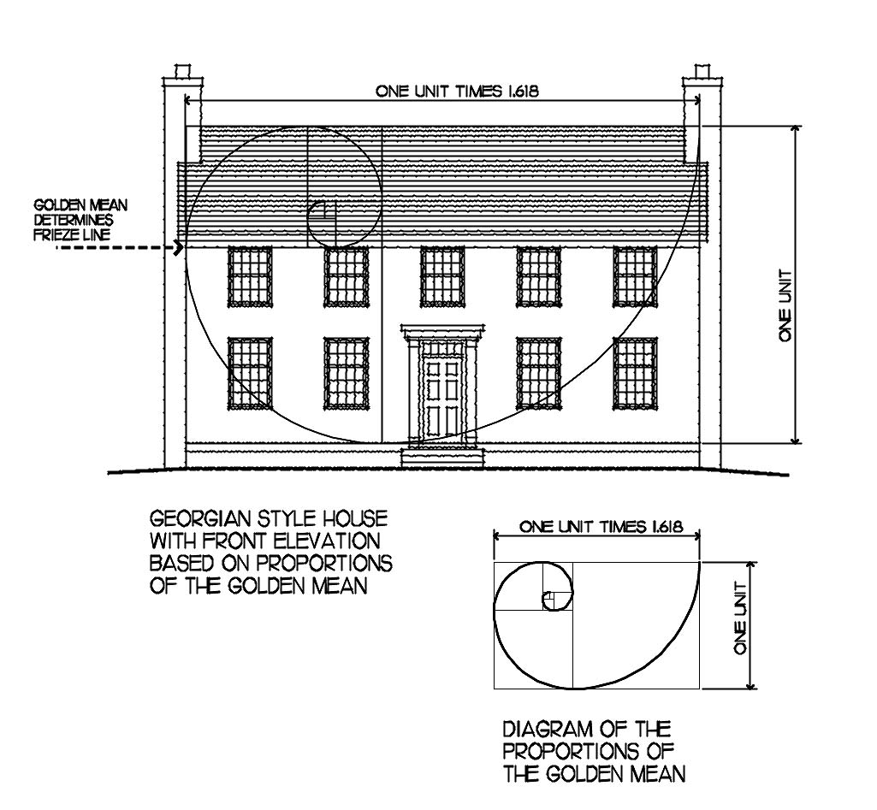
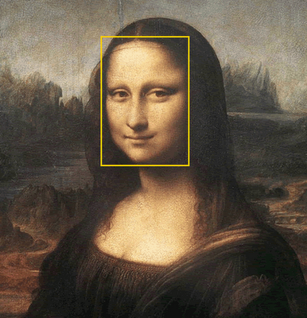
In art and architecture (hmm)
The Golden Ratio has a great impact on art, influencing artists' perspectives of a pleasant art piece. Have you ever wondered why Da Vinci's Mona Lisa looks so beautiful? Da Vinci, a sculpture, painter, inventor and a mathematician, was the first one who first called Phi the Golden Ratio. And scientifically, her face actually appears in a golden rectangle, which also makes her face appear more beautiful to human eyes. Also another masterpiece, the Last Supper, contains Golden Ratios. The French Impressionist painter George Seurat is famous by his new technique of drawing - Pointilism, he is said to have "attacked every canvas by the golden section." Mona Lisa
hmm
Source: kas06.blogspot.com/
Source: www.designingyourperfecthouse.com/

Slide 5
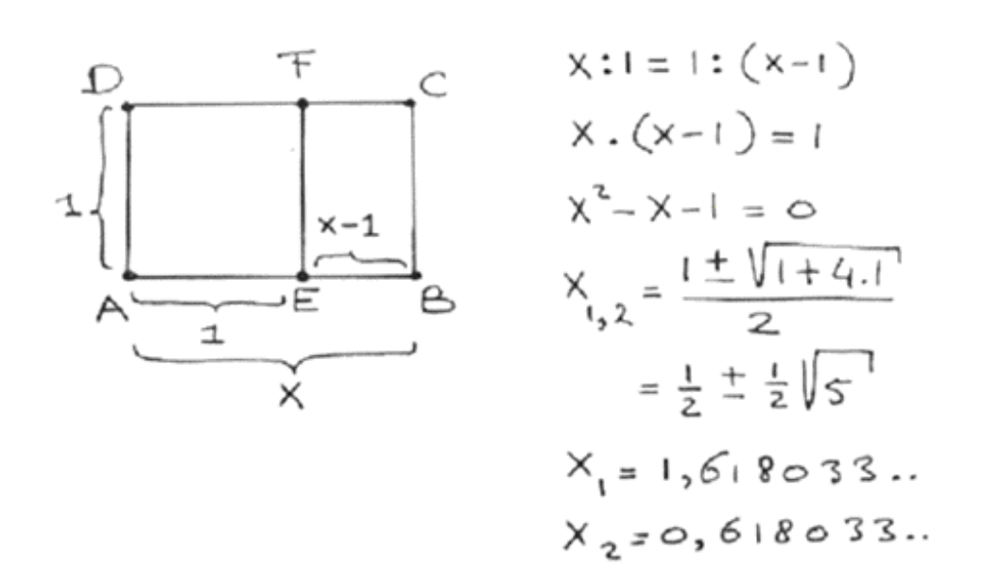

Slide 6
In engineering
R=1Ω
R=1Ω
etc.
R=1Ω
R=1Ω
1Ω ║ Z = 1/(1/1 + 1/Z)
1
= 1.6180339
R_{tot} =
1+
1
1+
1+ etc

Slide 7
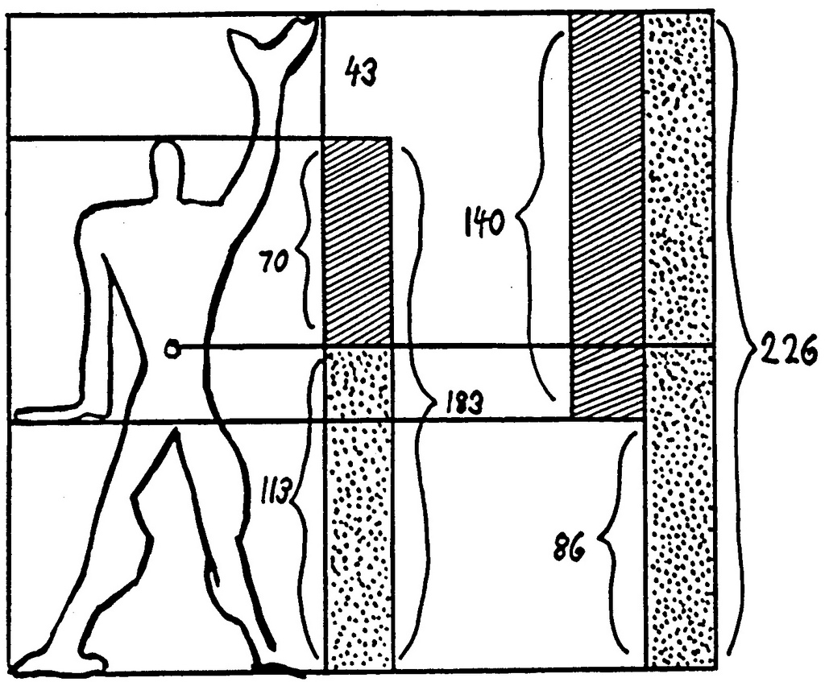
In design
Source: Le Corbusier, Modulor (1948)

Slide 8
Golden ratio in software
fractal drawing with rectangles
height and width related by golden ratio
repetition to create more smaller and smaller rectangles
dy
dx
Notes:
The processing example shows two for loops (with internally declared variables!)
Note, in the second for loop in the example both I AND j are declared internal !

Slide 9
Golden ratio in software
dy
size(420,680);
float phi = 1.6181034;
float dx = 420;
float dy = dx * phi;
for (int i=0; i<12; i++){
fill(random(255),random(255),random(255));
strokeWeight(5);
rect(0,0,dx,dy);
float tmp = dx;
dx = dy;
dy = tmp;
dx /= phi;
dy /= phi;
}
dx
Oops…?
dx,dy
dx = dy;
dy = dx;
Notes:
The processing example shows two for loops (with internally declared variables!)
Note, in the second for loop in the example both I AND j are declared internal !

Slide 10
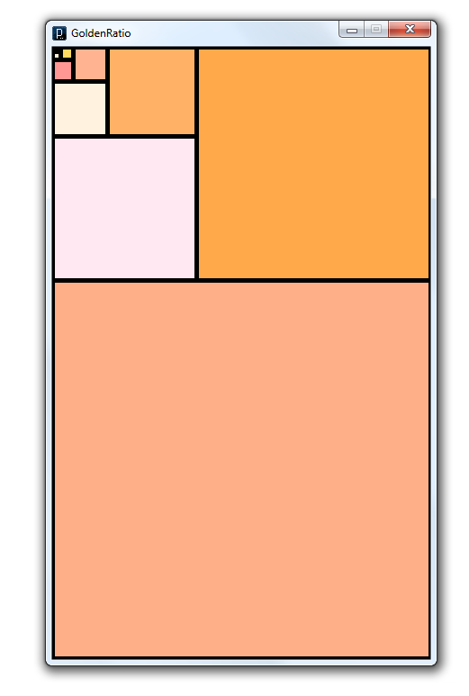
Golden ratio in software
Notes:
The processing example shows two for loops (with internally declared variables!)
Note, in the second for loop in the example both I AND j are declared internal !

Slide 11
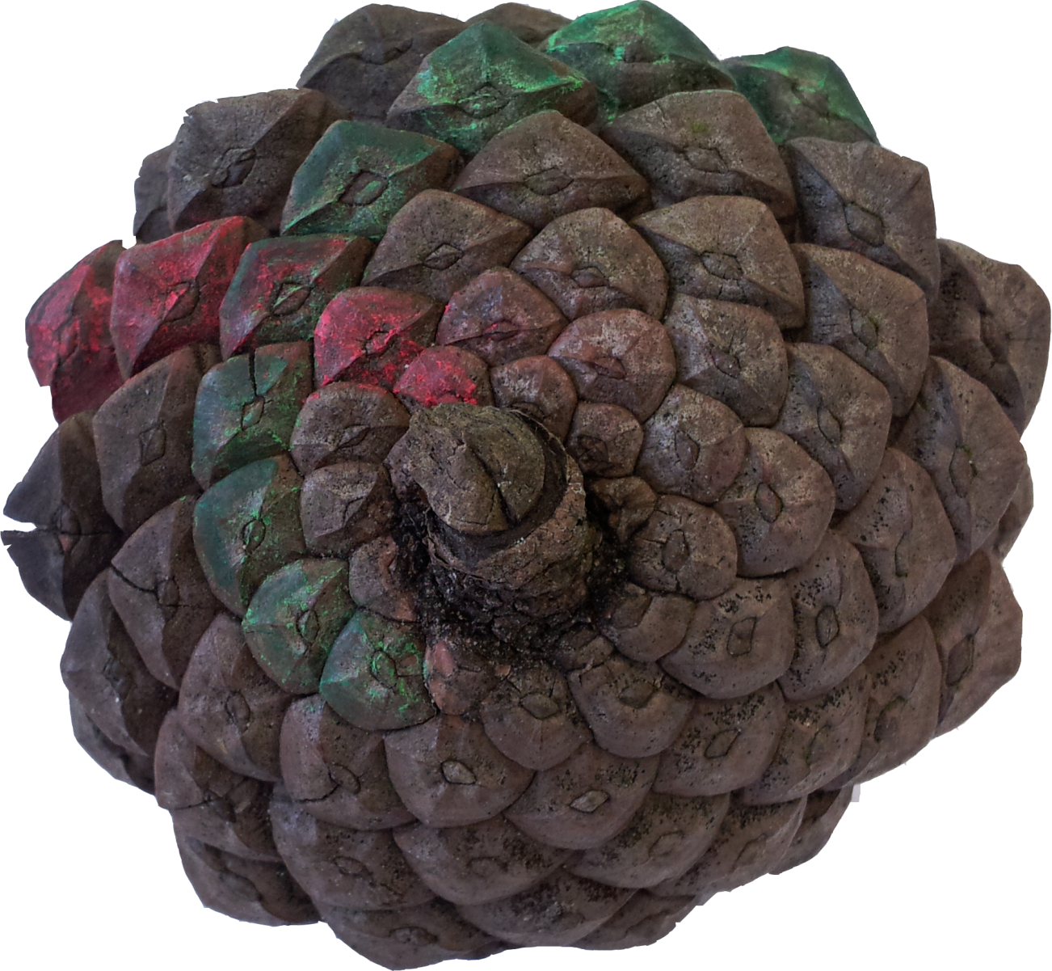
Golden ratio in nature
Photo: Peter Peters (2012)
Notes:
The processing example shows two for loops (with internally declared variables!)
Note, in the second for loop in the example both I AND j are declared internal !

Slide 12
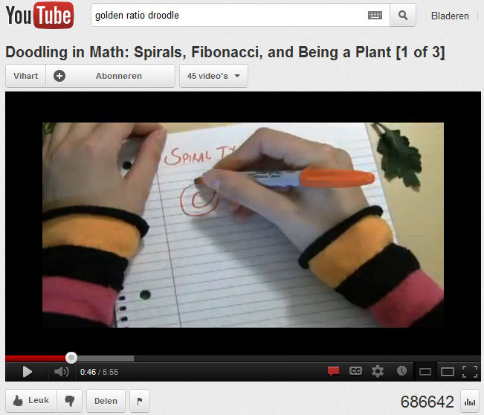
Golden ratio in nature
http://www.youtube.com/watch?v=ahXIMUkSXX0
Notes:
The processing example shows two for loops (with internally declared variables!)
Note, in the second for loop in the example both I AND j are declared internal !

Slide 13
Golden ratio in nature
Fibonacci numbers:
F₁ = 1
F₂ = 1
F_{n} = F_{n-2} + F_{n-1}
1,1,2,3,5,8,13,21,34, 55, 89, 144, 233, 377, 610, 987, 1597, 2584, 4181,..
lim _{n→∞} F_{n}/F_{n-1} = Φ
Notes:
The processing example shows two for loops (with internally declared variables!)
Note, in the second for loop in the example both I AND j are declared internal !

Slide 14
Golden ratio in nature
Fibonacci numbers:
F₁ = 1
F₂ = 1
F_{n} = F_{n-2} + F_{n-1}
1,1,2,3,5,8,13,21,34, 55, 89, 144, 233, 377, 610, 987, 1597, 2584, 4181,..
lim _{n→∞} F_{n}/F_{n-1} = Φ
Notes:
The processing example shows two for loops (with internally declared variables!)
Note, in the second for loop in the example both I AND j are declared internal !

Slide 15
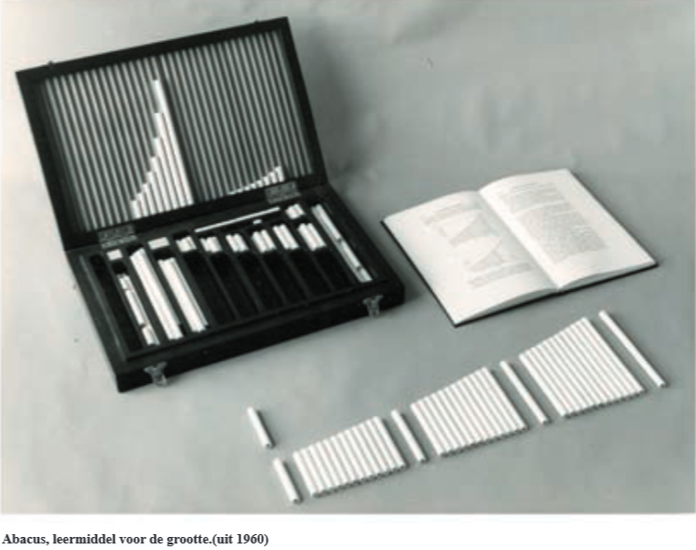
Plastic number
Van der Laan: two objects belong to different types of size if quotient of their sizes is about 4/3 (plastic number), while they belong to different orders of size if one object is about seven times larger than the other
Source: http://www.jandejongstichting.nl/cahier_jandejonghuis

Slide 16
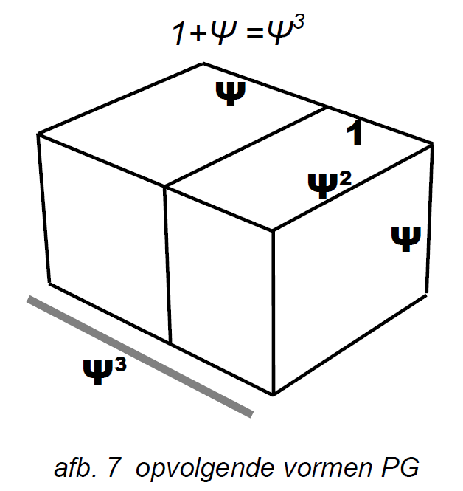
Luka Marohnić and Tihana Strmečki. Plastic Number: Construction and Applications, Advanced Research in Scientific Areas 2012, pp. 1523-1528, arsa-conf.com/archive/?vid=1&aid=3&kid=60101-209&q=f1
Pouderoyen, B.J.M.M. Maatbeperking in het architectonisch ontwerp; visuele relevantie van maatsystemen als Gulden snede en Plastische Getal - Measure limitation in architectural design, Proefschrift TUD 2013. repository.tudelft.nl/view/ir/uuid%3Ad5feaa76-cbfa-4577-80c7-878ced973730/

Slide 17
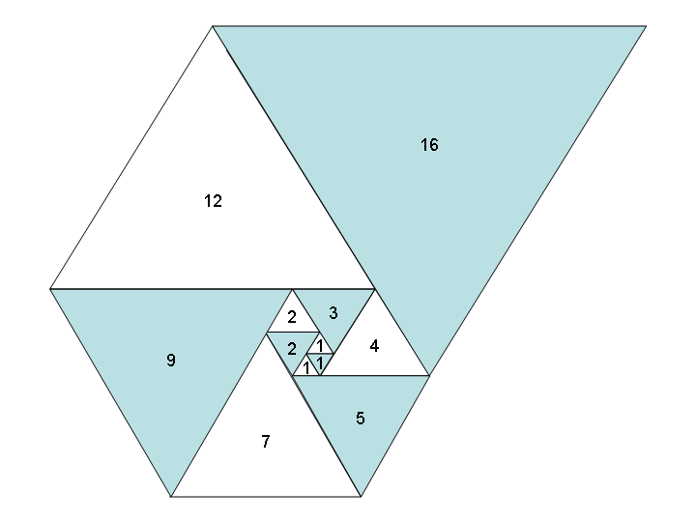
Spiral of equilateral triangles with side lengths which follow the Padovan sequence. Source: Gandalf61 Wikimedia

Slide 18
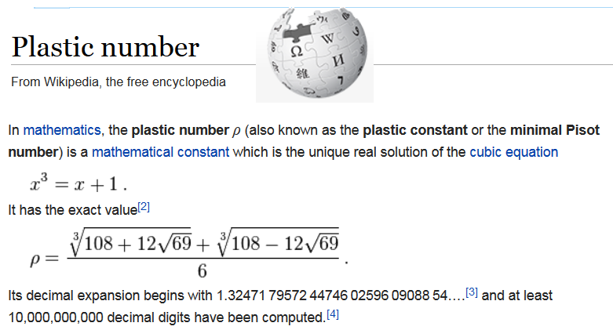

Slide 19
//Loe Feijs and TU/e, 2016
//Padovan sequence, related to plastic number
final int N = 25;
int pad[] = new int[N];
pad[0] = 1;
pad[1] = 1;
pad[2] = 1;
for (int i = 3; i < N; i++)
pad[i] = pad[i-2] + pad[i-3];
print("Padovan numbers: ");
for (int i=0; i < N; i++){
print(pad[i]);
print(", ");
}
println();
print("Successive ratios: ");
for (int i=0; i < N-1; i++){
float f = float(pad[i+1]) / float(pad[i]);
print(nf(f,1,4));
print(", ");
}

Slide 20
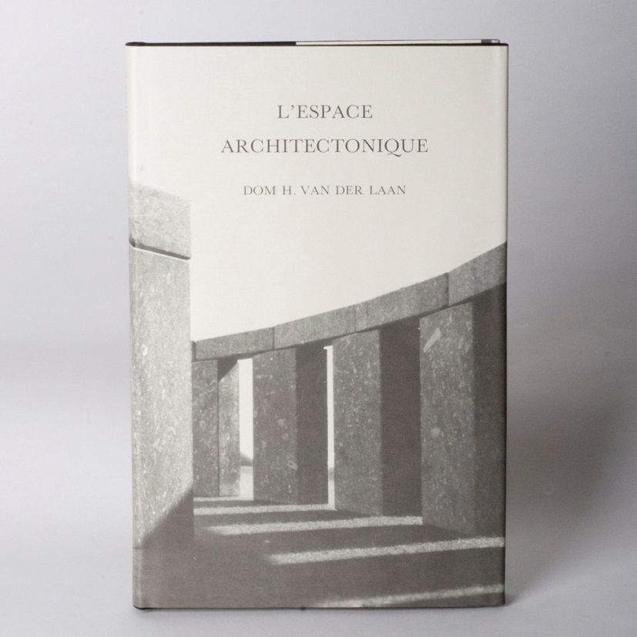
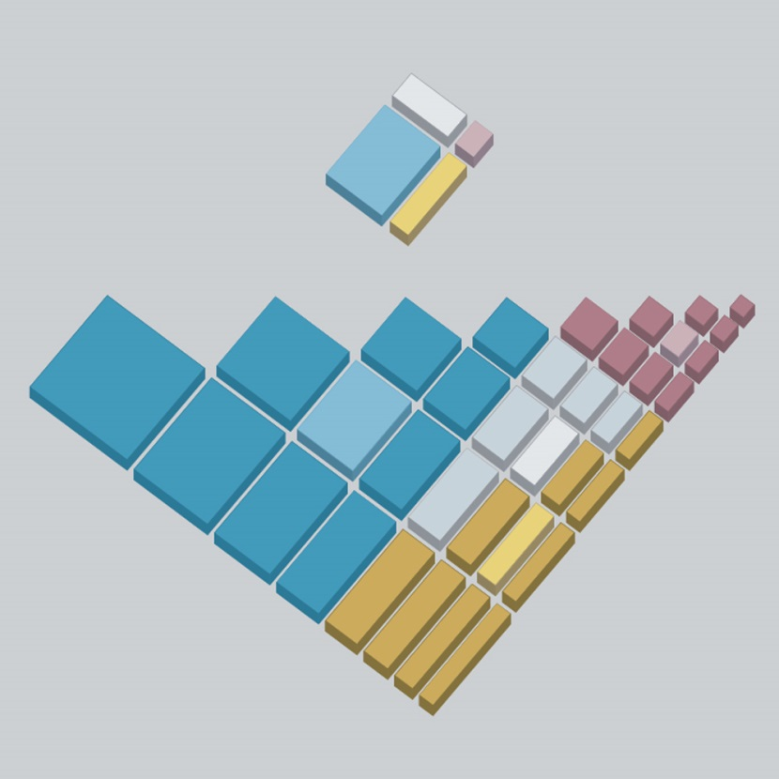
Source: van der Laan stichting, http://www.vanderlaanstichting.nl/pics/morphotheek%20vierkant%202.jpg

Slide 21
Source: van der Laan stichting, http://www.vanderlaanstichting.nl/pics/morphotheek%20vierkant%202.jpg

Slide 22
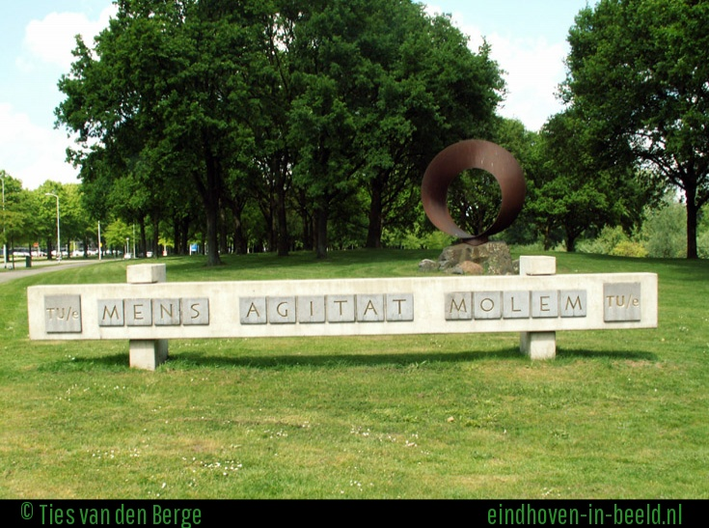
© Ties van de Berge

Slide 23
Exercises:
Find out more about Van der Laan
Generate the “morphotheek” in Processing

