Slide 1
The work of Quayola
Computer generated design

Slide 2
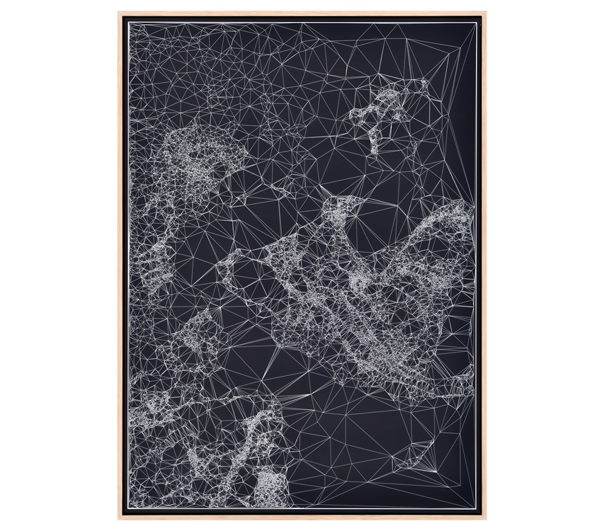
http://www.quayola.com/iconographies-21-80/

Slide 3
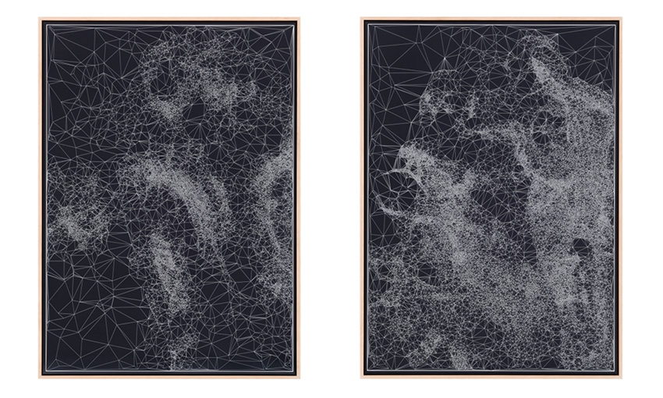
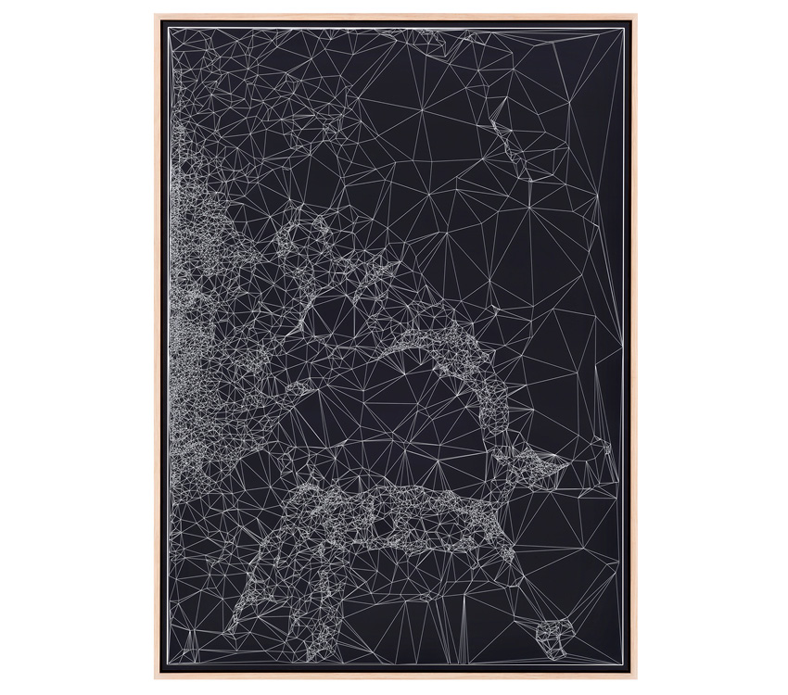
http://www.quayola.com/iconographies-21-80/

Slide 4
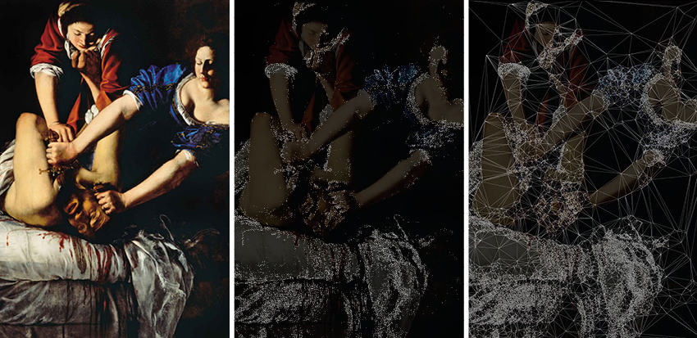
http://www.quayola.com/iconographies-21-80/

Slide 5
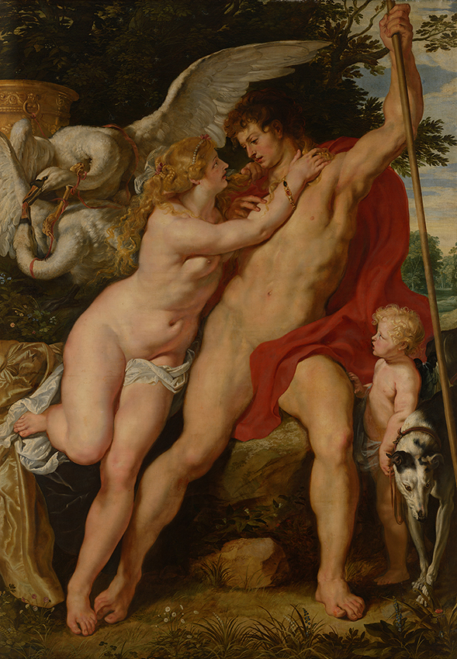
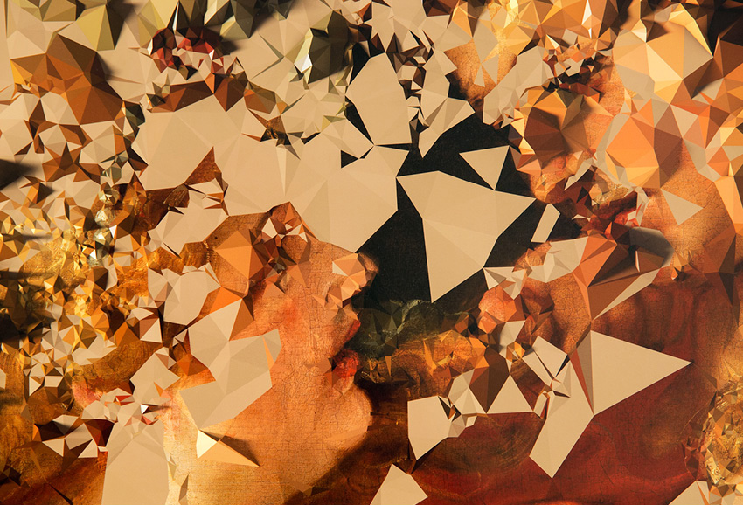
http://www.quayola.com/iconographies-16/

Slide 6
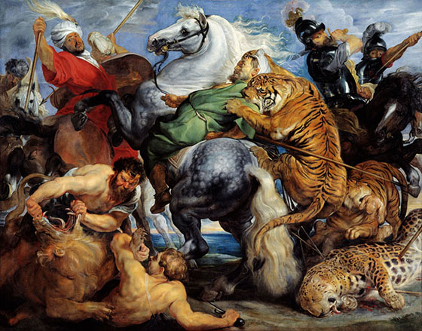
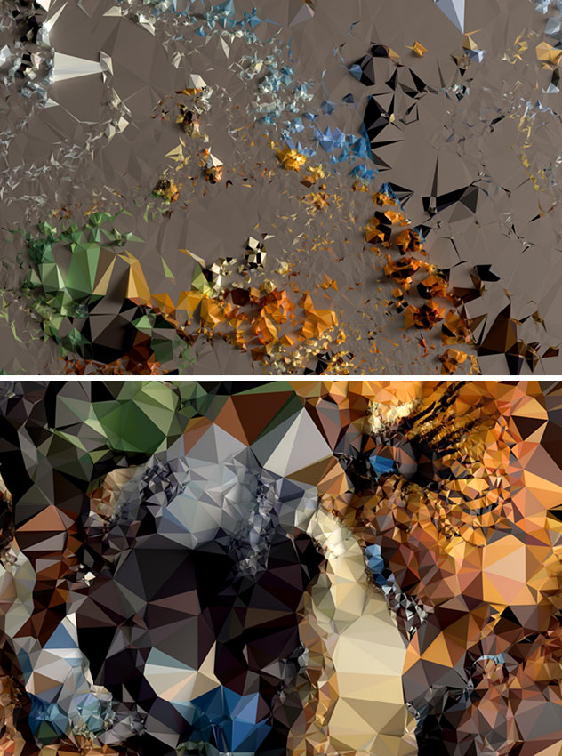
http://www.quayola.com/iconographies-20/

Slide 7
Very cool video!
http://www.quayola.com/strata3/

Slide 8
WALLPAPER
Wallpaper designed by Vivianne Heijkoop, coarse: Golden Ratio, Department of Industrial Design, TU/e

Slide 9
Inspiration for your miniproject!
An architectural view

Slide 10
Islamic Architecture

Slide 11
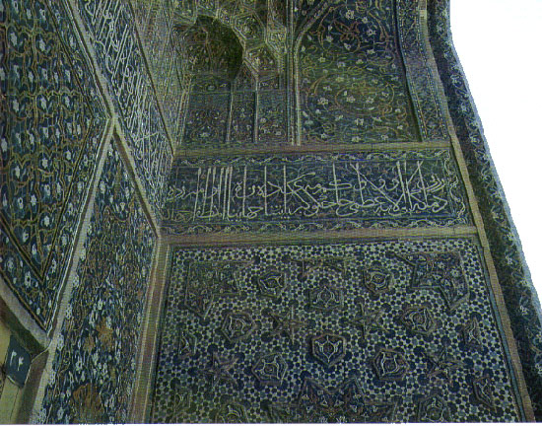
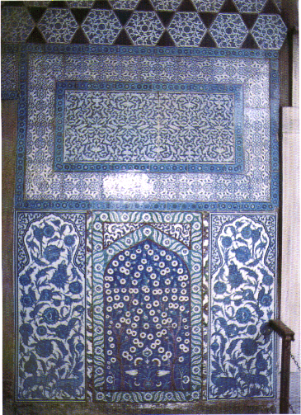
http://www.dartmouth.edu/~matc/math5.pattern/lesson5math.html

Slide 12
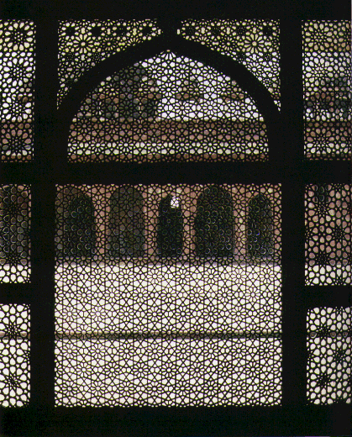
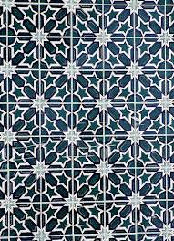
http://islamicartphotoshistory.blogspot.nl/2014/01/historians-of-islamic-art-islamic-art.html

Slide 13
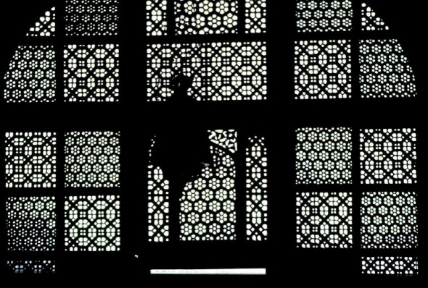
http://matsysdesign.com/studios/compositebodies/2010/01/patterns-in-islamic-art-website/

Slide 14
Farshid Moussavi

Slide 15
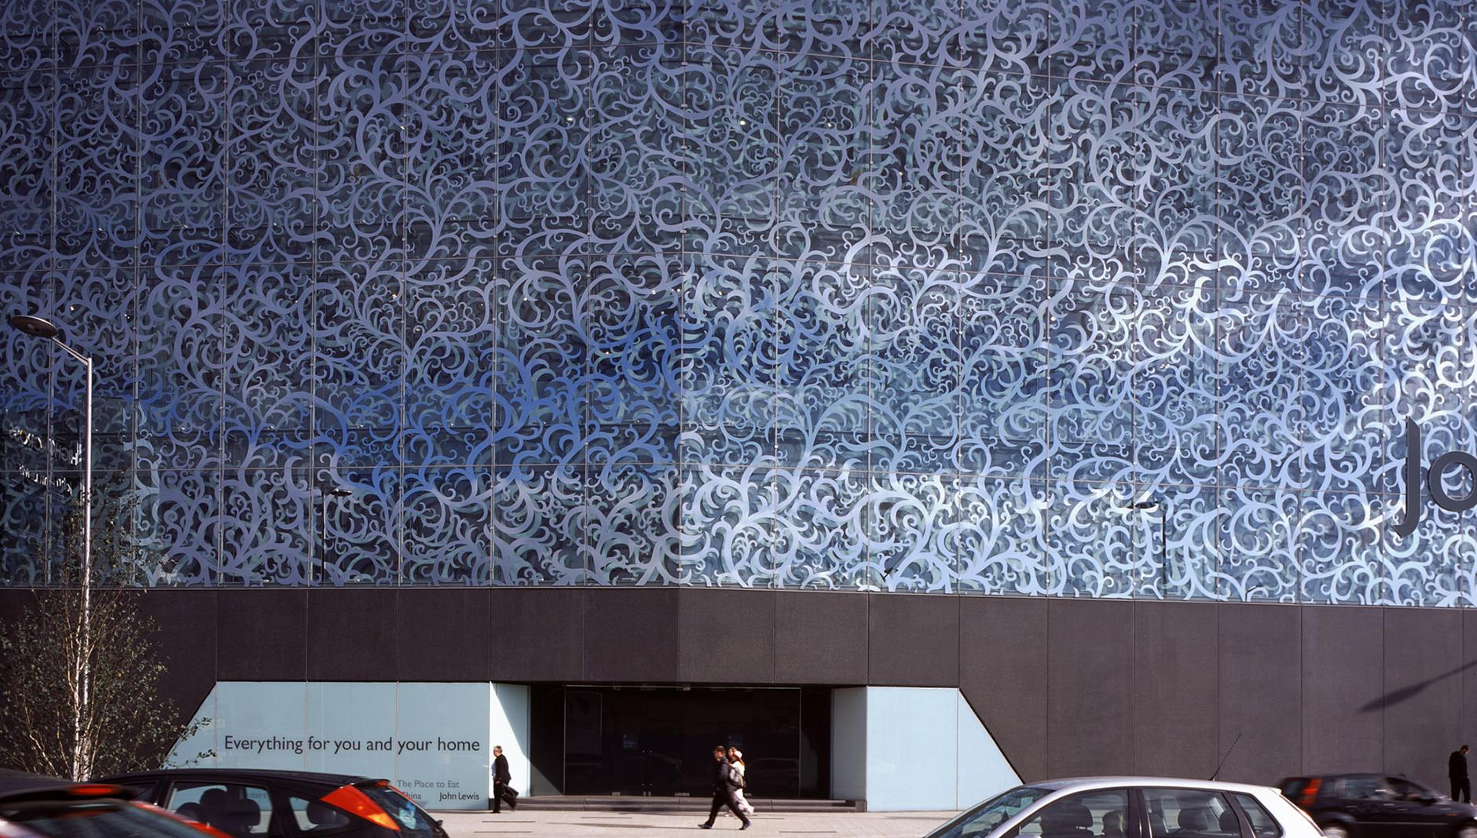
John Lewis Departement Store
http://www.farshidmoussavi.com/node/25#john_lewis_department_store_and_cineplex_leichester_25_209

Slide 16
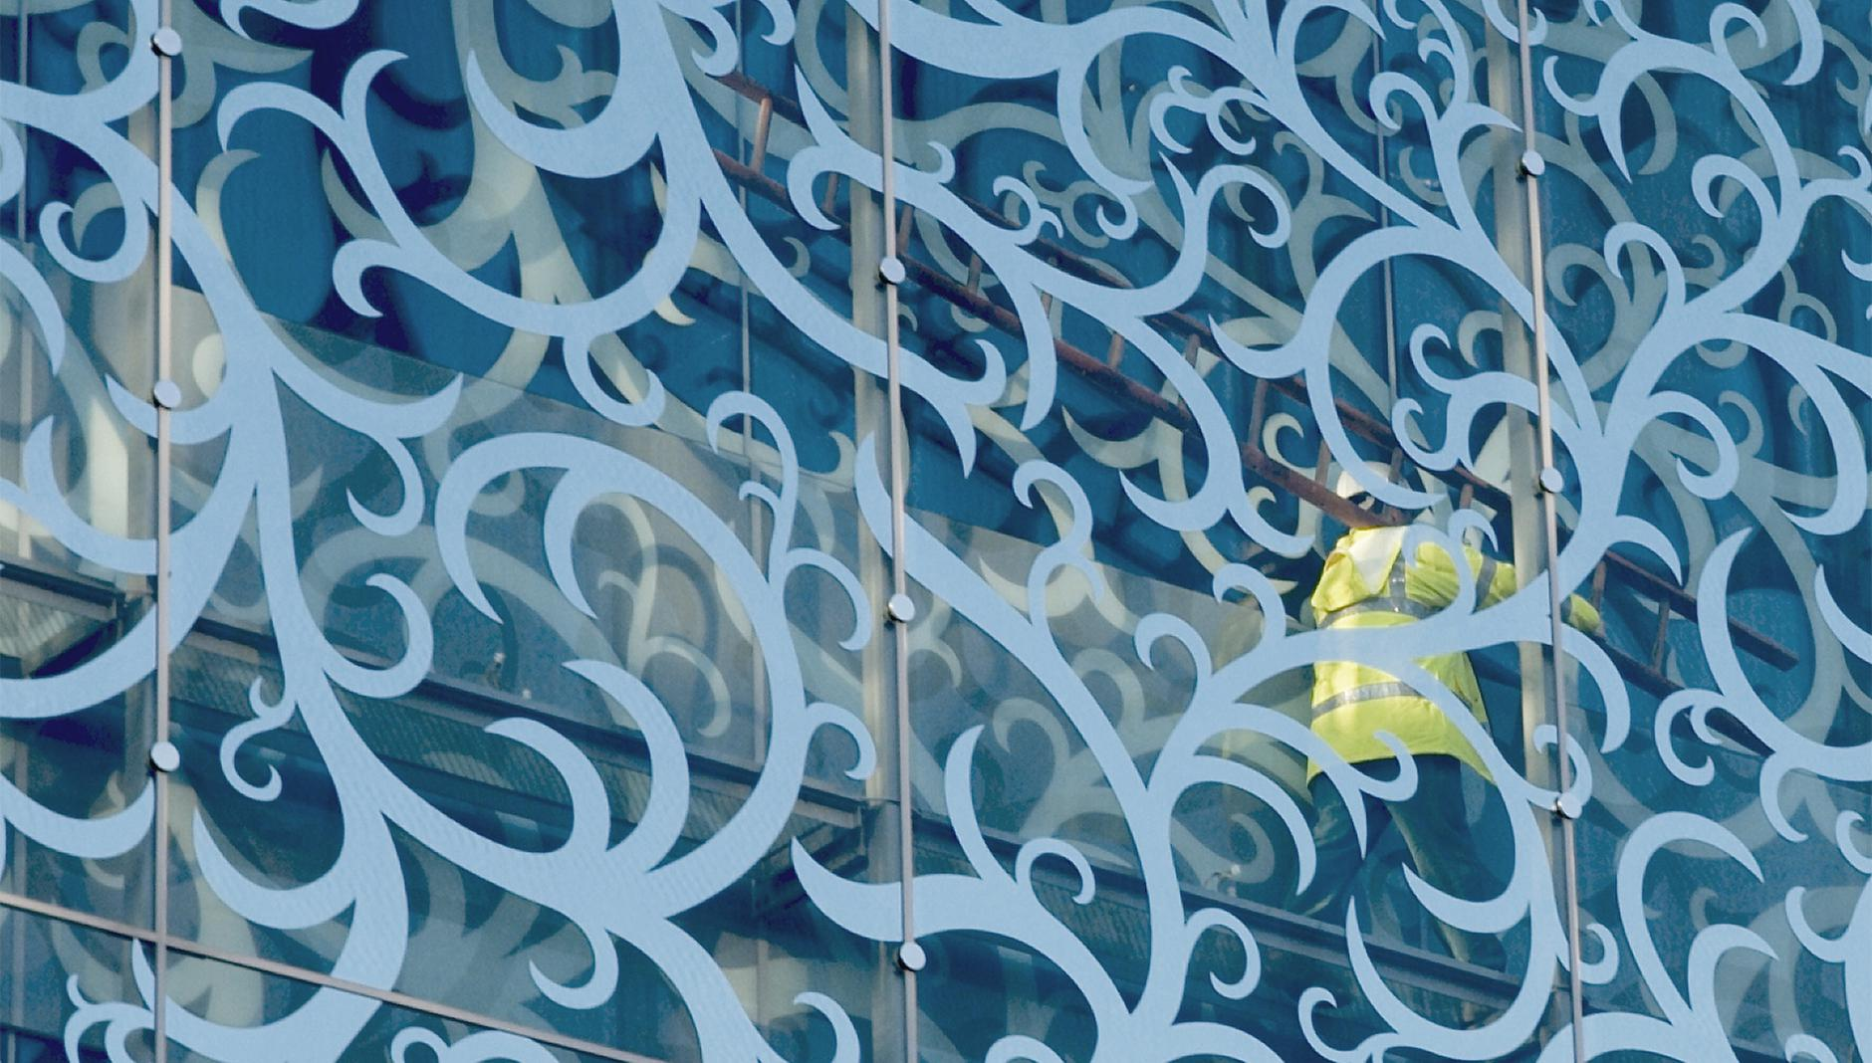
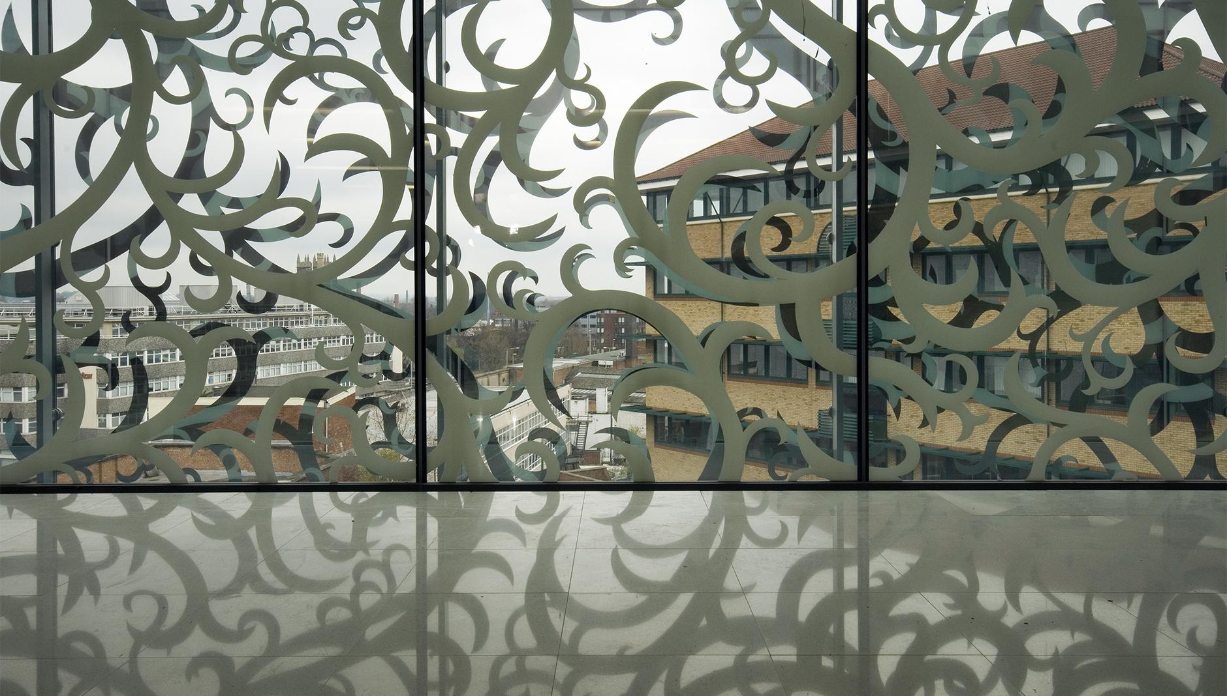
http://www.farshidmoussavi.com/node/25#john_lewis_department_store_and_cineplex_leichester_25_209

Slide 17
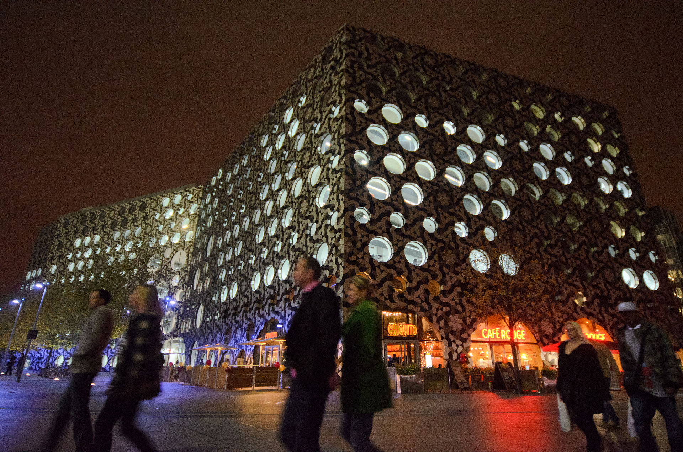
Ravensbourne College
http://www.dezeen.com/2010/09/13/ravensbourne-college-by-foreign-office-architects/

Slide 18
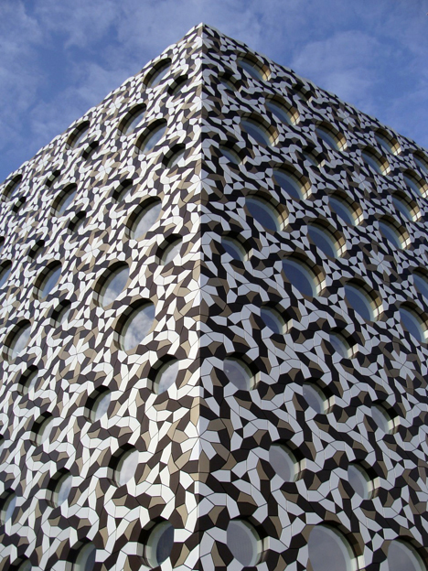
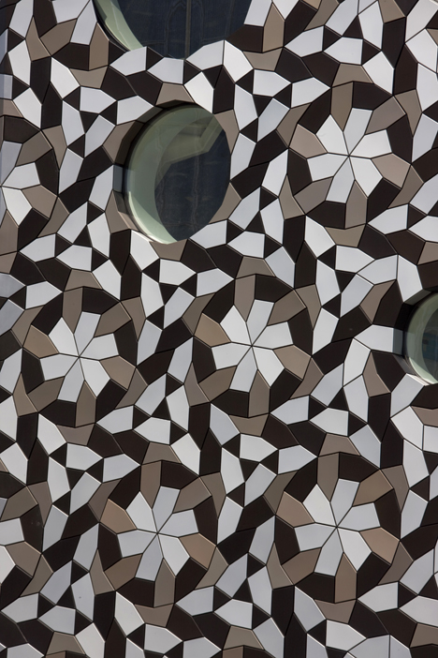
http://www.farshidmoussavi.com/node/28#ravensbourne_college_london_28_12

Slide 19
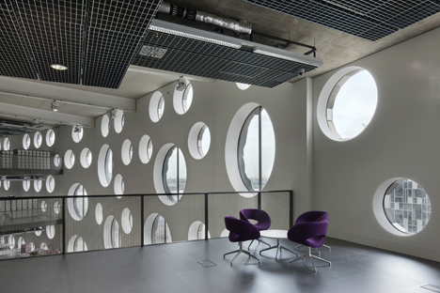
http://www.farshidmoussavi.com/node/28#ravensbourne_college_london_28_12

Slide 20
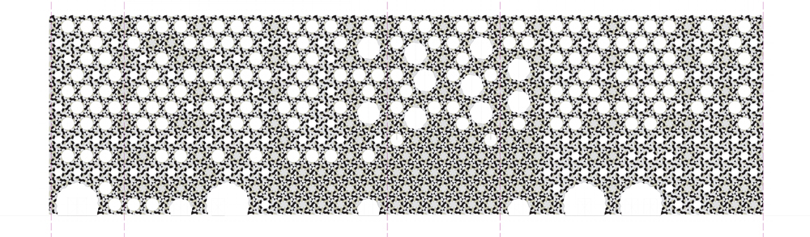
http://www.farshidmoussavi.com/node/28#ravensbourne_college_london_28_12

Slide 21
Glorieta Juan Carlos I Mula

Slide 22
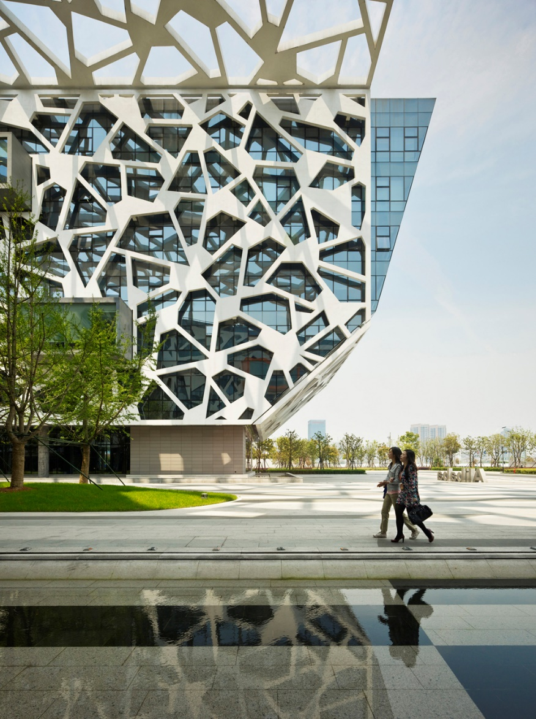
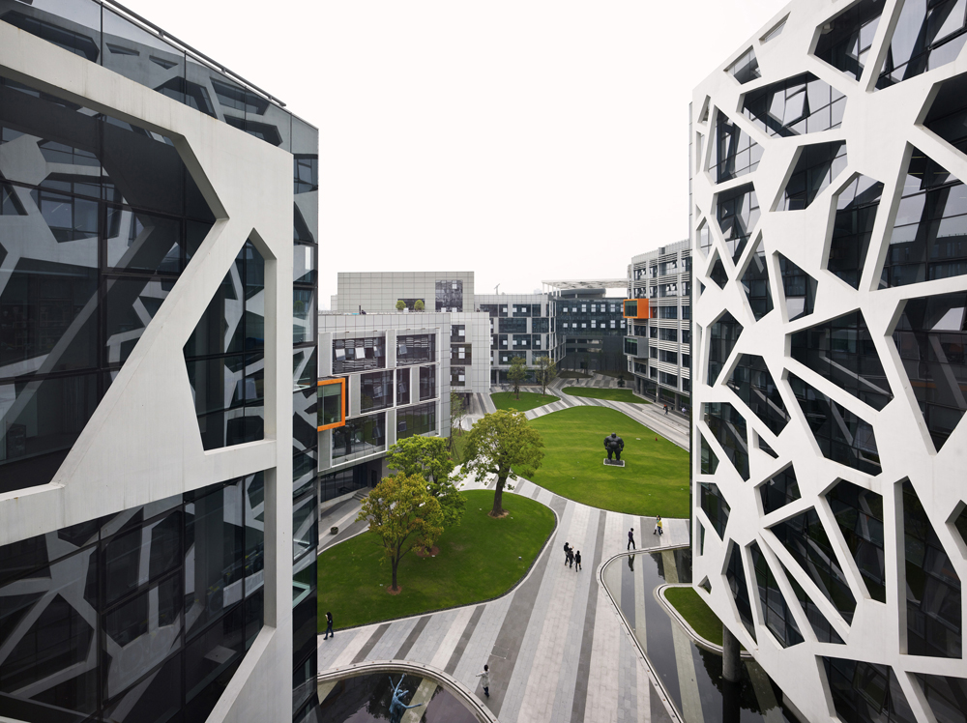
Ravensbourne College
https://tomaszjaniak.wordpress.com/2011/04/22/voronoi-diagram-in-architecture-3/

Slide 23
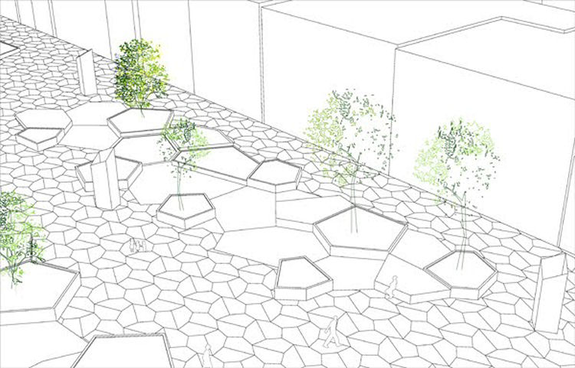
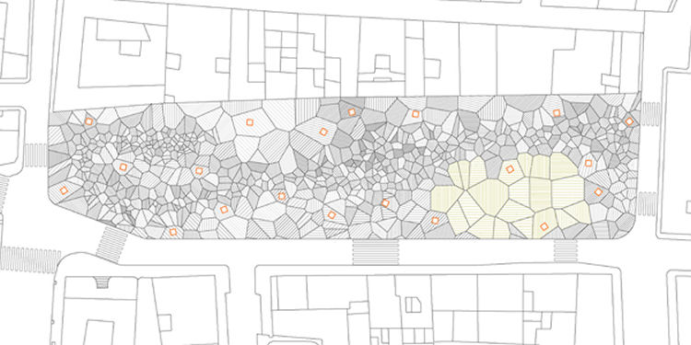
https://tomaszjaniak.wordpress.com/2011/04/22/voronoi-diagram-in-architecture-3/

Slide 24
Students of ETHZ, Zurich

Slide 25
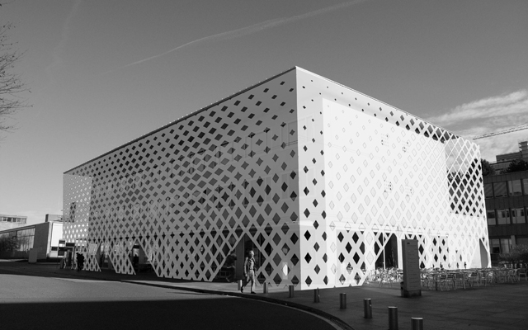
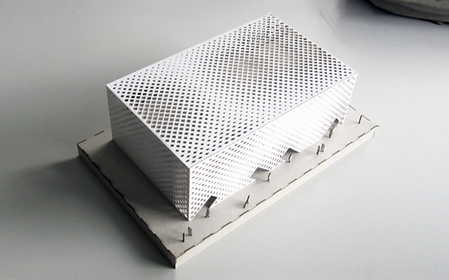
http://www.mas.caad.arch.ethz.ch/mas1011/index0ed6.html?p=410

Slide 26
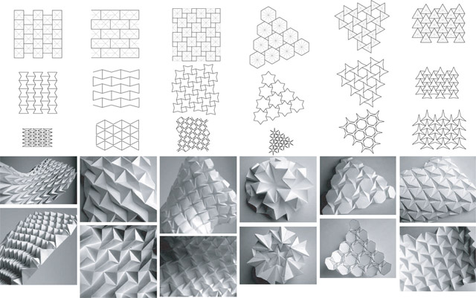
http://diseno1manuelaleon.blogspot.nl/2013/06/lunes-27-de-mayo.html

Slide 27
Elena Manferdini

Slide 28
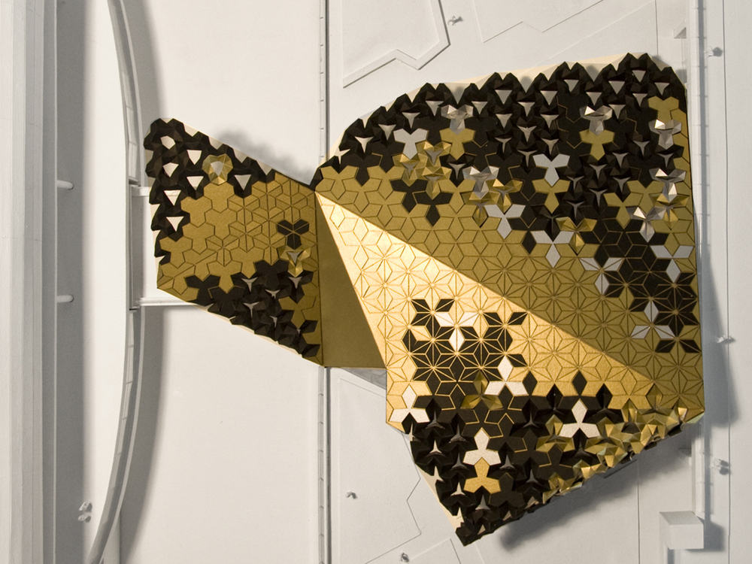
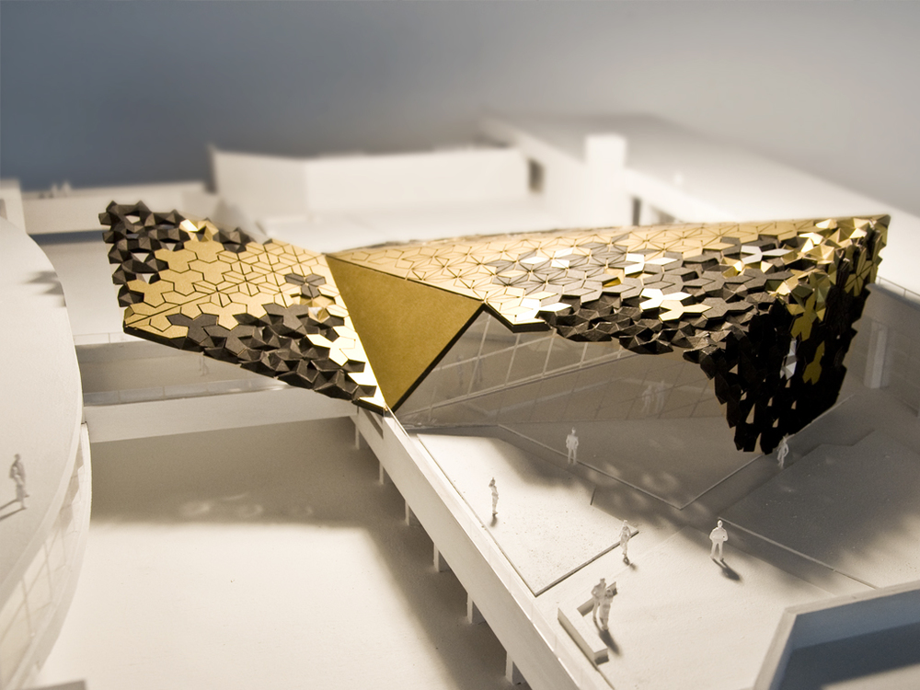
http://www.ateliermanferdini.com/work/#/still-1-4/

Slide 29
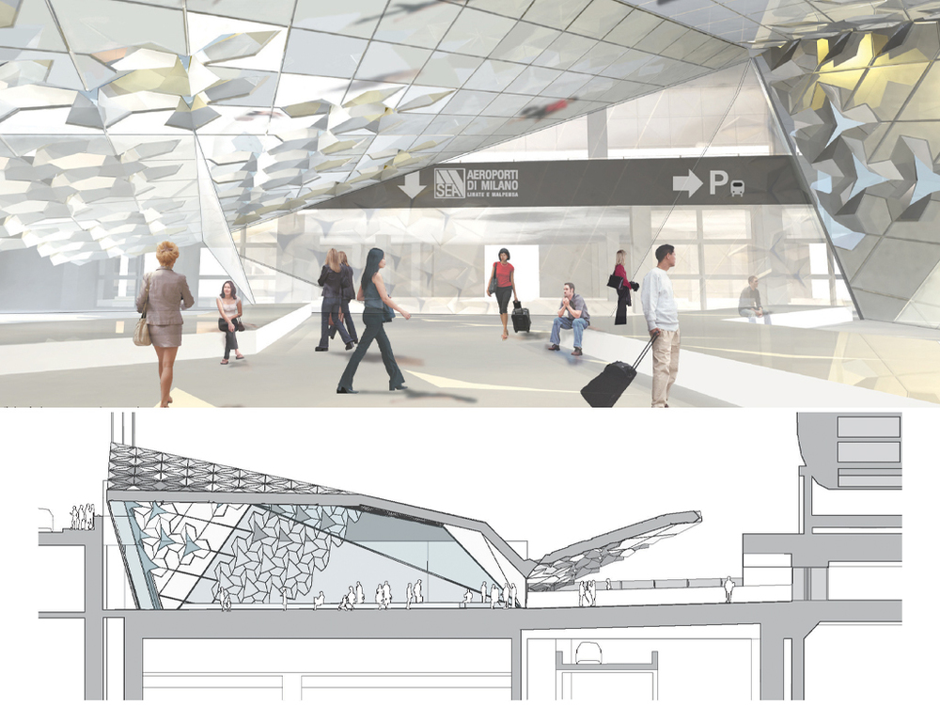
http://www.ateliermanferdini.com/work/#/still-1-4/

Slide 30
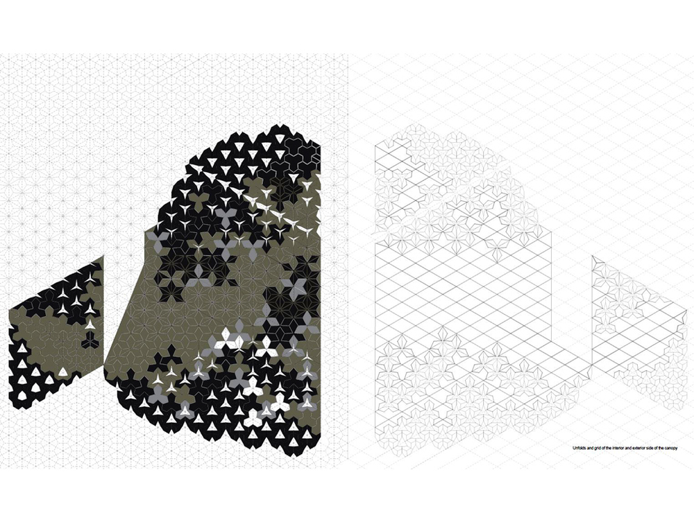
http://www.ateliermanferdini.com/work/#/still-1-4/

Slide 31
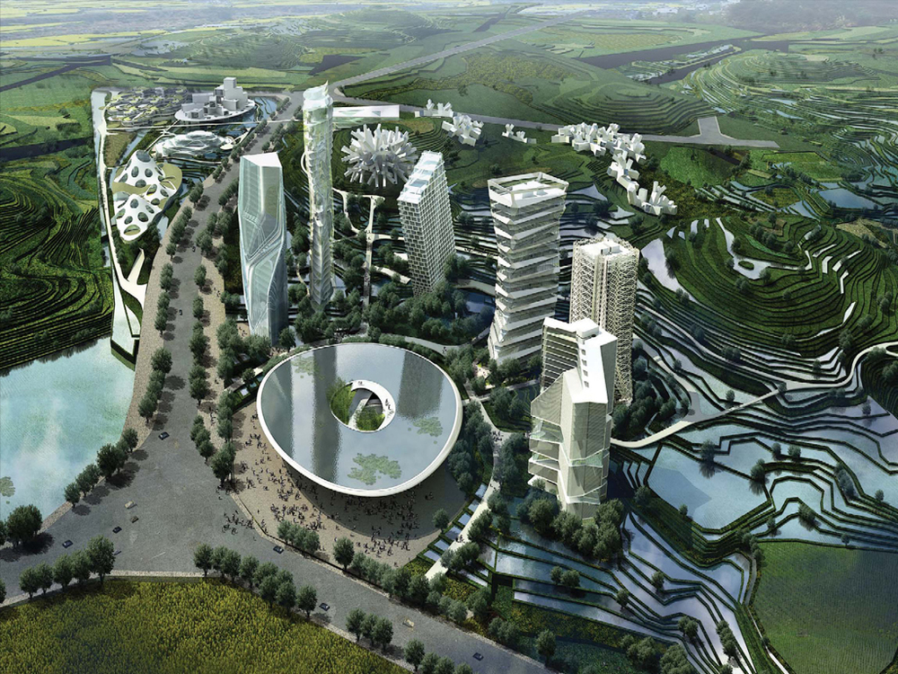
http://www.ateliermanferdini.com/work/#/still-1-4-4-1-1/

Slide 32
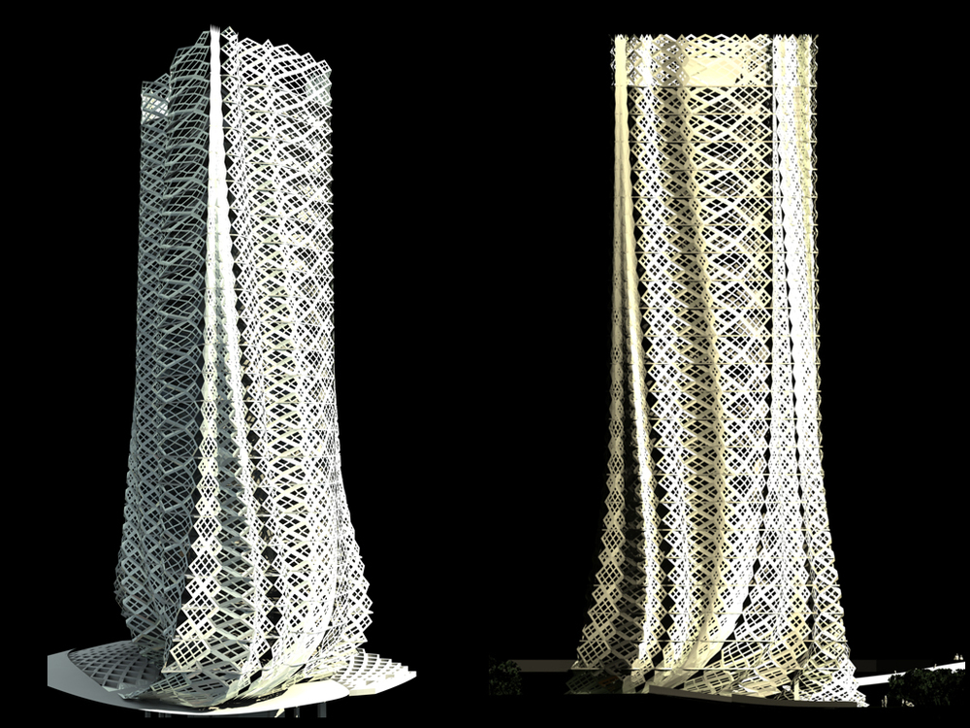
http://www.ateliermanferdini.com/work/#/still-1-4-4-1-1/

Slide 33
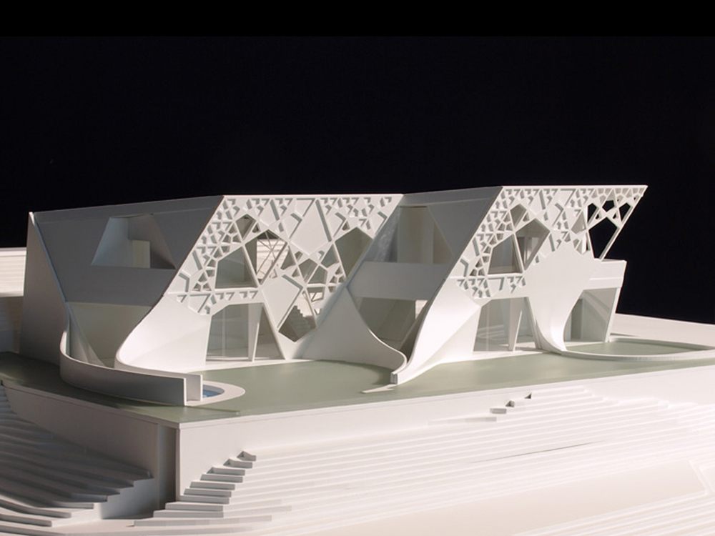
http://www.ateliermanferdini.com/work/#/still-1-4-4/

Slide 34
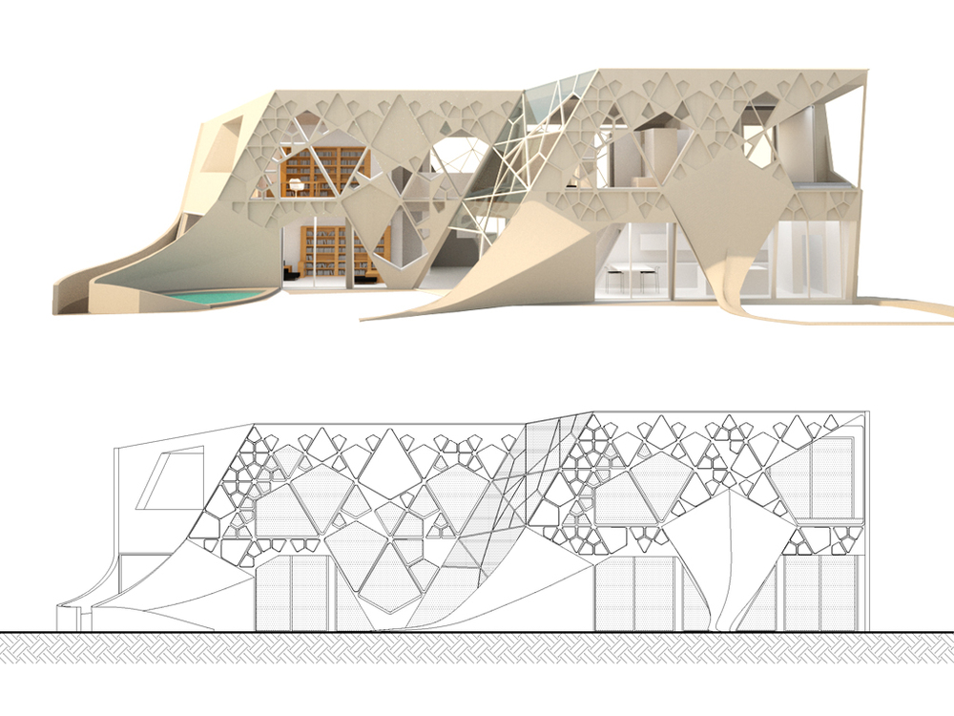
http://www.ateliermanferdini.com/work/#/still-1-4-4/

Slide 35
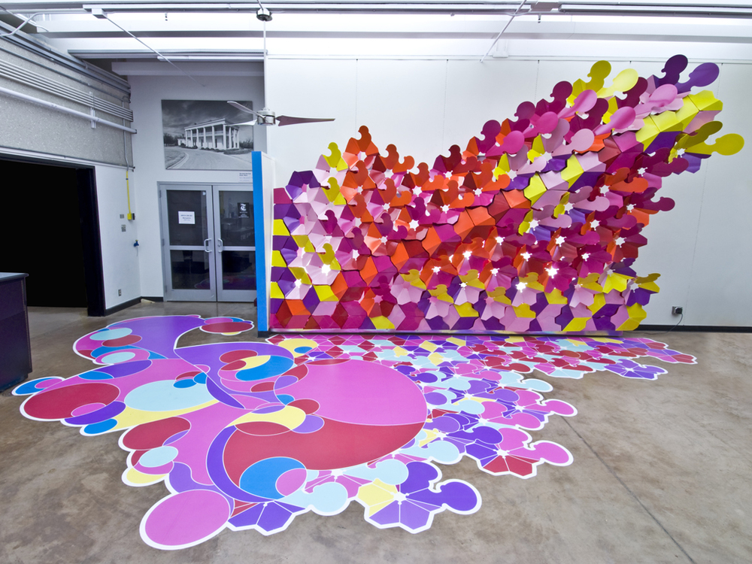
http://www.ateliermanferdini.com/installations/#/still-1-4-3-1-3/

Slide 36
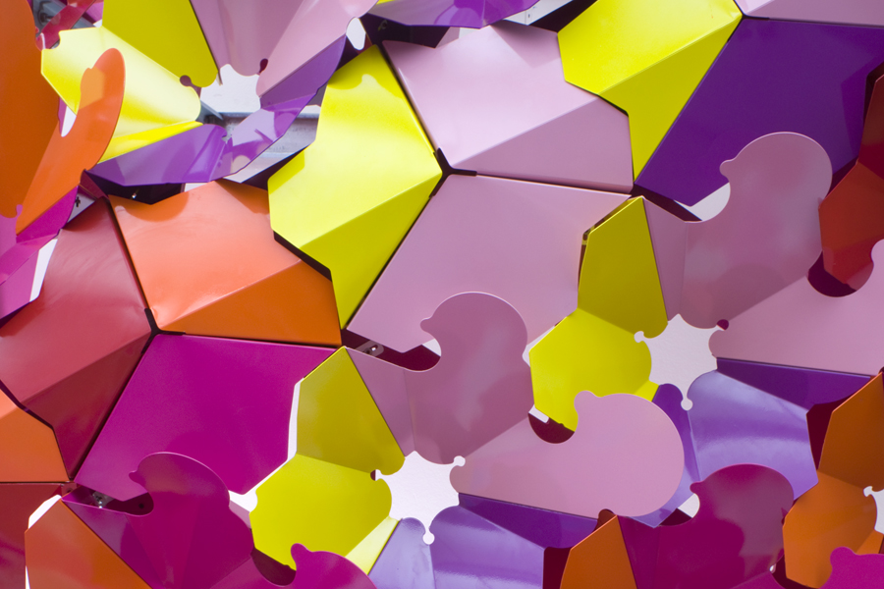
http://www.ateliermanferdini.com/installations/#/still-1-4-3-1-3/

Slide 37
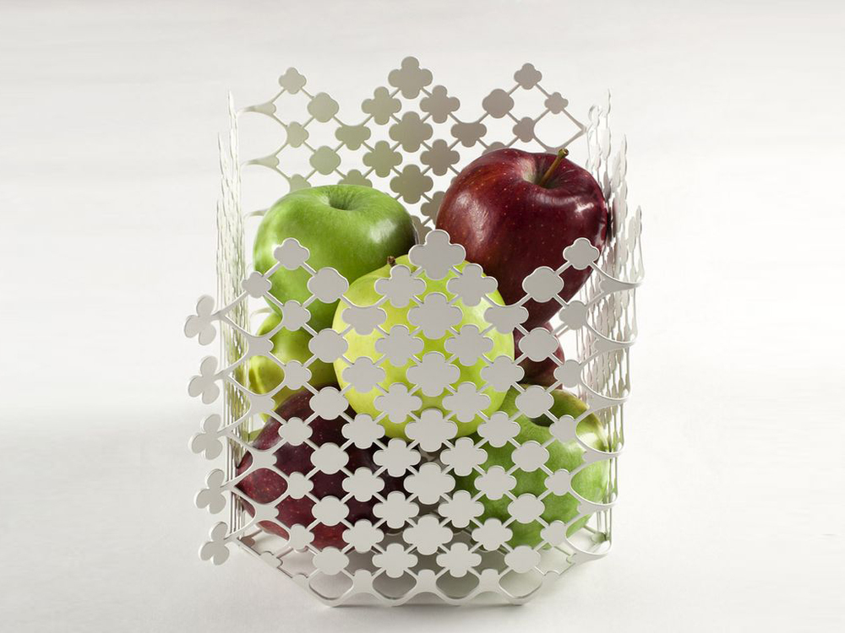
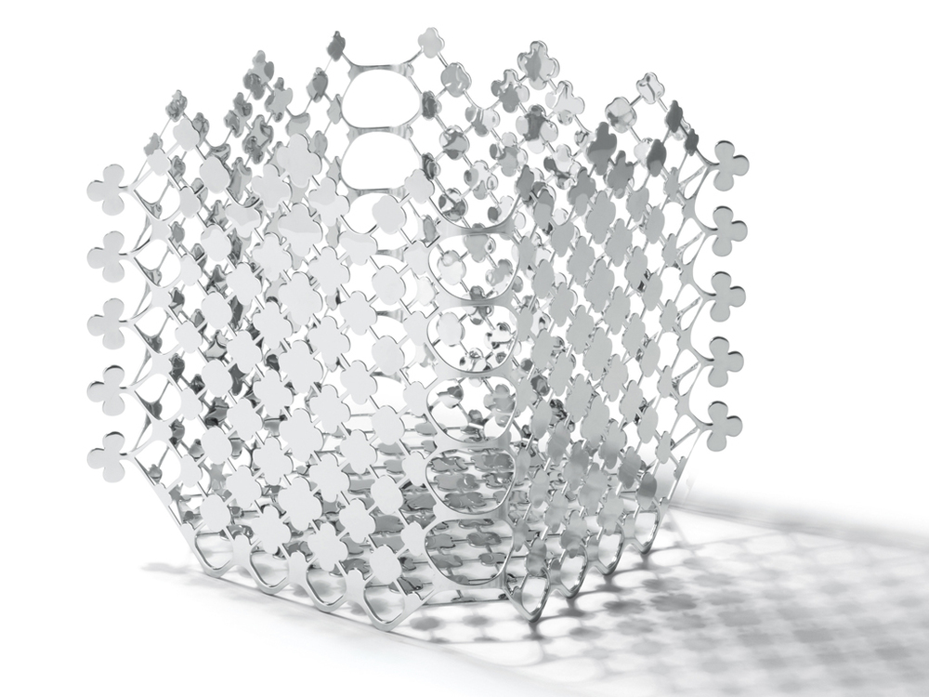
http://www.ateliermanferdini.com/design/#/still-1-4-3-1-4-1-1-1-1-1-1/

