Slide 1
Golden Ratio: Tessellations Theory
Jun Hu and Loe Feijs

Slide 2
Content
Tesselations
Heesch Kienzle theory
Heesch Kienzle in Processing

Slide 3
Tesselations

Slide 4
Tesselations
Examples in art, design, engineering and fashion
Esher’s art
Penrose’s puzzles
Tilings and brickwork
Metalware production
Pied de poule
Notes:
The first processing example shows if/then/else and printing booleans, also the use of the ternairy operator instead of if/then/else
The second processing example is a demo with 4 circles to play around with and demonstrate the first simple things you can do using variables, operators and if/then/else. When opening the sketch, below the actual code (scroll down) are remarks on how to alter the example in a step wise fashion to demonstrate some stuff.

Slide 5
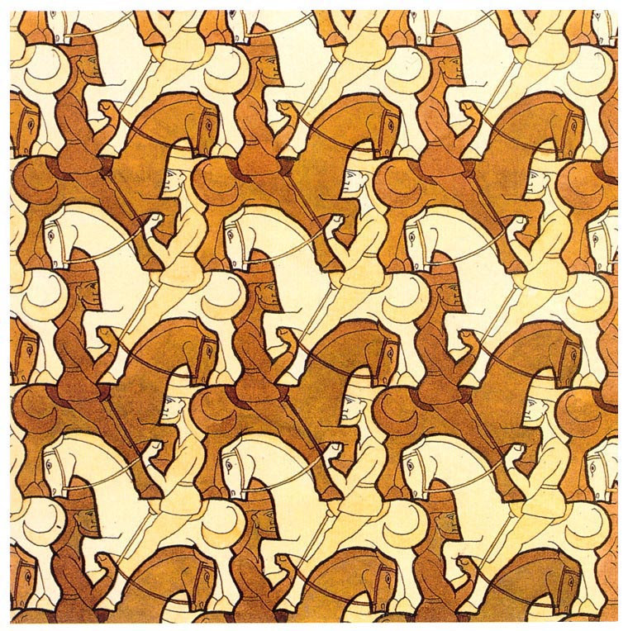
Tesselations (Escher’s art)
http://britton.disted.camosun.bc.ca/escher/jbescher.htm
https://en.wikipedia.org/wiki/M._C._Escher
Notes:
The first processing example shows if/then/else and printing booleans, also the use of the ternairy operator instead of if/then/else
The second processing example is a demo with 4 circles to play around with and demonstrate the first simple things you can do using variables, operators and if/then/else. When opening the sketch, below the actual code (scroll down) are remarks on how to alter the example in a step wise fashion to demonstrate some stuff.

Slide 6
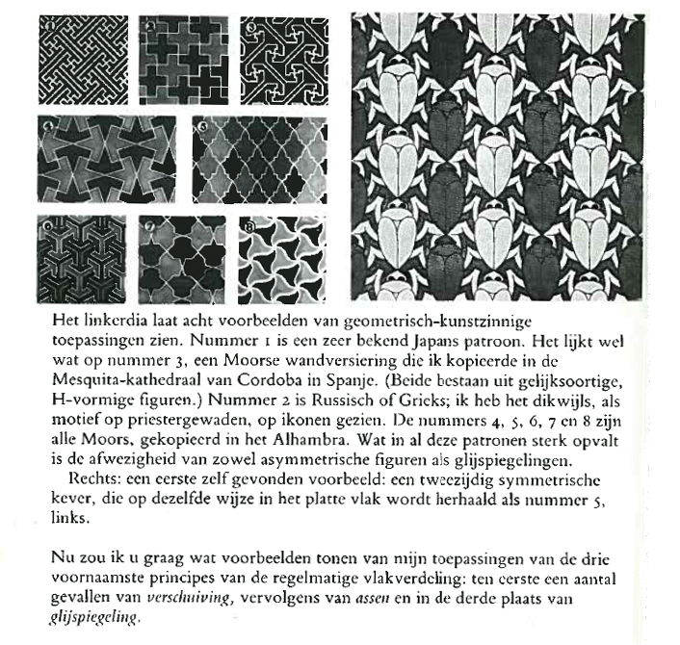
Het oneindige, M.C. Escher over eigen werk, Meulenhoff/Landshof 1986.

Slide 7
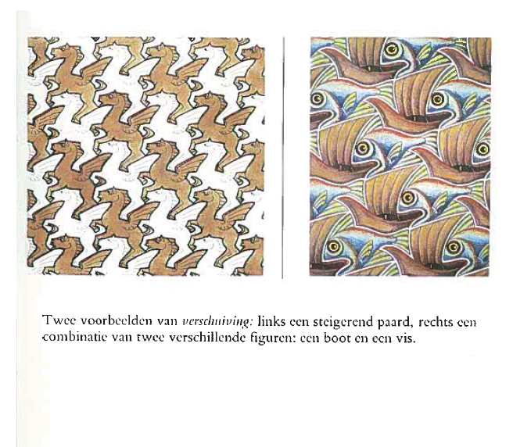
Het oneindige, M.C. Escher over eigen werk, Meulenhoff/Landshof 1986.

Slide 8
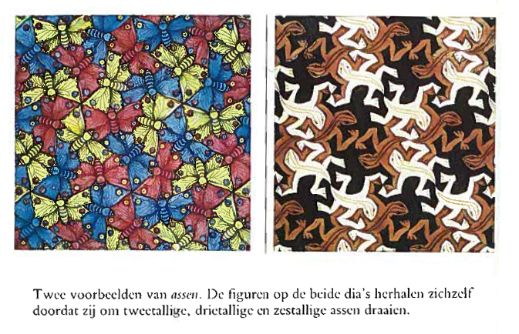
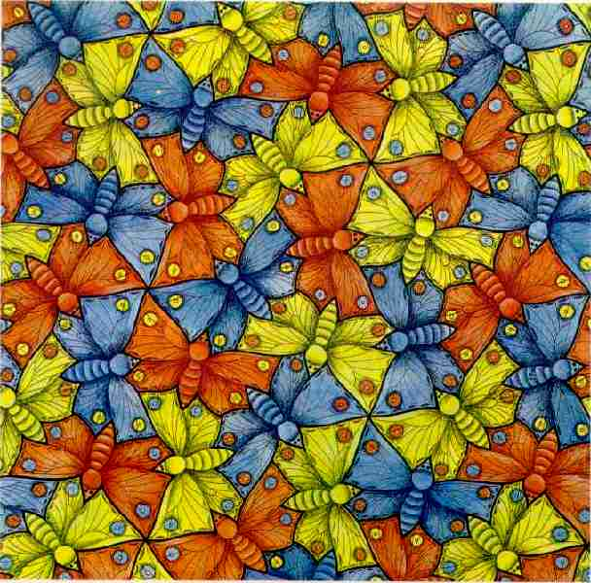
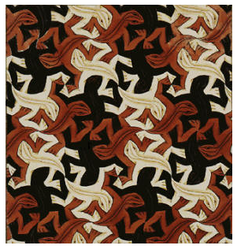
Het oneindige, M.C. Escher over eigen werk, Meulenhoff/Landshof 1986.

Slide 9
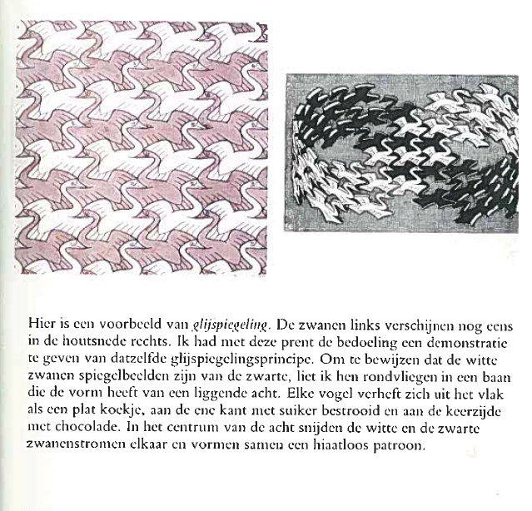
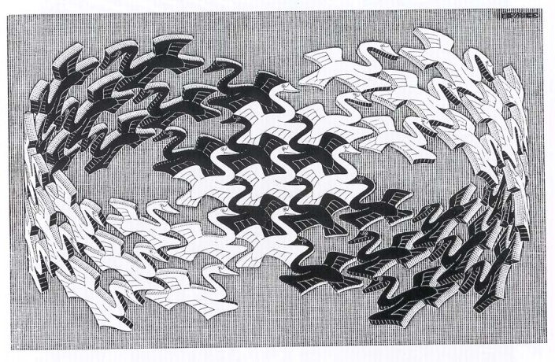
Het oneindige, M.C. Escher over eigen werk, Meulenhoff/Landshof 1986.

Slide 10
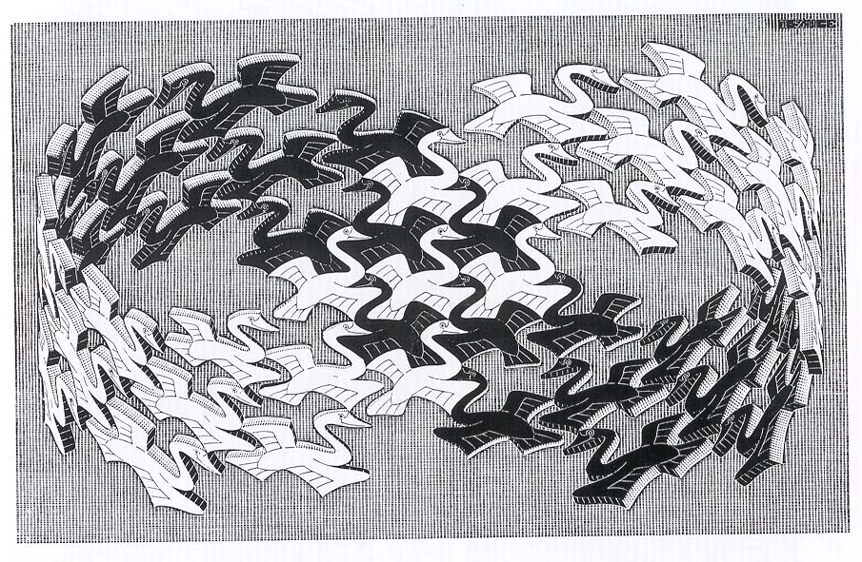

Slide 11
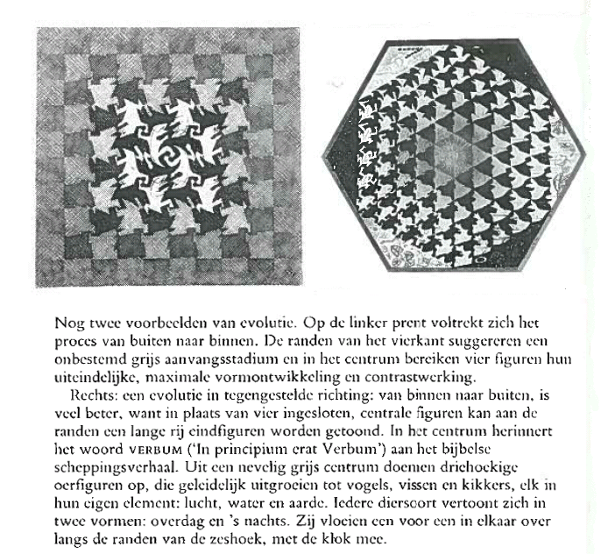
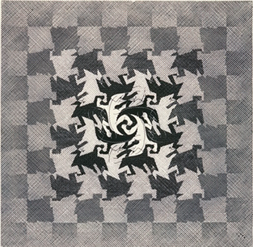
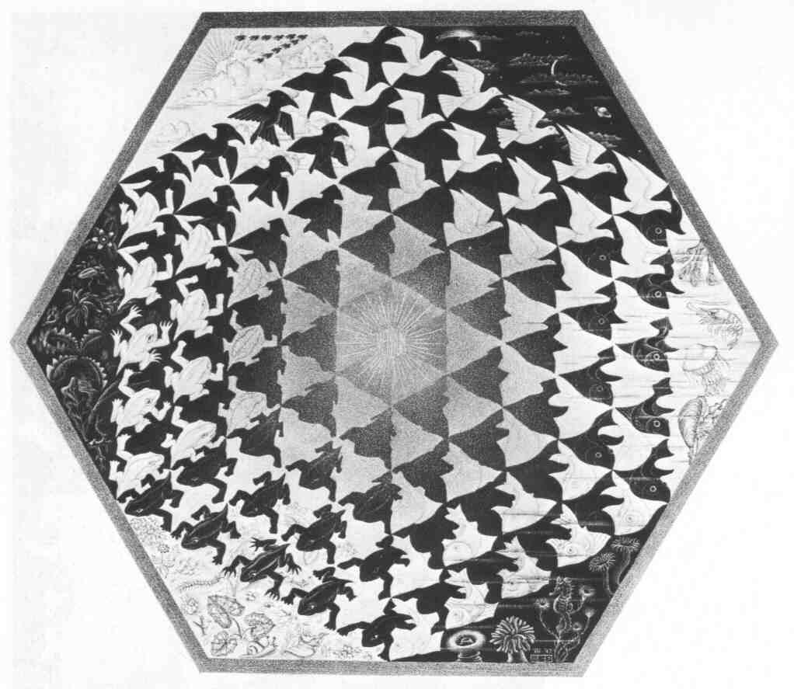
Het oneindige, M.C. Escher over eigen werk, Meulenhoff/Landshof 1986.

Slide 13
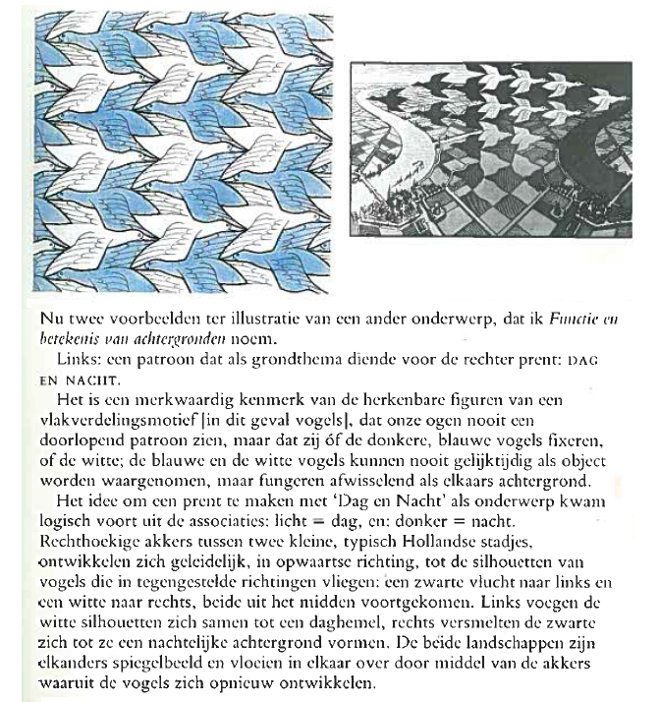
Het oneindige, M.C. Escher over eigen werk, Meulenhoff /Landshof 1986.

Slide 14
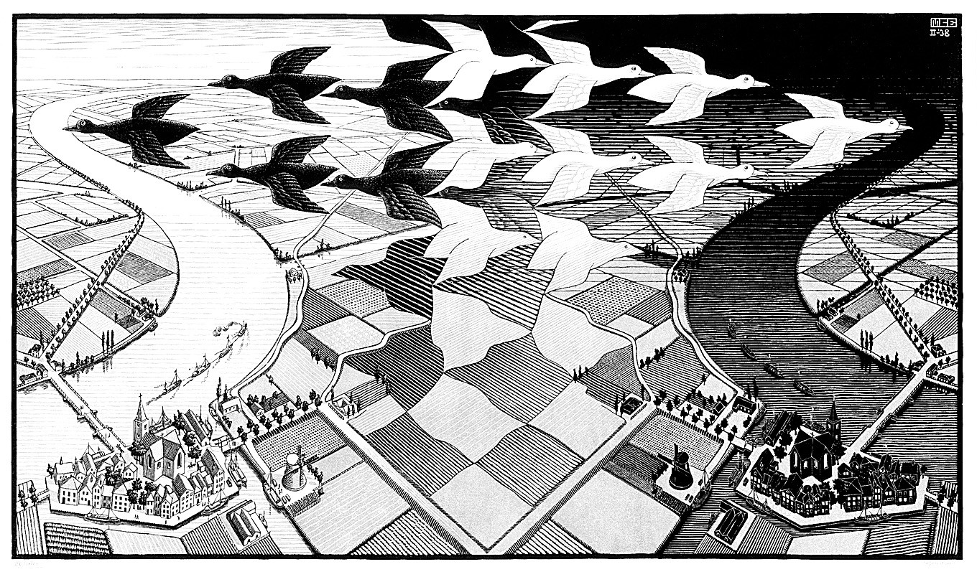

Slide 15
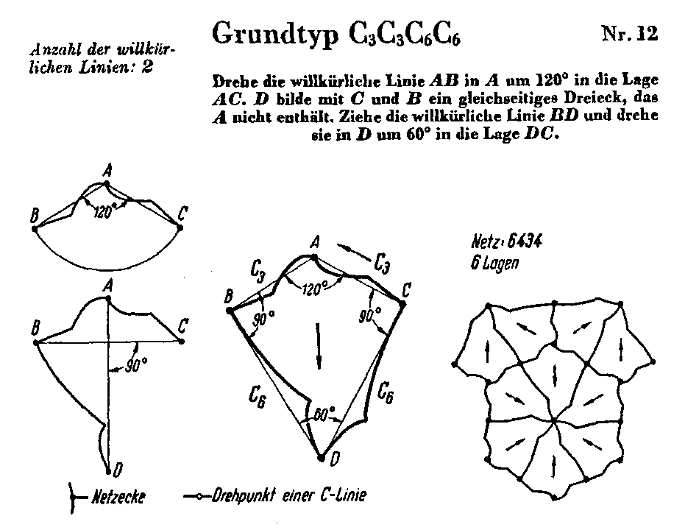
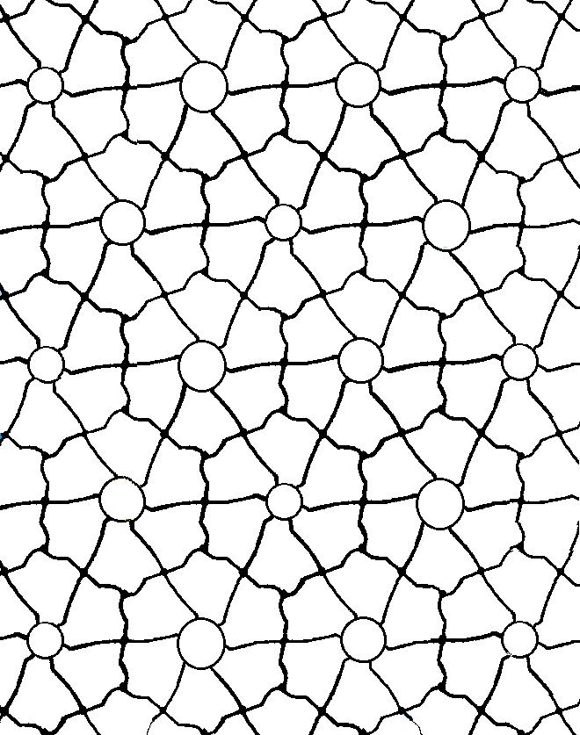
Heesch und Kienzle, Flachenschluss,Springer-Verlag, 1963.
http://katinkata.blogspot.com/2010/06/photos-by-team-peter-stigter.html

Slide 16
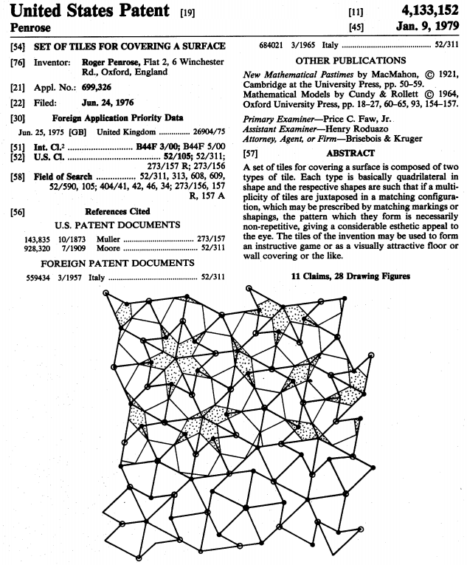
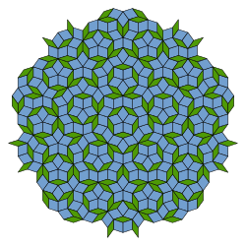
Tesselations (Penrose’s puzzles)
Source: espacenet
Notes:
The first processing example shows if/then/else and printing booleans, also the use of the ternairy operator instead of if/then/else
The second processing example is a demo with 4 circles to play around with and demonstrate the first simple things you can do using variables, operators and if/then/else. When opening the sketch, below the actual code (scroll down) are remarks on how to alter the example in a step wise fashion to demonstrate some stuff.

Slide 17
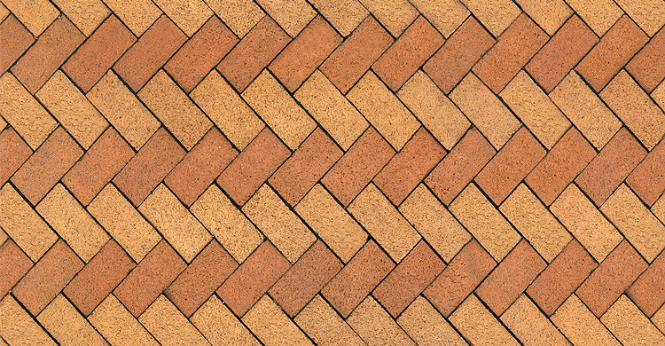
Tesselations (tilings and brickwork)
Source: http://www.evermotion.org/download/show/166/brick-tiles
Notes:
The first processing example shows if/then/else and printing booleans, also the use of the ternairy operator instead of if/then/else
The second processing example is a demo with 4 circles to play around with and demonstrate the first simple things you can do using variables, operators and if/then/else. When opening the sketch, below the actual code (scroll down) are remarks on how to alter the example in a step wise fashion to demonstrate some stuff.

Slide 18
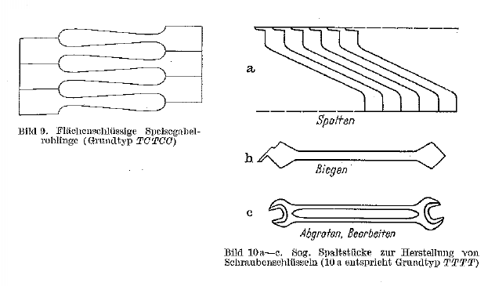
Tesselations (metalware production)
Source: Heesch & Kienzle, Flachenschluss
Notes:
The first processing example shows if/then/else and printing booleans, also the use of the ternairy operator instead of if/then/else
The second processing example is a demo with 4 circles to play around with and demonstrate the first simple things you can do using variables, operators and if/then/else. When opening the sketch, below the actual code (scroll down) are remarks on how to alter the example in a step wise fashion to demonstrate some stuff.

Slide 19
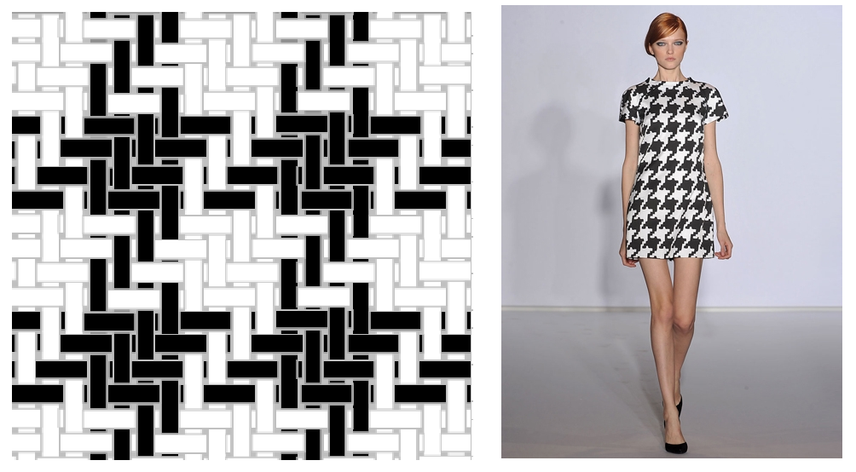
Tesselations (pied de poule)
L.M.G. Feijs, Geometry and computation of houndstooth (pied de poule), accepted for
Mathematics, Music, Art, Architecture, Culture, Proceedings of Bridges 2012.
Pied de poule fabric with two up two down twill (source: wikimedia) and application
(Preen autumn winter 2009) [www.elle.nl=mode=Modetrends=Wintertrend-2009-pied-de-poule]
Notes:
The first processing example shows if/then/else and printing booleans, also the use of the ternairy operator instead of if/then/else
The second processing example is a demo with 4 circles to play around with and demonstrate the first simple things you can do using variables, operators and if/then/else. When opening the sketch, below the actual code (scroll down) are remarks on how to alter the example in a step wise fashion to demonstrate some stuff.

Slide 20
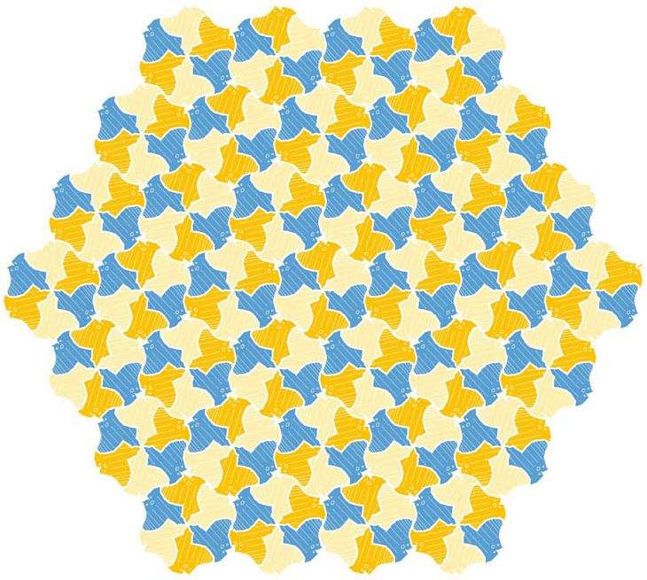
Tesselations (golden ratio course)
Source: Floor Mattheijssen’s manta
Notes:
The first processing example shows if/then/else and printing booleans, also the use of the ternairy operator instead of if/then/else
The second processing example is a demo with 4 circles to play around with and demonstrate the first simple things you can do using variables, operators and if/then/else. When opening the sketch, below the actual code (scroll down) are remarks on how to alter the example in a step wise fashion to demonstrate some stuff.

Slide 21
Tesselations (Mathematical Art galleries)
http://gallery.bridgesmathart.org/exhibitions/2012-bridges-conference/feijs
http://gallery.bridgesmathart.org/exhibitions/2013-bridges-conference/mrhujun
http://gallery.bridgesmathart.org/exhibitions/2013-bridges-conference/feijs
http://gallery.bridgesmathart.org/exhibitions/2014-bridges-conference/feijs
Notes:
The first processing example shows if/then/else and printing booleans, also the use of the ternairy operator instead of if/then/else
The second processing example is a demo with 4 circles to play around with and demonstrate the first simple things you can do using variables, operators and if/then/else. When opening the sketch, below the actual code (scroll down) are remarks on how to alter the example in a step wise fashion to demonstrate some stuff.

Slide 22
Heesch Kienzle theory

Slide 23
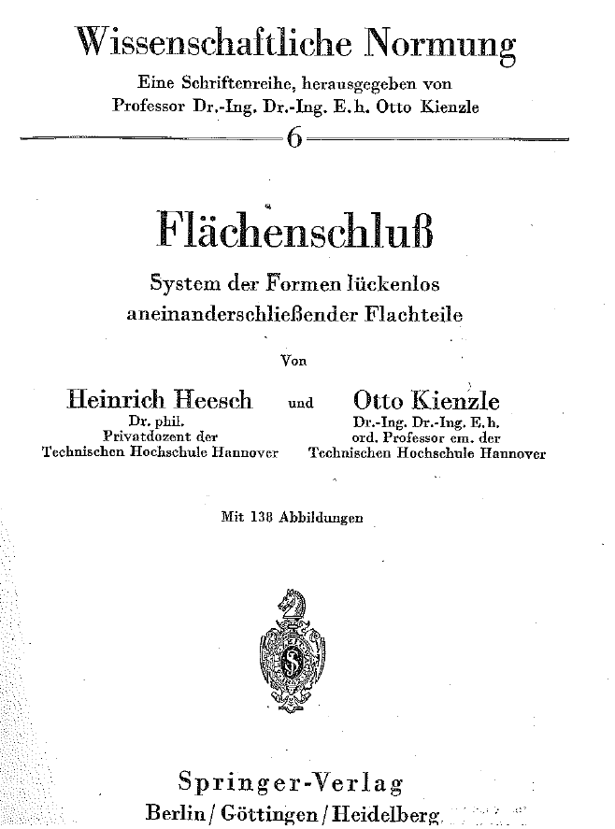
Heesch Kienzle theory
Although there are essentially 17 wallpapers,
there exist essentially 28 different tesselation types
(not only the transformations matter, but also the network topology)
Notes:
The first processing example shows if/then/else and printing booleans, also the use of the ternairy operator instead of if/then/else
The second processing example is a demo with 4 circles to play around with and demonstrate the first simple things you can do using variables, operators and if/then/else. When opening the sketch, below the actual code (scroll down) are remarks on how to alter the example in a step wise fashion to demonstrate some stuff.

Slide 24
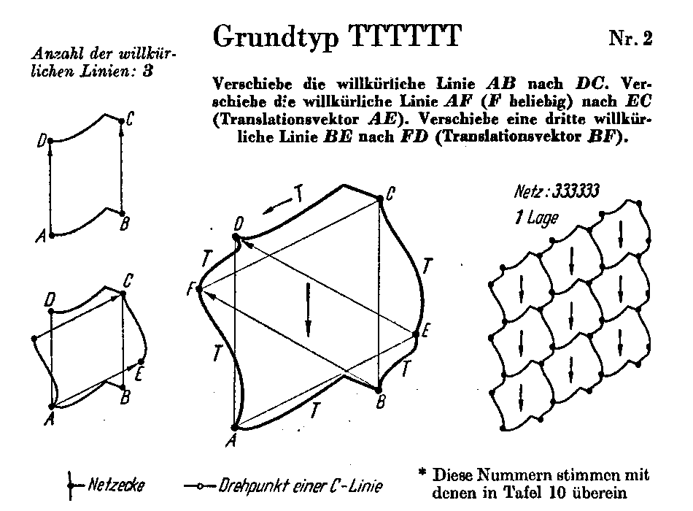
Heesch Kienzle theory
Notes:
The first processing example shows if/then/else and printing booleans, also the use of the ternairy operator instead of if/then/else
The second processing example is a demo with 4 circles to play around with and demonstrate the first simple things you can do using variables, operators and if/then/else. When opening the sketch, below the actual code (scroll down) are remarks on how to alter the example in a step wise fashion to demonstrate some stuff.

Slide 25
Heesch Kienzle theory
Coding scheme:
TT a line and its translated version
C a line having 180º rotation symmetry
C₃C₃ a line and its 120º rotated version
C₄C₄ a line and its 90º rotated version
C₆C₆ a line and its 60º rotated version
G₁G₁ a line and its glide-reflected version
G₂G₂ another line and its glide-reflected version
Notes:
The first processing example shows if/then/else and printing booleans, also the use of the ternairy operator instead of if/then/else
The second processing example is a demo with 4 circles to play around with and demonstrate the first simple things you can do using variables, operators and if/then/else. When opening the sketch, below the actual code (scroll down) are remarks on how to alter the example in a step wise fashion to demonstrate some stuff.

Slide 27
Heesch Kienzle theory (translations)
Verbs:
verschiebe
shift
bringe
bring
führe
draw
Nouns:
Linie
line
Achse
axis
Annschluß
connection
Gerade
Straight (line)
Punkt
point
Abstand
distance
Lage
position
Gleitspiegelung
glide reflection
Propositions etc.:
eine
a, one
nach
to, towards
durch
through, via
auf
at, upon
nicht
not
wobei
whereby, such that
Adjectives:
frei gewählten
freely chosen
willkürliche
arbitrary
weitere
further
dritte
third
gleichen
equal
Notes:
The first processing example shows if/then/else and printing booleans, also the use of the ternairy operator instead of if/then/else
The second processing example is a demo with 4 circles to play around with and demonstrate the first simple things you can do using variables, operators and if/then/else. When opening the sketch, below the actual code (scroll down) are remarks on how to alter the example in a step wise fashion to demonstrate some stuff.

Slide 28
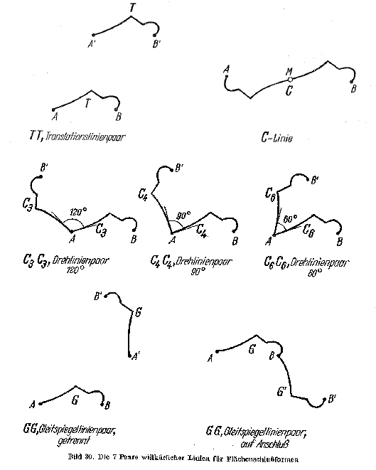

Slide 29
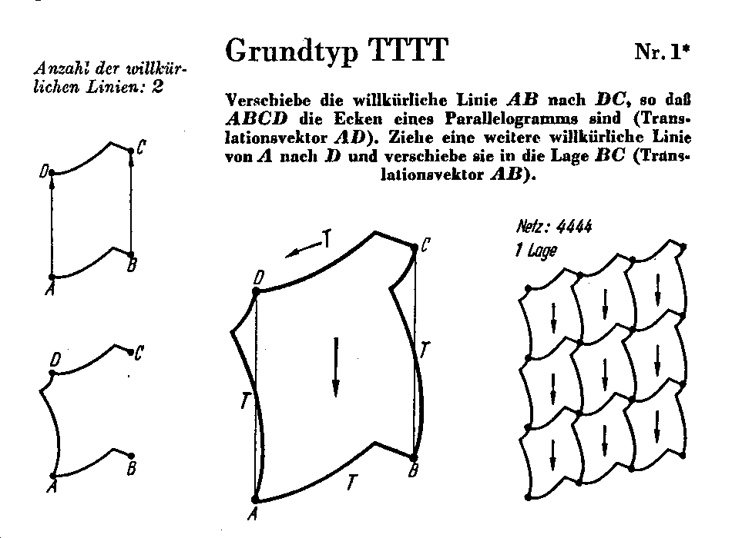

Slide 31
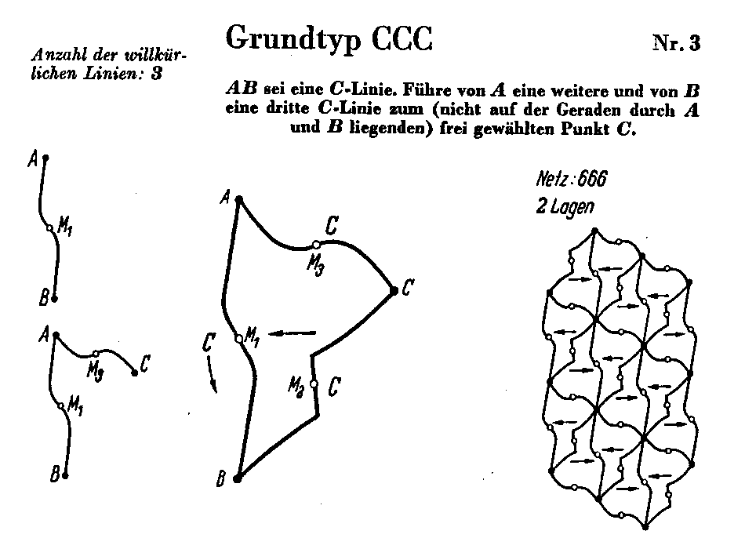
Heesch Kienzle theory
Notes:
The first processing example shows if/then/else and printing booleans, also the use of the ternairy operator instead of if/then/else
The second processing example is a demo with 4 circles to play around with and demonstrate the first simple things you can do using variables, operators and if/then/else. When opening the sketch, below the actual code (scroll down) are remarks on how to alter the example in a step wise fashion to demonstrate some stuff.

Slide 32
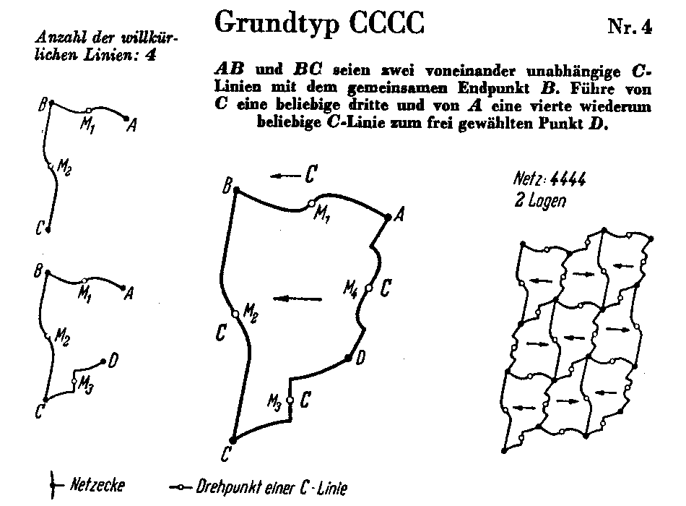

Slide 33
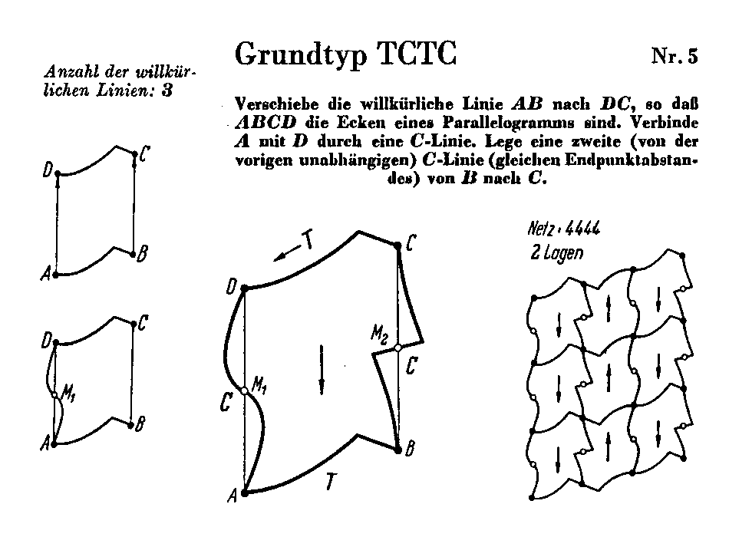

Slide 34
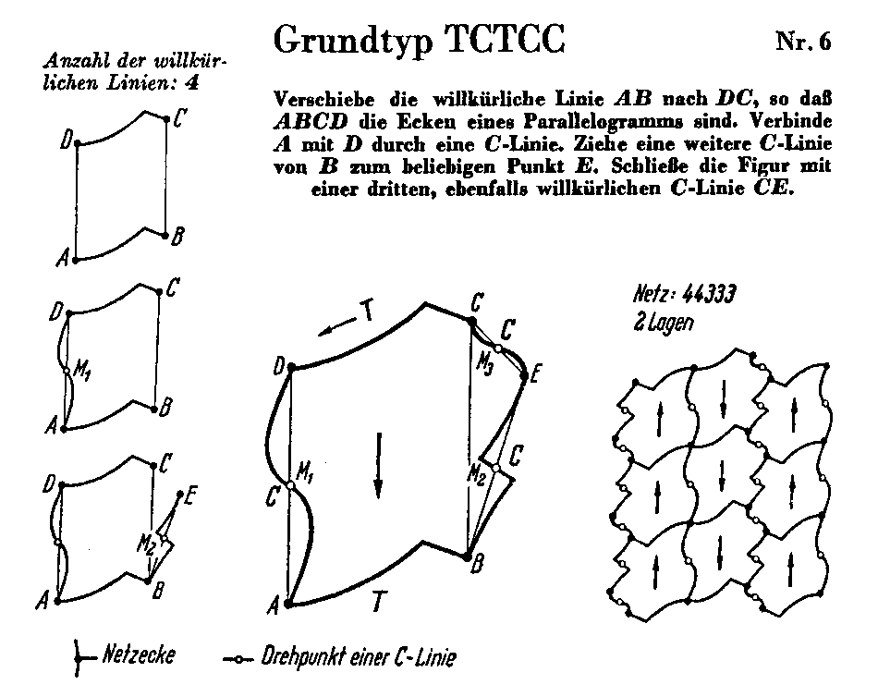
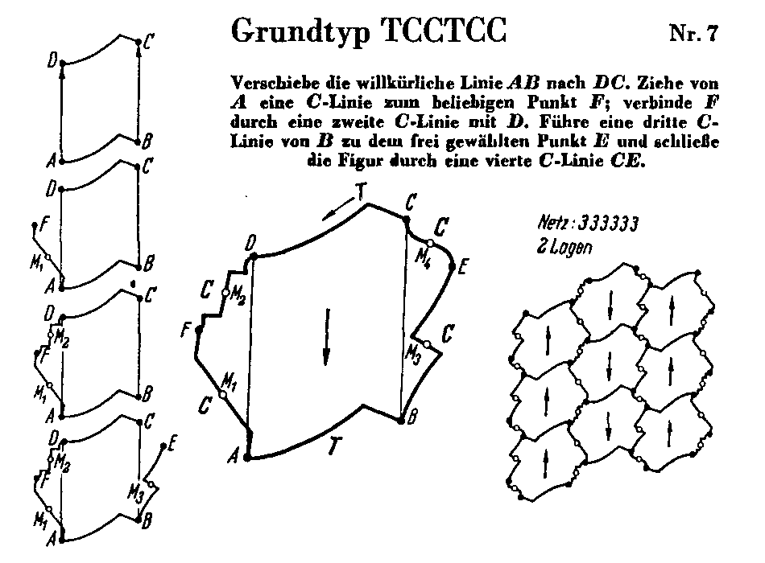

Slide 35
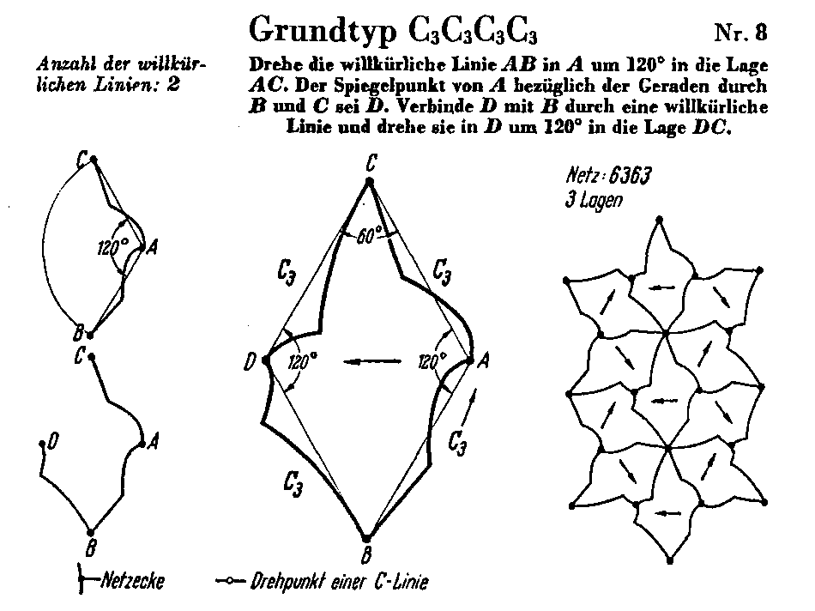
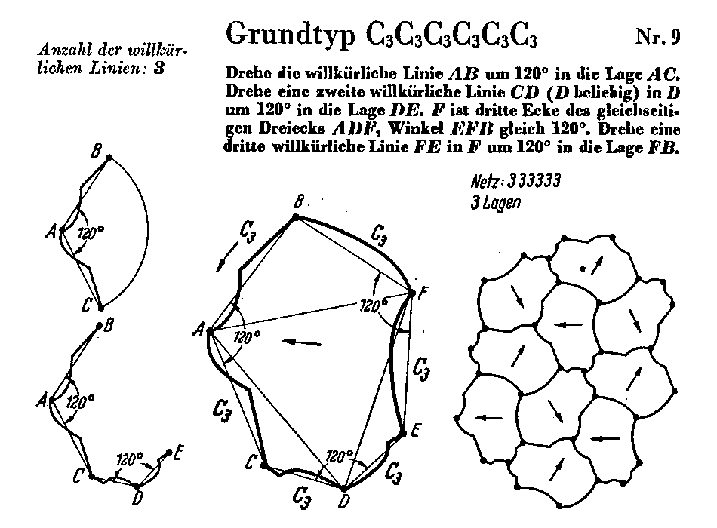

Slide 36
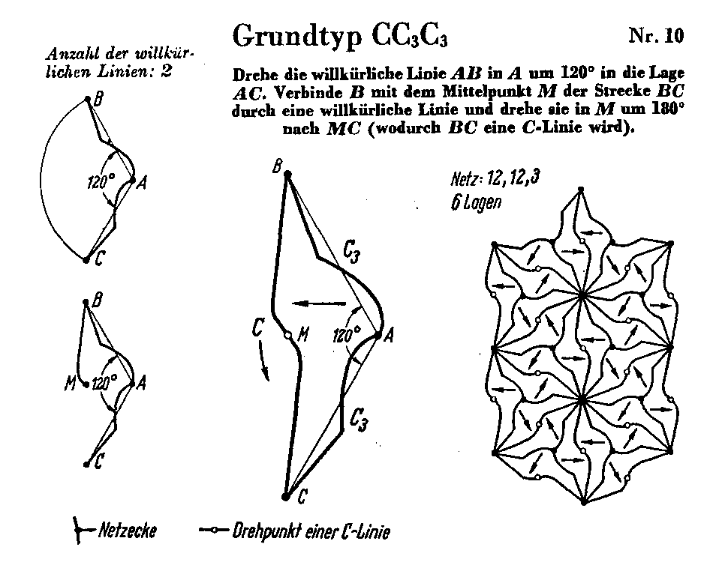

Slide 37
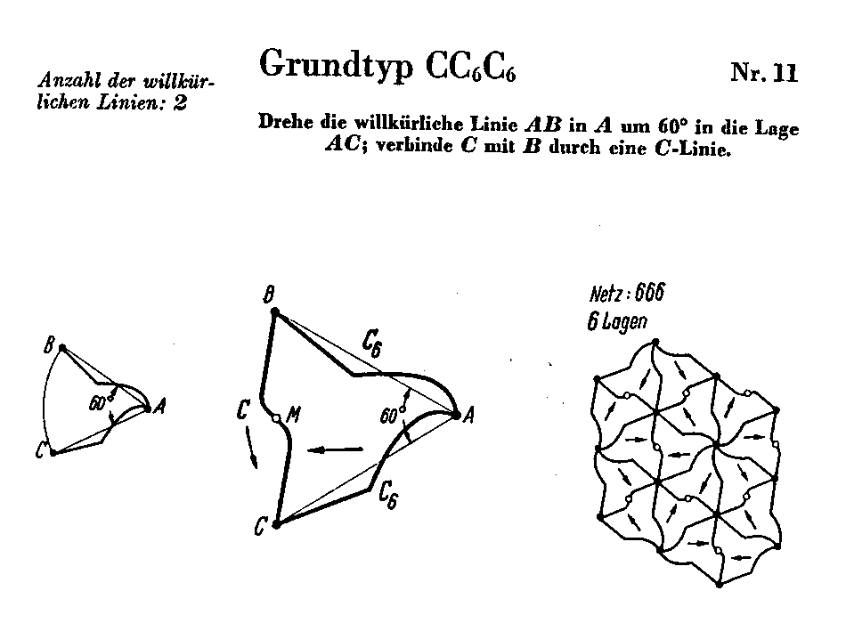

Slide 39
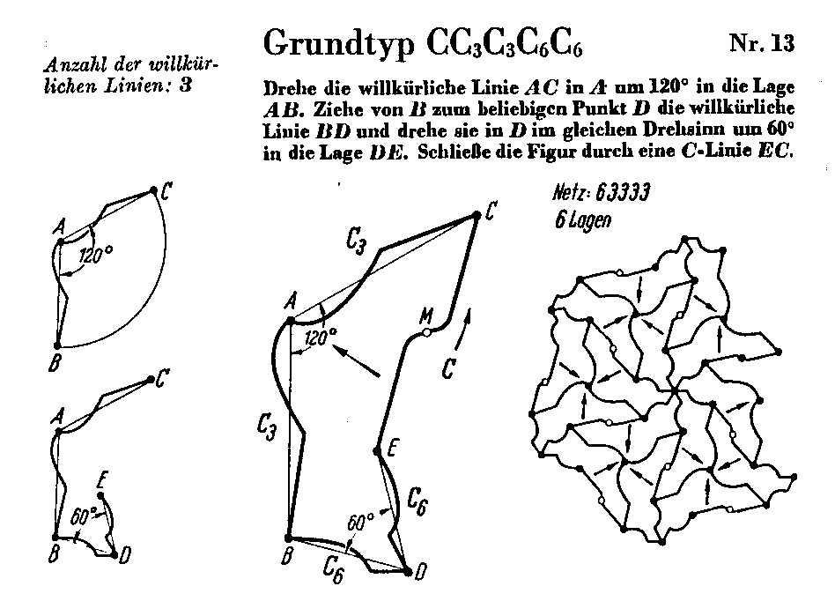

Slide 40
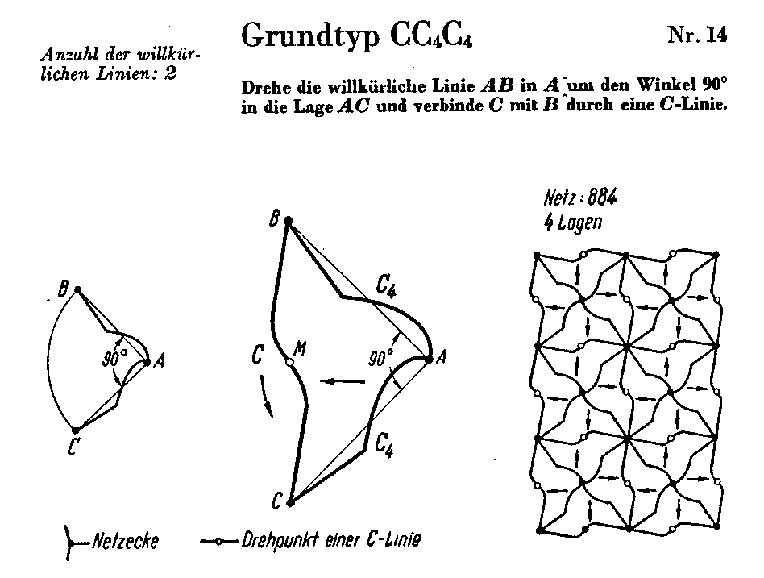

Slide 41
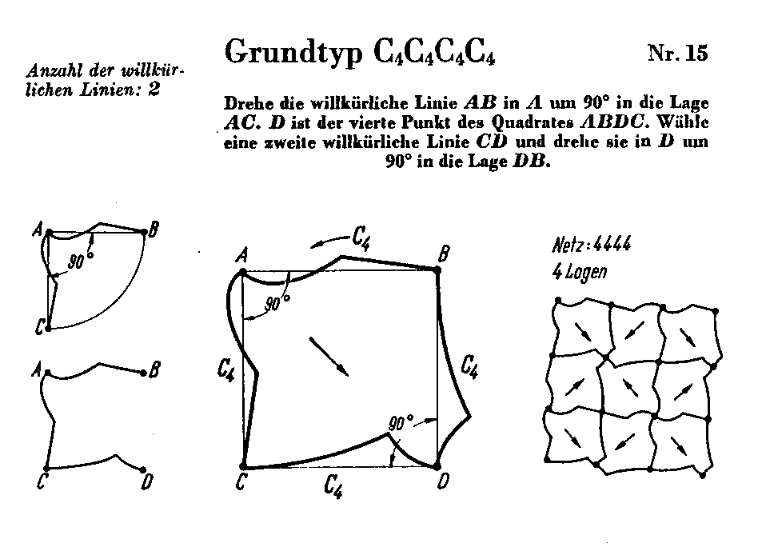

Slide 42
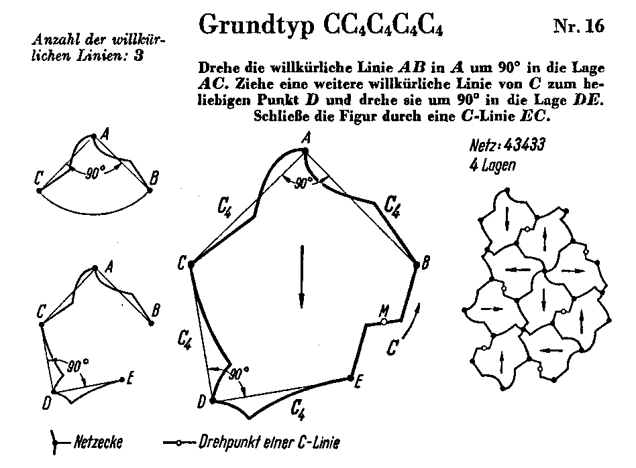

Slide 43
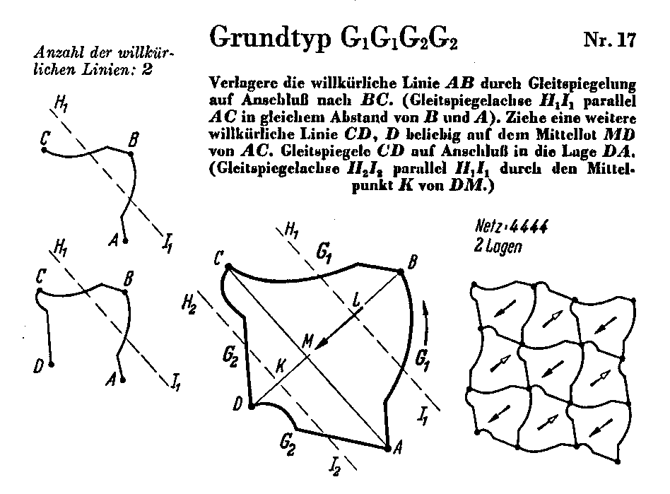

Slide 44
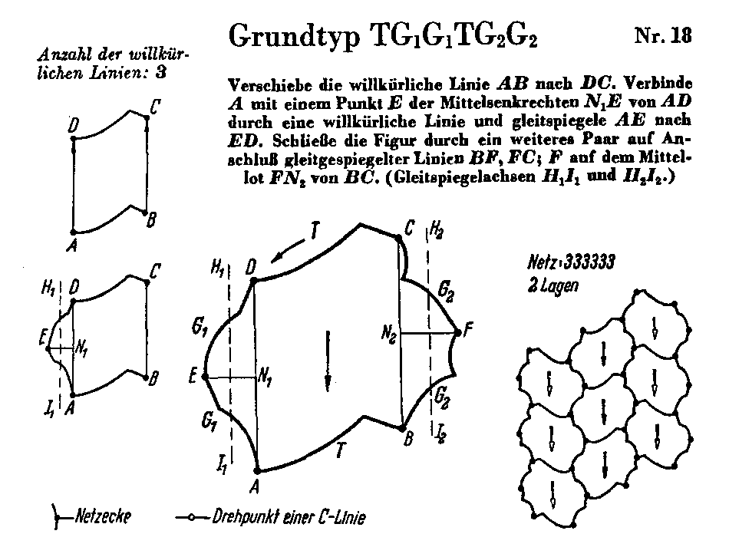

Slide 45
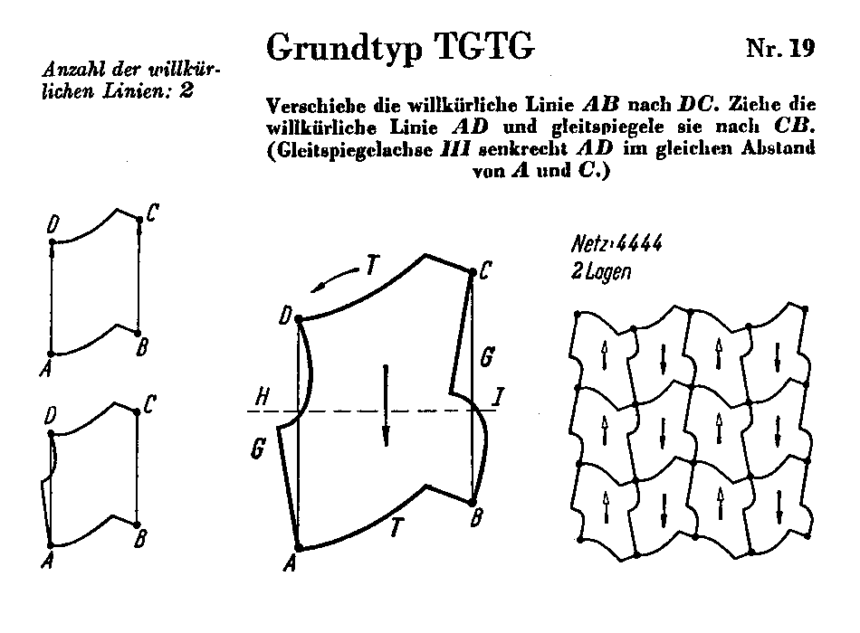

Slide 46
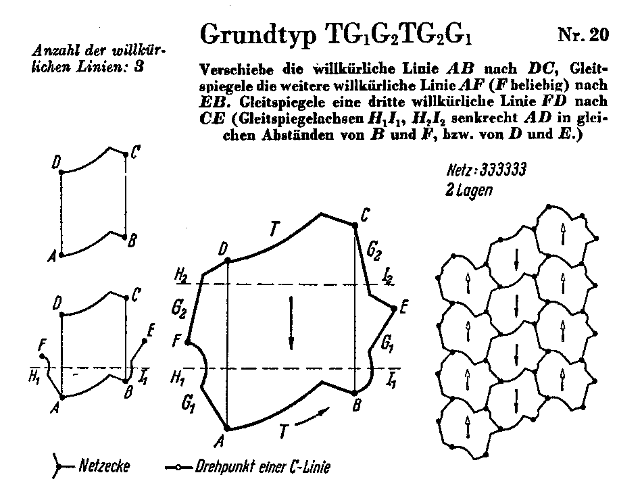

Slide 47
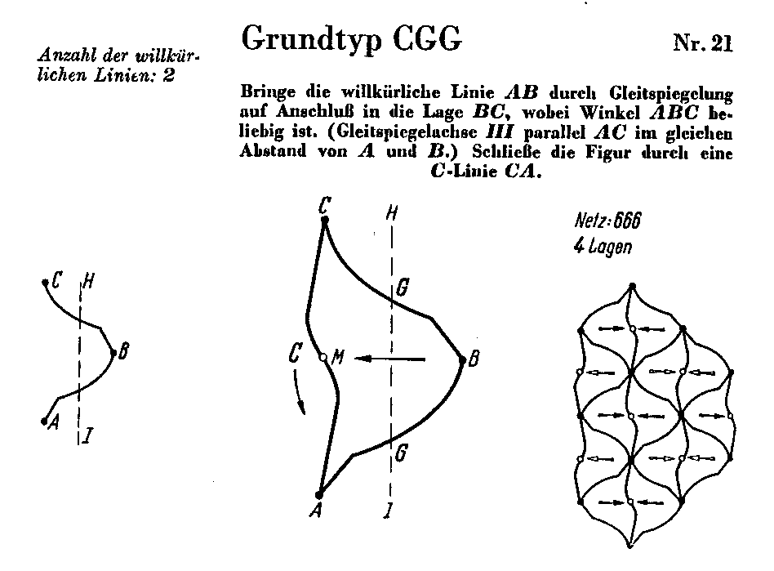
Heesch Kienzle theory
Notes:
The first processing example shows if/then/else and printing booleans, also the use of the ternairy operator instead of if/then/else
The second processing example is a demo with 4 circles to play around with and demonstrate the first simple things you can do using variables, operators and if/then/else. When opening the sketch, below the actual code (scroll down) are remarks on how to alter the example in a step wise fashion to demonstrate some stuff.

Slide 48
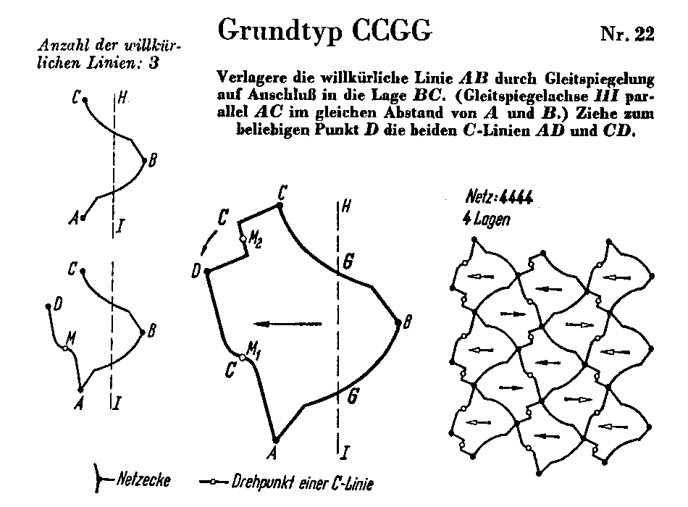

Slide 49
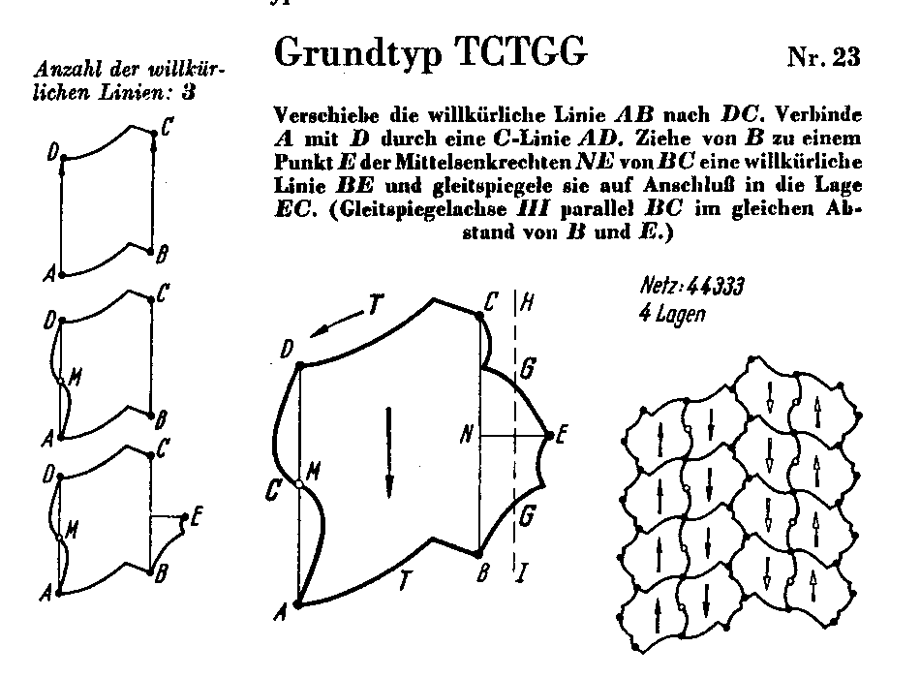

Slide 50
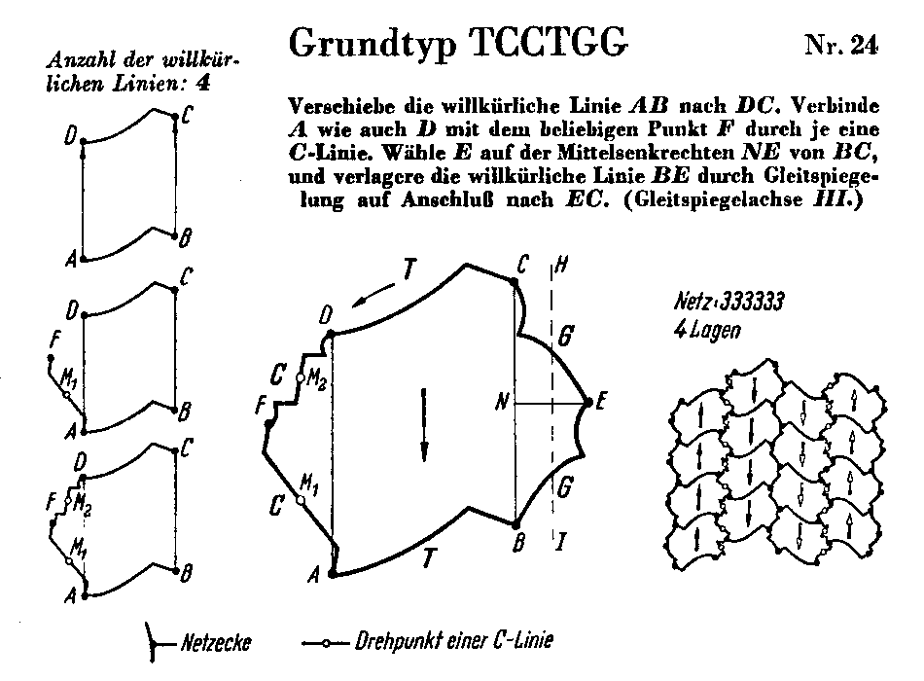

Slide 51
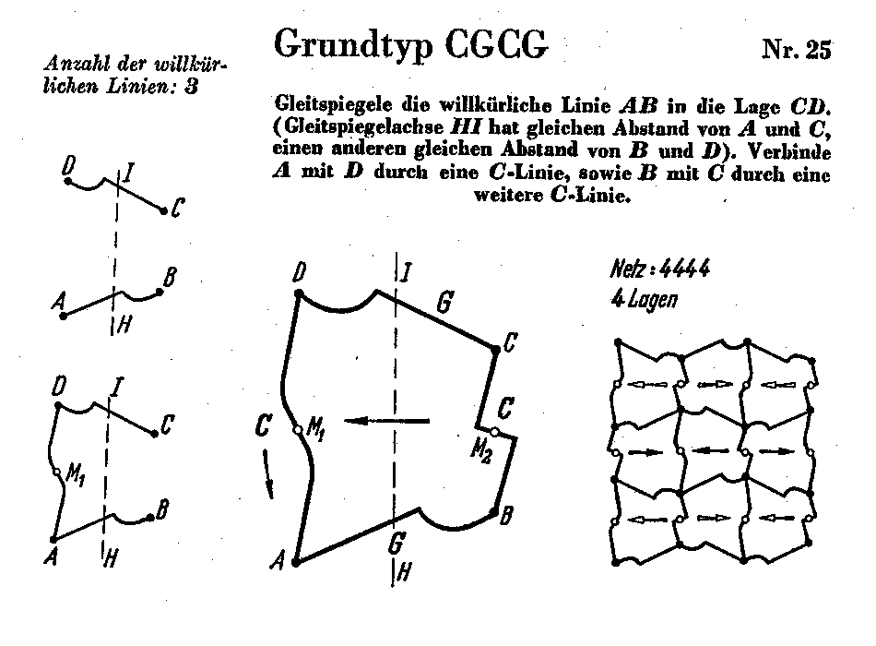

Slide 52
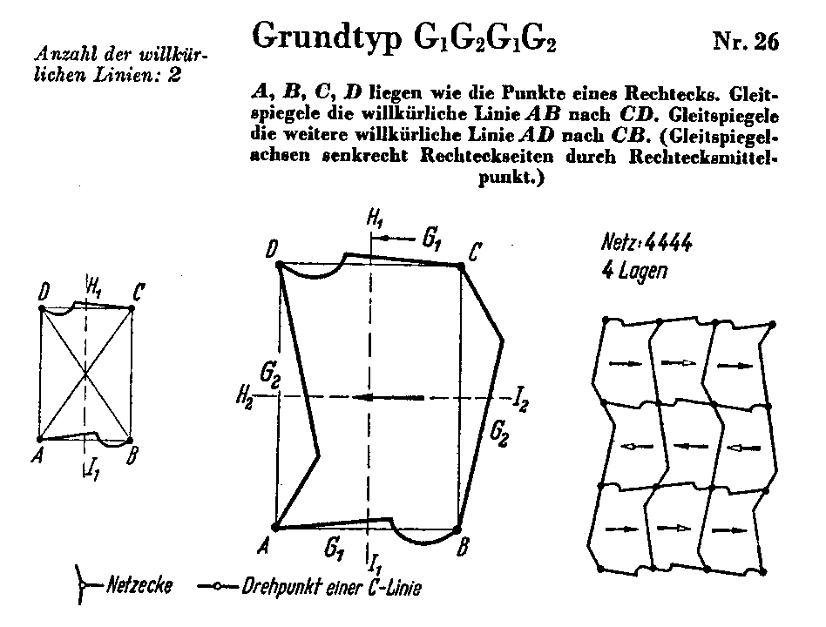

Slide 53
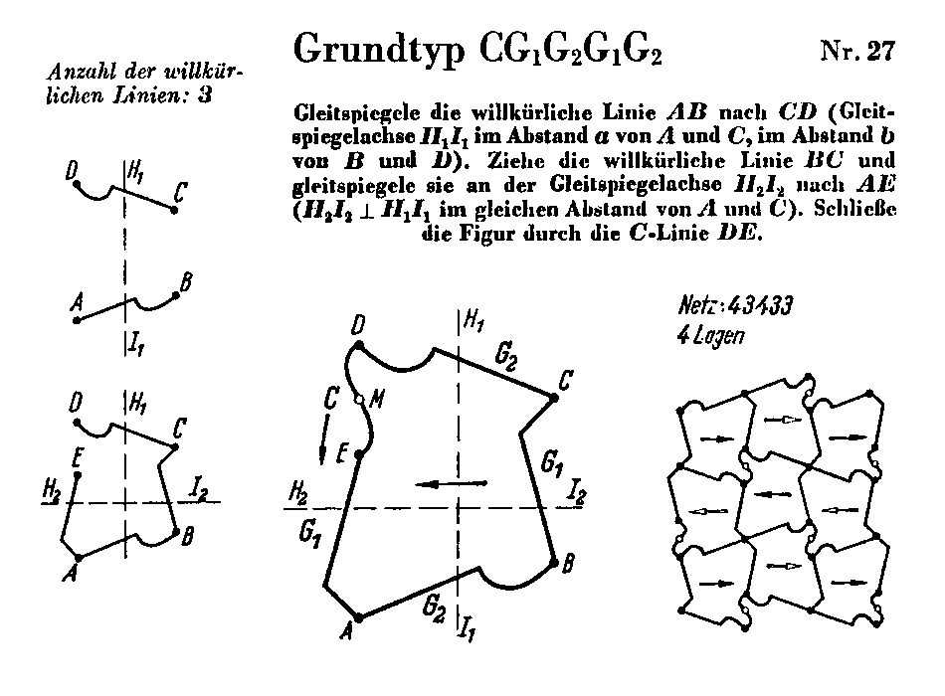

Slide 55
Heesch Kienzle in Processing

Slide 56
Heesch Kienzle in Processing
How to rotate something over θ around the origin O
Working with the turtle
prefix the turtle program with t.left(θ);
Working with coordinates (x,y)
multiply them by the matrix
Changing Processing’s coordinate system
pushMatrix(); rotate(θ);
preferred
Notes:
The first processing example shows if/then/else and printing booleans, also the use of the ternairy operator instead of if/then/else
The second processing example is a demo with 4 circles to play around with and demonstrate the first simple things you can do using variables, operators and if/then/else. When opening the sketch, below the actual code (scroll down) are remarks on how to alter the example in a step wise fashion to demonstrate some stuff.

Slide 57
Heesch Kienzle in Processing
How to translate something over vector v
Working with the turtle
prefix the turtle program with t.left(θ); t.forward(d); t.right(θ);
where θ is the direction of the vector and d its length
Working with coordinates (x,y)
by addition to get (x+x_{v}, y+y_{v})
Changing Processing’s coordinate system
pushMatrix(); translate(x_{v}, y_{v});
preferred
Notes:
The first processing example shows if/then/else and printing booleans, also the use of the ternairy operator instead of if/then/else
The second processing example is a demo with 4 circles to play around with and demonstrate the first simple things you can do using variables, operators and if/then/else. When opening the sketch, below the actual code (scroll down) are remarks on how to alter the example in a step wise fashion to demonstrate some stuff.

Slide 58
Heesch Kienzle in Processing
How to rotate something over θ around a point P
Working with the turtle
prefix the turtle program with:
turn towards P and move forward to it
t.left(θ);
move the same distance back and turn back over the same angle
Working with coordinates (x,y)
translate over –OP
rotate as usual
translate over OP
Changing Processing’s coordinate system
like when working with coordinates
Notes:
The first processing example shows if/then/else and printing booleans, also the use of the ternairy operator instead of if/then/else
The second processing example is a demo with 4 circles to play around with and demonstrate the first simple things you can do using variables, operators and if/then/else. When opening the sketch, below the actual code (scroll down) are remarks on how to alter the example in a step wise fashion to demonstrate some stuff.

Slide 59
Heesch Kienzle in Processing
How to reflect something over a line
Working with the turtle
run the modified turtle program with left := right and right := left
if the line is through the turtle’s position and along its direction
Working with coordinates (x,y)
multiply the y coordinate by -1
if the line happens to be the horizontal (x) axis
Changing Processing’s coordinate system
Align the coordnite system with the line
Use scale();
Notes:
The first processing example shows if/then/else and printing booleans, also the use of the ternairy operator instead of if/then/else
The second processing example is a demo with 4 circles to play around with and demonstrate the first simple things you can do using variables, operators and if/then/else. When opening the sketch, below the actual code (scroll down) are remarks on how to alter the example in a step wise fashion to demonstrate some stuff.

Slide 60
Heesch Kienzle in Processing
Notes:
The first processing example shows if/then/else and printing booleans, also the use of the ternairy operator instead of if/then/else
The second processing example is a demo with 4 circles to play around with and demonstrate the first simple things you can do using variables, operators and if/then/else. When opening the sketch, below the actual code (scroll down) are remarks on how to alter the example in a step wise fashion to demonstrate some stuff.

Slide 61
Heesch Kienzle in Processing
Notes:
The first processing example shows if/then/else and printing booleans, also the use of the ternairy operator instead of if/then/else
The second processing example is a demo with 4 circles to play around with and demonstrate the first simple things you can do using variables, operators and if/then/else. When opening the sketch, below the actual code (scroll down) are remarks on how to alter the example in a step wise fashion to demonstrate some stuff.

