Slide 1
Golden ratio: Splines Theory
Loe Feijs

Slide 2
Content
Catmull-Rom splines
Bezier curves

Slide 3
Catmull-Rom splines

Slide 4
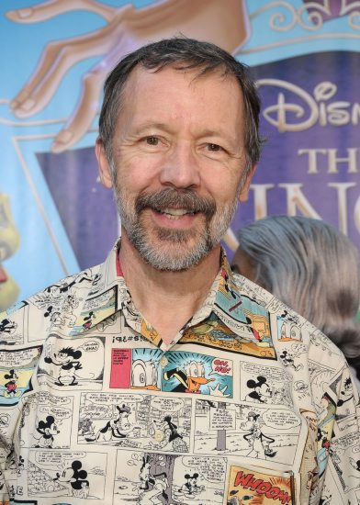
Background
Ed Catmull founded Pixar
interpolated motion
Ed Catmull , R.J. Rom, A class of local interpolating splines, In: R.E. Barnhill, R.F. Riesenfeld (Eds.), Computer Aided Geometric Design, AcademicPress, Orlando (1974), pp. 317–326
Source: “innerview”, The NETworker, Vol 8, Nr 1, Sept/oct 1997.
Notes:
Naming is not strict, start lowercase, capitalize word-parts
Mind the case of names. That goes for variables, but also for all other names like function names, method names, class names etc…

Slide 5
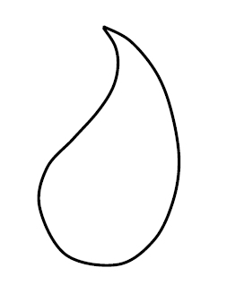
Catmull-Rom spline in Processing
void innerleaf(int x, int y, float s){
beginShape();
curveVertex(x + s*177.0 , y + s*287.0);
curveVertex(x + s*177.0 , y + s*287.0);
curveVertex(x + s*205.0 , y + s*270.0);
curveVertex(x + s*249.0 , y + s*263.0);
curveVertex(x + s*293.0 , y + s*270.0);
curveVertex(x + s*342.0 , y + s*289.0);
curveVertex(x + s*378.0 , y + s*318.0);
// more
curveVertex(x + s*253.0 , y + s*339.0);
curveVertex(x + s*239.0 , y + s*312.0);
curveVertex(x + s*221.0 , y + s*295.0);
curveVertex(x + s*201.0 , y + s*287.0);
curveVertex(x + s*178.0 , y + s*288.0);
curveVertex(x + s*178.0 , y + s*288.0);
endShape();
}
From example Paisley.pde, partially generated by paisleyMaker.pde

Slide 6
Properties
four control points define one segment
between P₁ and P₂ parameter t runs from 0 to 1
the point P(t) is a weighted average of P₀,P₁,P₂,P₃
P = ½ (-t+2t²-t³)P₀ + ½ (2-5t²+3t³)P₁ + ½ (t+4t²-3t³)P₂ + ½(-t²+t³)P₃
the line goes through P₁ and P₂
the tangent at P₁ parallels the line P₀- P₂
the tangent at P₂ parallels the line P₁- P₃
P₁
P₃
P₀
P₂
Read more at www.mvps.org/directx/articles/catmull/
Notes:
Object Reference variables will be dealt with in OOP lateron
Available simple types are determined by the language
Variable names can be freely chosen, give meaningful names!
Assigning a value in the variable declaration is optional… but…it is good practice to initialize variables

Slide 7
Bézier curves

Slide 8
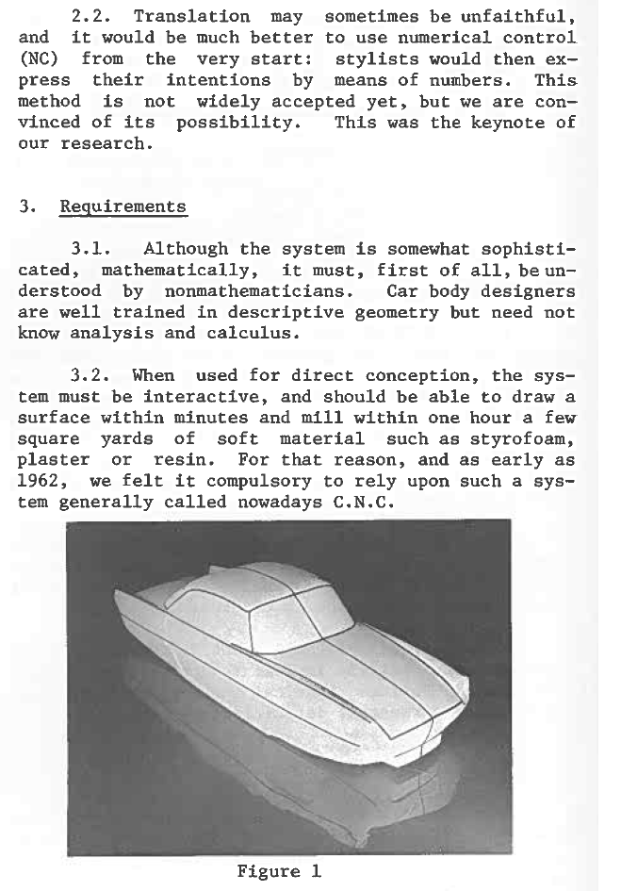
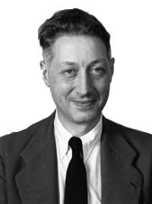
Background
Pierre Bézier (1910-1999), working at Renault, Paris in 1962
Paul de Casteljau (1930-1999) at Citroen already found the rendering algorithm in 1959
Mathematical and practical possibilities of Unisurf, In: R.E. Barnhill, R.F. Riesenfeld (Eds.), Computer Aided Geometric Design, AcademicPress, Orlando (1974), pp. 127 – 152.
Source: “innerview”, The NETworker, Vol 8, Nr 1, Sept/oct 1997.
Source: vision paper p.128
Notes:
Naming is not strict, start lowercase, capitalize word-parts
Mind the case of names. That goes for variables, but also for all other names like function names, method names, class names etc…

Slide 9
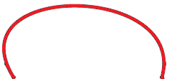
Properties
one segment defined by N ≥ 2 points
between P₀ and P_{N-1}, the parameter t runs from 0 to 1
the point P(t) is a weighted average of P₀,P₁,P₂, … P_{N-1}
e.g. P = (1- t)³P₀ + 3t(1- t)²P₁ + 3t²(1- t)P₂ + t³P₃
the tangent at P₀ is the line P₀ - P₁
the tangent at P_{N-1} is the line P_{N-2}- P_{N-1}
the line does not go not through P₁ … P_{N-2}
the line is inside the convex hull of P₀,P₁,P₂, … P_{N-1}
P₁
P₂
P₀
P₃
Read more at http://www.tsplines.com/resources/class_notes/Bezier_curves.pdf
Notes:
Object Reference variables will be dealt with in OOP lateron
Available simple types are determined by the language
Variable names can be freely chosen, give meaningful names!
Assigning a value in the variable declaration is optional… but…it is good practice to initialize variables

Slide 10
Properties
think of t as a percentage of a path
e.g. having taken 30% of the path from P₀ to P₁
and similarly the paths from P₁ to P₂ and from P₂ to P₃
which defines new interpolating points
and new paths between these
again assumed 30% taken
and so on
P₂
P₁
P₀
P₃
Tip: animation at www.aac.bartlett.ucl.ac.uk/processing/samples/decasteljau.html
Notes:
Object Reference variables will be dealt with in OOP lateron
Available simple types are determined by the language
Variable names can be freely chosen, give meaningful names!
Assigning a value in the variable declaration is optional… but…it is good practice to initialize variables

Slide 11
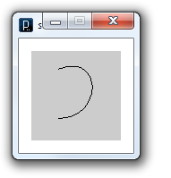
Bézier curve in Processing
noFill();
beginShape();
vertex(30, 20);
bezierVertex(80, 0, 80, 75, 30, 75);
endShape();
bezierVertex() adds one a new segment
each call sets 2 control points + 1 anchor point
preface call to vertex() to set the first anchor point
each set of four control points defines one segment
Fram example Paisley.pde, partially generated by paisleyMaker.pde

Slide 12
Exercises:
make your own capturing tool generating curveVertex code
make an interactive Catmull Rom demo (using the formula)
or: make an interactive Bézier demo (using the given formula)
or even better: find the formula for Bézier curves with three control points and make an interactive Bézier demo (using the new formula)

