Slide 1
CREATIVE PROGRAMMING
Lecture 6: Use Of Resources
DBB210 team,
today: Loe Feijs
Department of Industrial Design TU/e, Eindhoven

Slide 2
Overview of todays lecture
Use of resources
libraries
examples
communities
open source software
patents, models, trademarks
copyright
comment
reference
publication
documentation
acknowledgement
code of scientific conduct
RE-USE
IS
GOOD
RE-USE IS GOOD
BUT YOU MUST OBEY THE CODE OF SCIENTIFIC CONDUCT
CONDUCT
BUT
YOU
MUST
SCIENTIFIC
THE
CODE OF
OBEY

Slide 3
Libraries
Several types of libraries:
Libraries already distributed with Procesing
PDF Export, Network, Serial, and DXF Export
Video and Sound libraries
Video, minim, Sound
Contributed libraries
Jmyron, ControlP5, HPGL, [more]
Libraries that need manual installation
Mesh, [more]
Processing 3.x
Processing 2.x
Source: processing.org/reference/libraries/ (downloaded 14-9-2015)

Slide 4
aka “My Documents”
for example “myPacMan”
always “libraries”
Documents
Processing
your sketch folders
libraries
theLibrary
examples
library
theLibrary.jar
reference
src
for example “HPGL”
always “library”
for example “HPGL.jar”
content of theLibrary.zip
Source of folder hierarchy example: https://github.com/processing/processing/wiki/How-to-Install-a-Contributed-Library

Slide 5
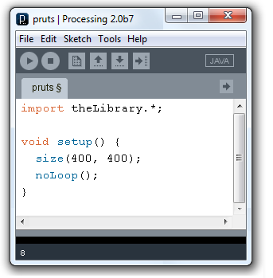
library
theLibrary.jar
reference
src
010000110010001111000100001111101011111100100111
(jar = java archive file)
zip
class theLibrary {
int x = 1234567;
void hoelahoep(){
x++;
}
}
50 4B 03 04 0A 00 00 00 00 00 33 74 7B 3D 00 00 00 00 00 00 00 00 00 00 00 00 09 00 04 00 4D 45 54 41 2D
Java compiler
(source code)
(byte code)

Slide 6
Libraries
Advantages of using a library:
enjoy ready-made useful functions
well-documented and tested by others
with lots of examples and suggestions
without temptations to modify the source code
without need to decipher other people’s source code

Slide 7
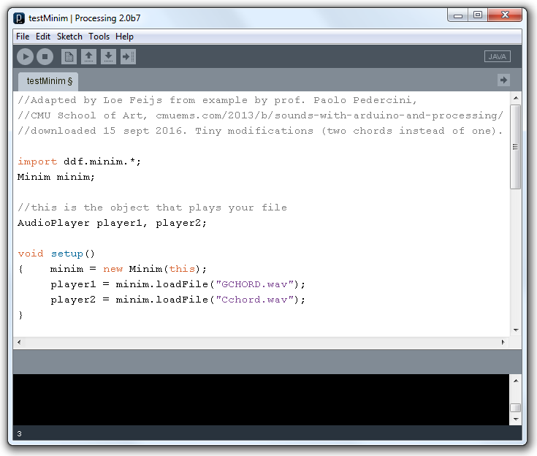

Slide 8
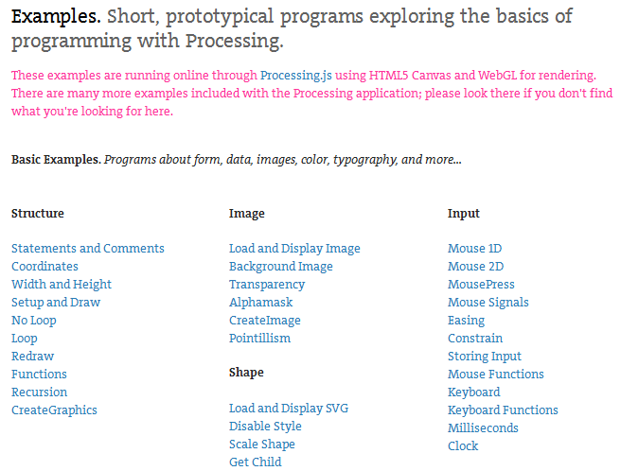
Examples (1)
https://processing.org/examples/ (one for each language feature of Processing)

Slide 9
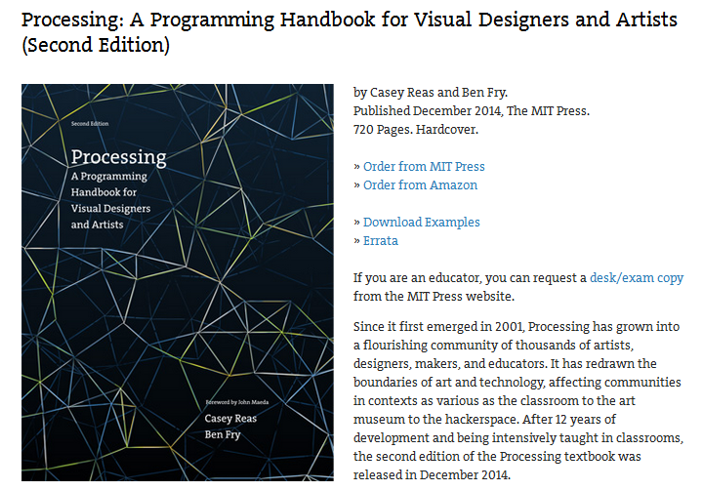
Examples (2)
https://processing.org/handbook/ (drawing, simulation, visualisation, typography etc.)
download
unzip

Slide 10
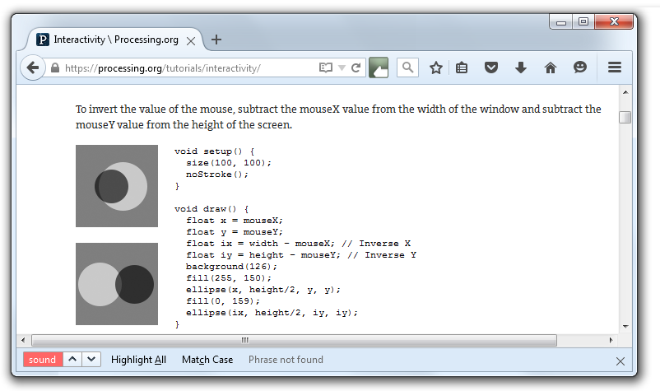
Examples (3)
https://processing.org/tutorials/interactivity/ (for example the Interactivity chapter)

Slide 11
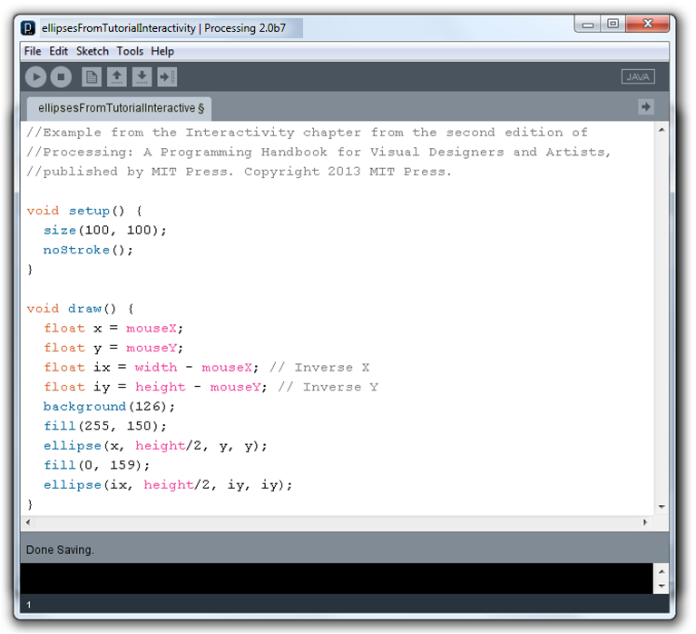

Slide 12
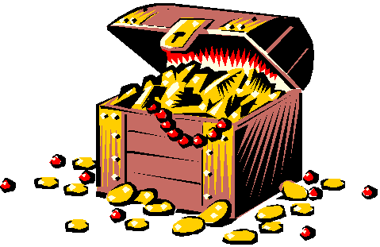
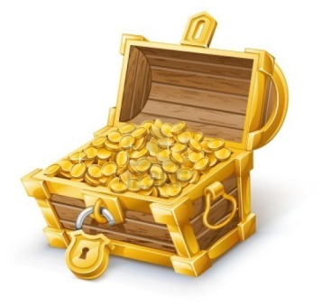
Communities
question
same question again
forum.processing.org
openprocessing.org
answers
immediate answer
experience
projects
need inspiration
code
code
projects
learning

Slide 13
Communities

Slide 14
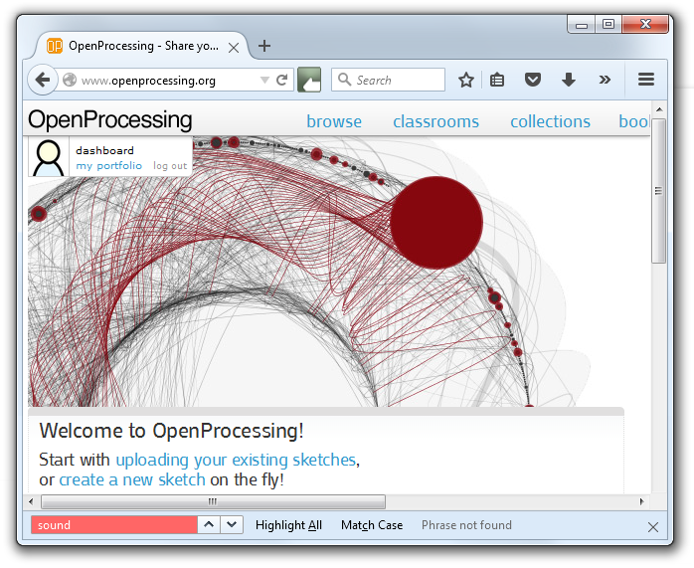

Slide 15
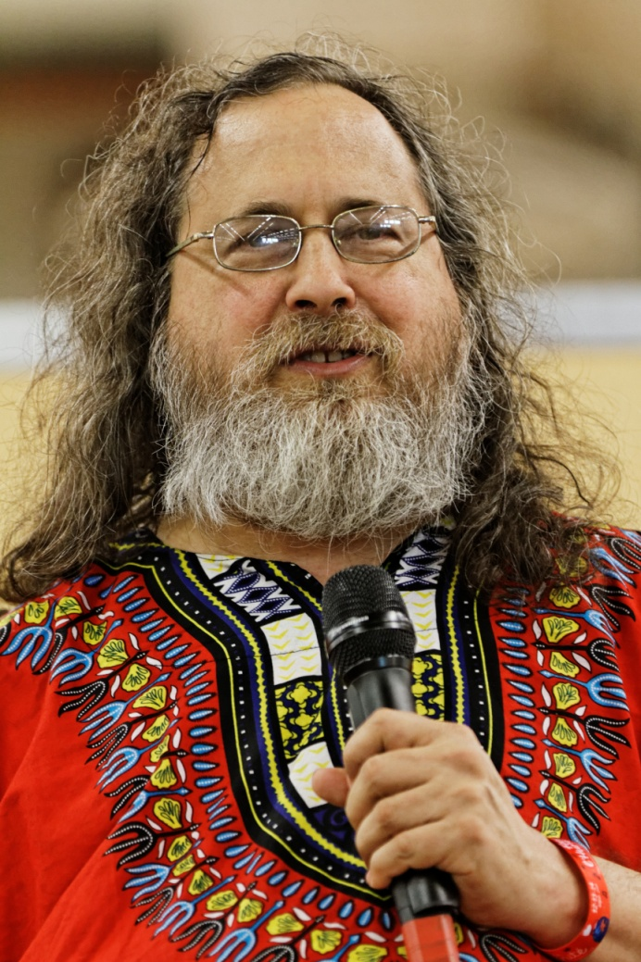
Open source software
ORIGINS:
Richard Stallman
GNU Project 1983
Manifesto 1984
League for Programming Freedom (1989)
GNU General Public Licence Version 3 (2007)
GNU is Not Unix
Photo: Richard Stallman Fête de l'Humanité 2014, Photographer Thesupermat, licensed under the Creative Commons Attribution-Share Alike 3.0 Unported license.

Slide 16
Open source software
NOWADAYS:
GNU General Public License (GNU GPL)
MIT licence (simple, permissive)
Apache licence (also copes with patents)
Creative Commons (also for non-code)
Github (only repository, choose licence type)
Open Source Initiative (definitions and approval for open source licences)

Slide 17
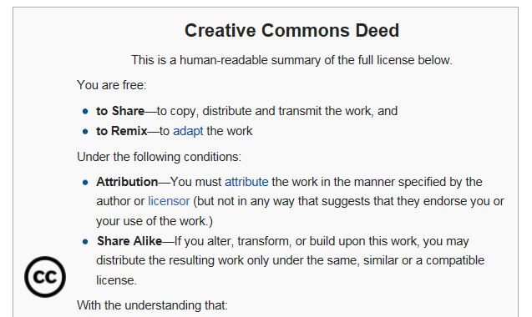
Open source software
Etc. etc.
Source: https://en.wikipedia.org/wiki/Wikipedia:Text_of_Creative_Commons_Attribution-ShareAlike_3.0_Unported_License (downloaded 15 sept 2015)

Slide 18
Patents, models, trademarks
Patent
describes technical invention
inventors
owner
regions
fees
expiration
Model
describes form in two or three dimensions
designer, owner, regions, fees, expiration
Trademark
distinguishable sign for business’ good or service
owner, regions, fees, expiration
can ask licence fee, and prosecute infringement
after that it is free, and can be used by all of mankind

Slide 19
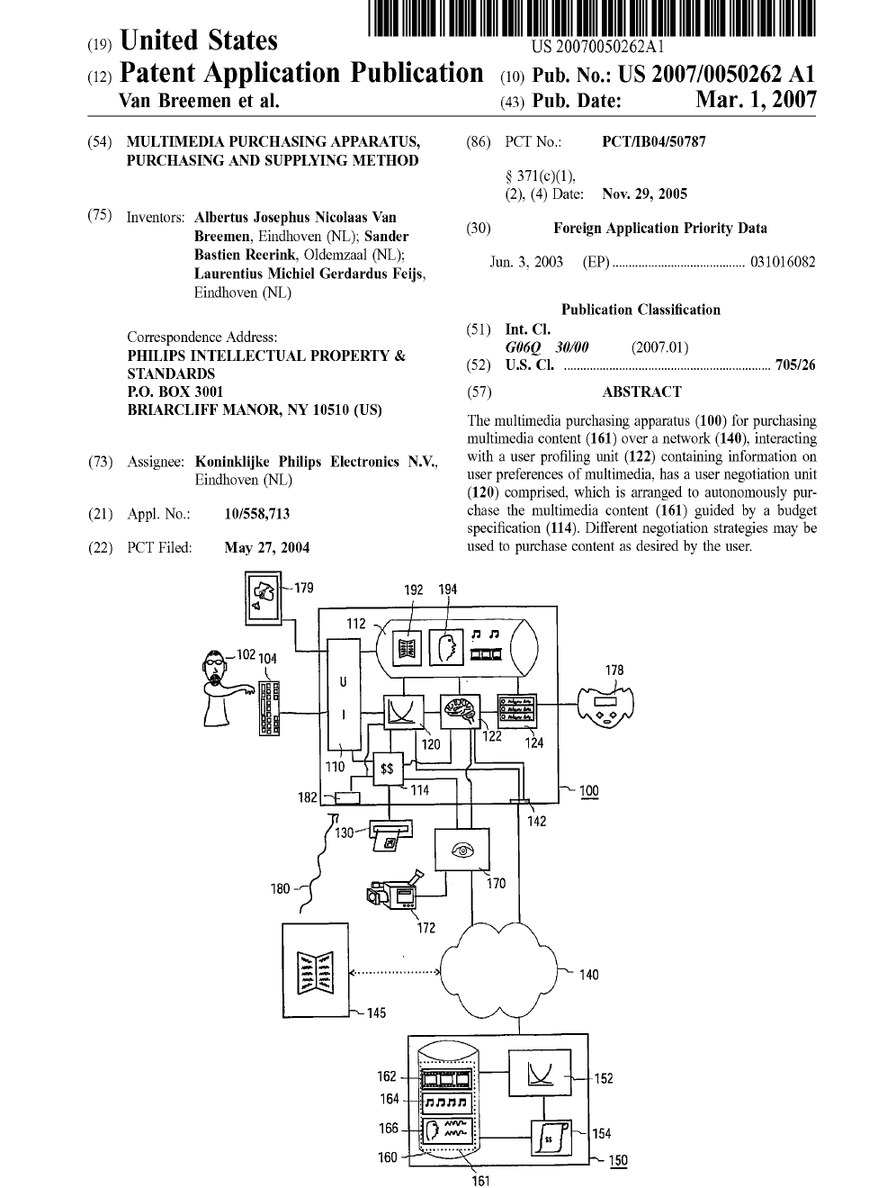
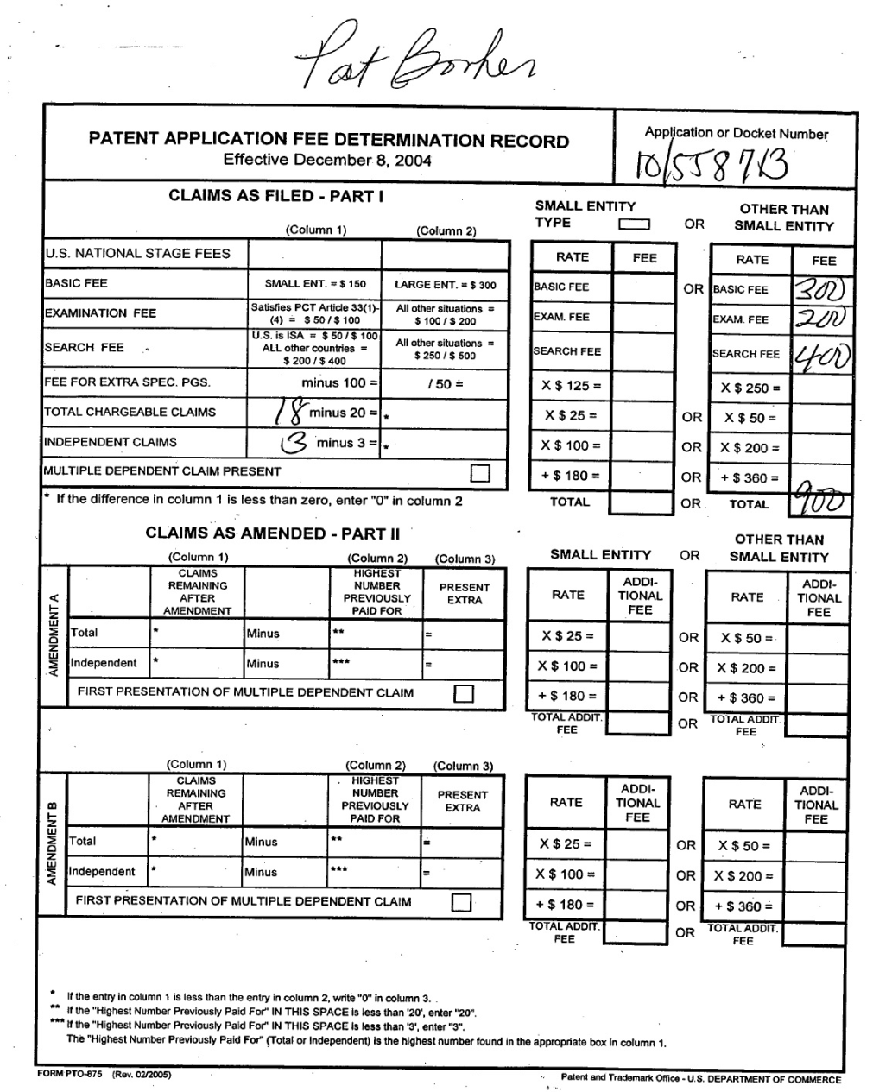
Patents, models, trademarks
Source: Espacenet (Rijksdienst voor Ondernemend Nederland)

Slide 20
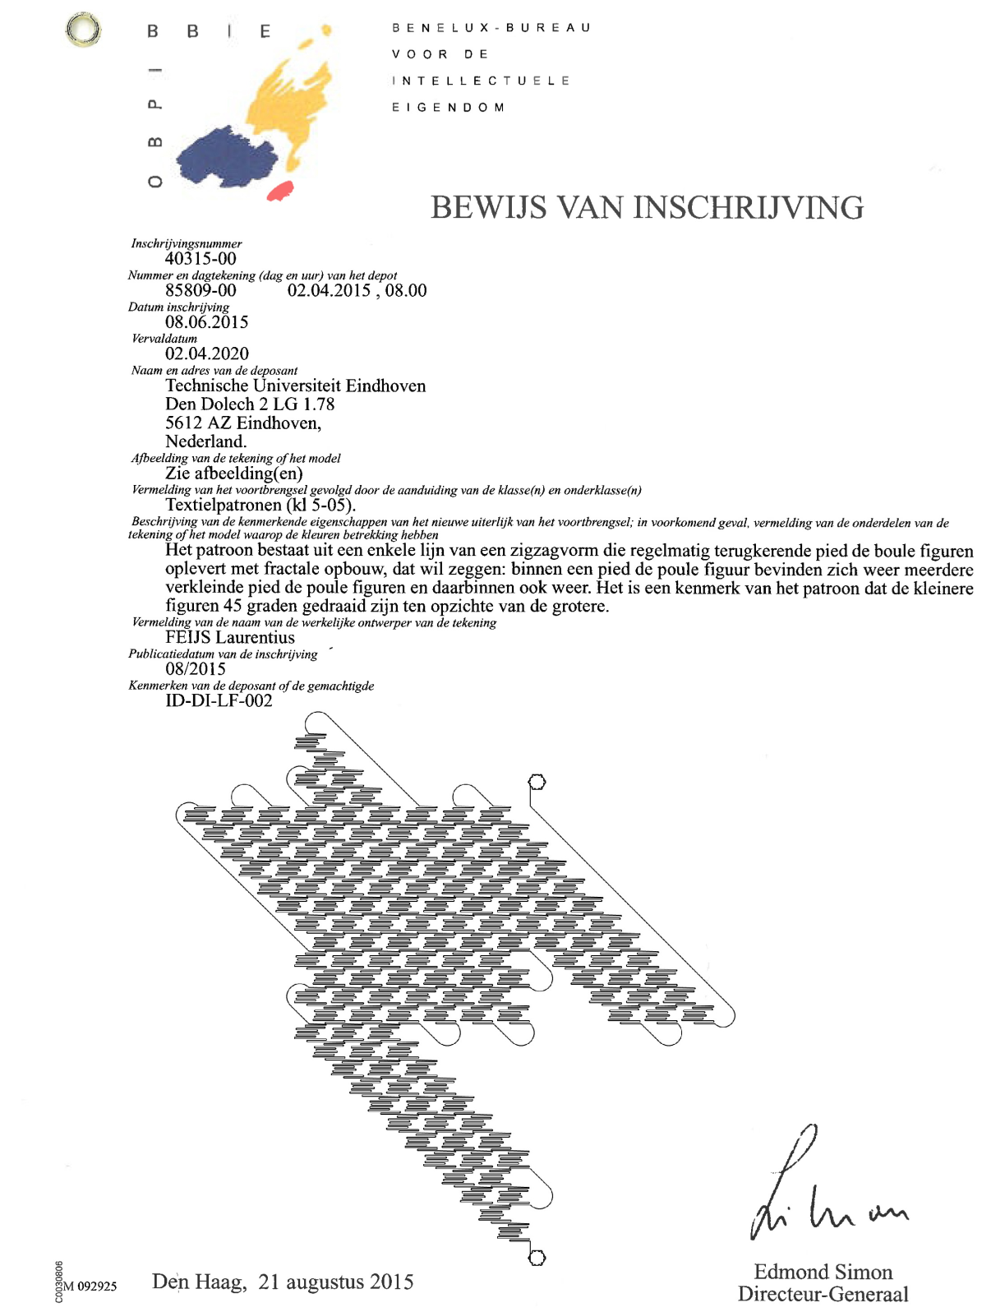
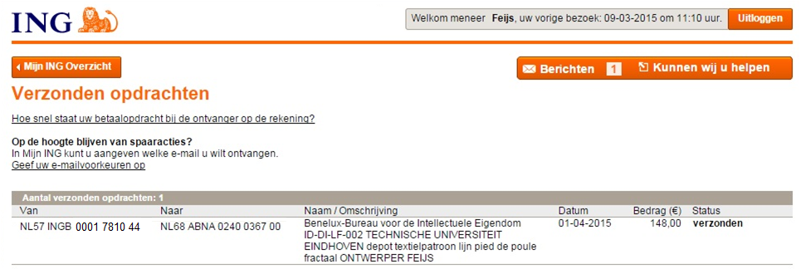
Patents, models, trademarks

Slide 21
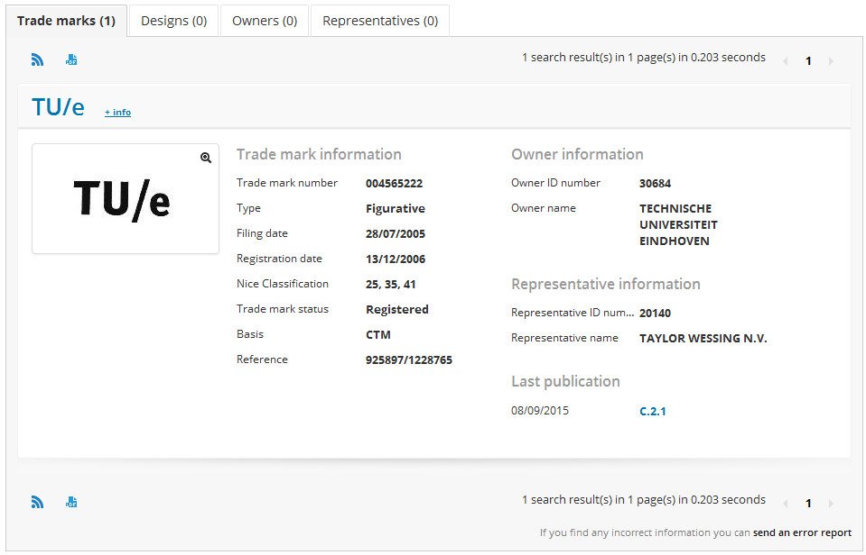
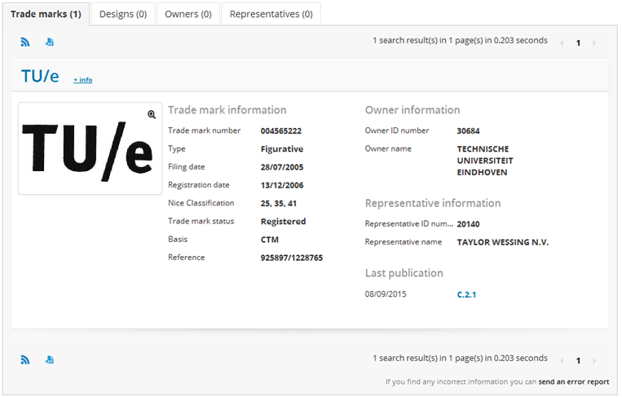
Patents, models, trademarks
Source: European Office for the Harmonisation of Internal Markets https://oami.europa.eu/ohimportal/en/databases

Slide 22
Copyright
Het auteursrecht is het uitsluitend recht van den maker van een werk van letterkunde, wetenschap of kunst, of van diens rechtverkrijgenden, om dit openbaar te maken en te verveelvoudigen, behoudens de beperkingen, bij de wet gesteld.
Het auteursrecht gaat over bij erfopvolging en is vatbaar voor gehele of gedeeltelijke overdracht. De maker, of zijn rechtverkrijgende, kan aan een derde een licentie verlenen voor het geheel of een gedeelte van het auteursrecht. De levering vereist voor gehele of gedeeltelijke overdracht, alsmede de verlening van een exclusieve licentie, geschiedt bij een daartoe bestemde akte. more
Behoudens bewijs van het tegendeel wordt voor den maker gehouden hij die op of in het werk als zoodanig is aangeduid, of bij gebreke van zulk eene aanduiding, degene, die bij de openbaarmaking van het werk als maker daarvan is bekend gemaakt door hem, die het openbaar maakt. More
(Source: Nederlands wetboek, //wetten.overheid.nl/BWBR0001886/geldigheidsdatum_17-09-2015)

Slide 23
Copyright
If you make something in writing, science or art, you own the exclusive right to copy and publish it
Het auteursrecht is het uitsluitend recht van den maker van een werk van letterkunde, wetenschap of kunst, of van diens rechtverkrijgenden, om dit openbaar te maken en te verveelvoudigen, behoudens de beperkingen, bij de wet gesteld.
Het auteursrecht gaat over bij erfopvolging en is vatbaar voor gehele of gedeeltelijke overdracht. De maker, of zijn rechtverkrijgende, kan aan een derde een licentie verlenen voor het geheel of een gedeelte van het auteursrecht. De levering vereist voor gehele of gedeeltelijke overdracht, alsmede de verlening van een exclusieve licentie, geschiedt bij een daartoe bestemde akte. more
Behoudens bewijs van het tegendeel wordt voor den maker gehouden hij die op of in het werk als zoodanig is aangeduid, of bij gebreke van zulk eene aanduiding, degene, die bij de openbaarmaking van het werk als maker daarvan is bekend gemaakt door hem, die het openbaar maakt. More
PS. English summary by Loe Feijs, no rights No rights may be derived from this summary.
PS2. also see https://www.tue.nl/universiteit/bibliotheek/praktische-informatie/overzicht-dienstverlening/copyright-coach/
The copyright can be transferred by inheritance or by licencing agreement
By default the maker is whose name appears on the work or whose name was mentioned when it was published

Slide 24
Comment
First comment block:
copyright notice
short explanation
design decisions
sources
references
acknowledgements
Additional comments in code:
explain variables
functions, etc.
avoid this:
x++; //increment x

Slide 25
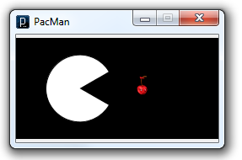
Comment
//Pac-man in one dimension: (C) Loe Feijs and TU/e, 2015 for DBB210.
//The program shows a pac-man enjoying a cherry and demonstrates
//the usage of the % operator for cylinder and torus topologies.
//The program is adapted from Ex. 7-4, p.93 in Casey Reas & Ben Fry,
//Getting Started with Processing (Loe added the cherry and the
//up-down jumping). The cherry image comes from www.softicons.com //Pacman is a game by NAMCO released in 1980.
//Pac-man was designed by Toru Iwatani.

Slide 26
Comment
//memory bank to store existing rectangles
int memx[] = new int[100];
int memy[] = new int[100];
int memw[] = new int[100];
int memh[] = new int[100];
int mem=0;
void memo(int x, int y, int w, int h){
//memorize x,y,w,h as the mem-th rectangle
memx[mem] = x;
memy[mem] = y;
memw[mem] = w;
memh[mem] = h;
mem++;
}
boolean inside(int tx, int ty, int x, int y, int w, int h){
//test whether a point tx,ty is inside a rectangle (x,y,w,h)
if ((tx >= x) && (tx <= x+w) && (ty >= y) && (ty <= y+h))
return true;
else return false;
}

Slide 27
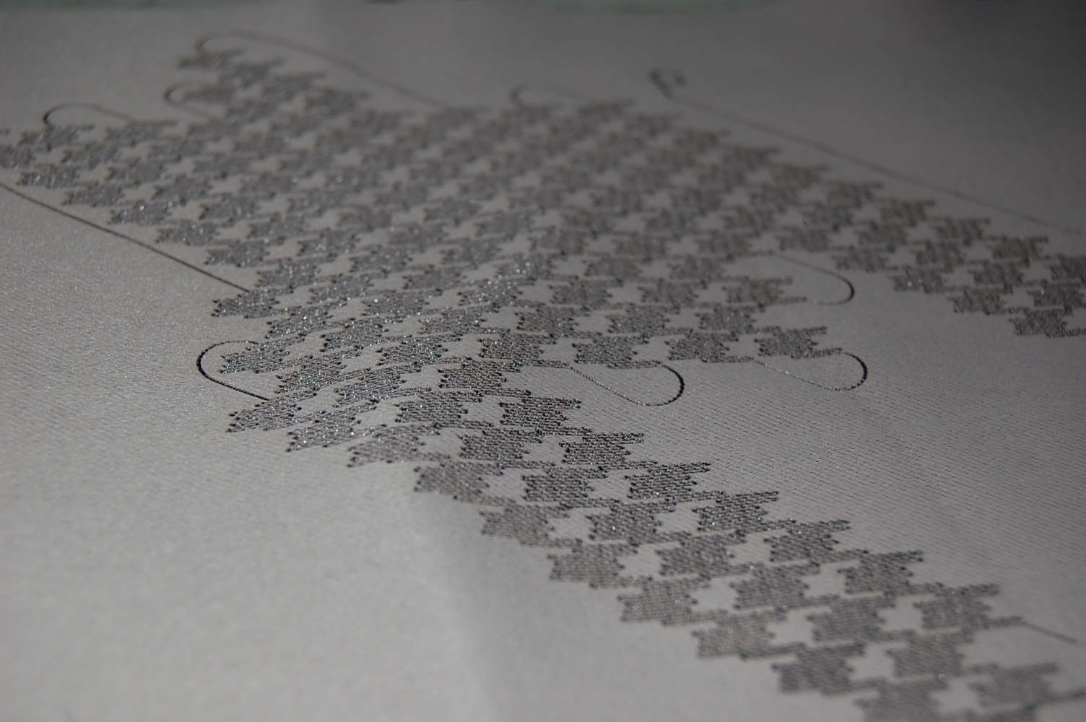
Reference (APA style)
In earlier work we explored both turtle graphics (Feijs, Hu 2013) and also fractals (Feijs, Toeters, 2013). Nowadays we combine turtle graphics and fractals.
Feijs, L.M.G., Hu, J. Turtles for Tessellations. (2013). Proceedings of Bridges 2013: Mathematics, Music, Art, Architecture, Culture, 241–248.
Feijs, L.M.G., Toeters M. Constructing and Applying the Fractal Pied de Poule (Houndstooth). (2013). Proceedings of Bridges 2013: Mathematics, Music, Art, Architecture, Culture, 429-432.

Slide 28
Publication
Is this a publication?
student shows things in a classroom
answer: no
sources must be mentioned
student sends homework to a teacher
answer: yes
sources must be mentioned
and proper referencing is obligatory
but: formal permission for reproduction not needed
Student submits work to a website, exhibition or conference
answer: yes
sources must be mentioned
and proper referencing is obligatory
formal permission for reproduction is needed

Slide 29
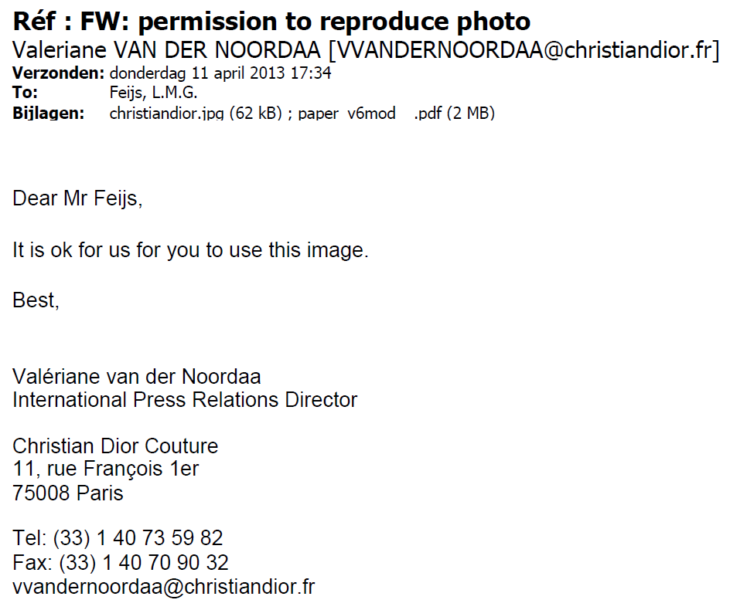
Publication
When using photographs of others in a publication you have to obtain their written permission

Slide 30
Documentation
Comment
first comment block: copyright notice, statement of copying permission, short explanation, design decisions, sources, references, acknowledgements
additional comments in code: explain variables, functions, etc.
readme.txt
instructions for installation and use
repeat acknowledgements, sources, references
Diagrams
flow charts
finite state machines
wiring diagrams for arduino
Reflection document
what did I learn?
mandatory
recommended

Slide 31
Acknowledgement
if you received support from others:
thank them.
if the original idea was not yours,
or you include work of others,
or you deliver joint work with others:
write that down explicitly.
Never ever claim or even suggest authorship for something you did not create yourself. Otherwise it is plagiarism, which is fraud and which leads to shame on you, “process verbaal”, investigations and measures by the Board of Examiners.

Slide 32
Documentation (readme.txt)
README (C) Loe Feijs and TU/e 2013.
Mondrian-inspired Victory Boogie Woogie program for Setup Call for Code.
The program runs in Processing 2.0
Install Processing from Processing.org first.
The code is in 10 files of type pde.
The code files must be in one directory with the same name as the main file.
Open the main file in Processing and press the Play button, or run by Sketch > Run.
The output can be captured as a pdf file by pressing key 'p' after circa 25 seconds.
Or it can be captured with PRINTSCREEN, copy-pasted into Paint and stored as BMP file.
The program was tested on Windows 7.
The following keys control the behaviour of the program:
'c' count total number of cells
'e' exit program (result is gone, but replay with reported seed is possible)
'f' freeze (toggle)
'g' grow one step (when frozen)
'o' old look (toggle), add some speckles and rough edges - rather slow
'p' print, create a pdf file in the same directory as the pde
'x' x-ray (toggle), "rontgen", show gridlines and cell-centers.
The following variables in the prelude of the main file could be adjusted:
seed = 72; (-1 means random, note the reported seed in the console area)
boolean speedy = false;
boolean rontgen = false;
boolean frozen = false;
boolean boxing = false;
boolean sketchFullScreen(){ return false;}
Adapted from source: https://github.com/Elegant-Setup/LMG-Feijs/blob/master/VBWzeroDotEighteen/README.TXT

Slide 33
Code of scientific conduct
TU/e expects its academic staff and students to respect the following five central values of scientific integrity and to conform to the norms and principles that follow from them for their research, design and educational activities:
Trustworthiness
Intellectual honesty
Openness
Independence
Societal responsibility
Source: TU/e code of scientific conduct, static.tue.nl/fileadmin/content/universiteit/Over_de
_universiteit/integriteit/TUe_Code_of_Scientific_Conduct_21-1-2015 (downloaded 14-9-2015).
Plagiarism is unacceptable.
Authorship for genuine contribution only.
Respect intellectual property and authorship.
more ..

Slide 34
Overview of todays lecture
Use of resources
libraries
examples
communities
open source software
patents, models, trademarks
copyright
comment
reference
publication
documentation
acknowledgement
code of scientific conduct
RE-USE
IS
GOOD
RE-USE IS GOOD
BUT YOU MUST OBEY THE CODE OF SCIENTIFIC CONDUCT
CONDUCT
BUT
YOU
MUST
SCIENTIFIC
THE
CODE OF
OBEY

Slide 35
Finally
Acknowledgements: the author thanks Jun Hu who proposed the title of this lecture “Use of resources” and helped create the content and also TU/e Copyright coach Drs. Leon Osinski for his kind advice and support.
Thank you for your attention

