Slide 1
Arduino and state machines

Slide 2
Content
Light-Time-Switch
Light-Time-LDR-Fade

Slide 3
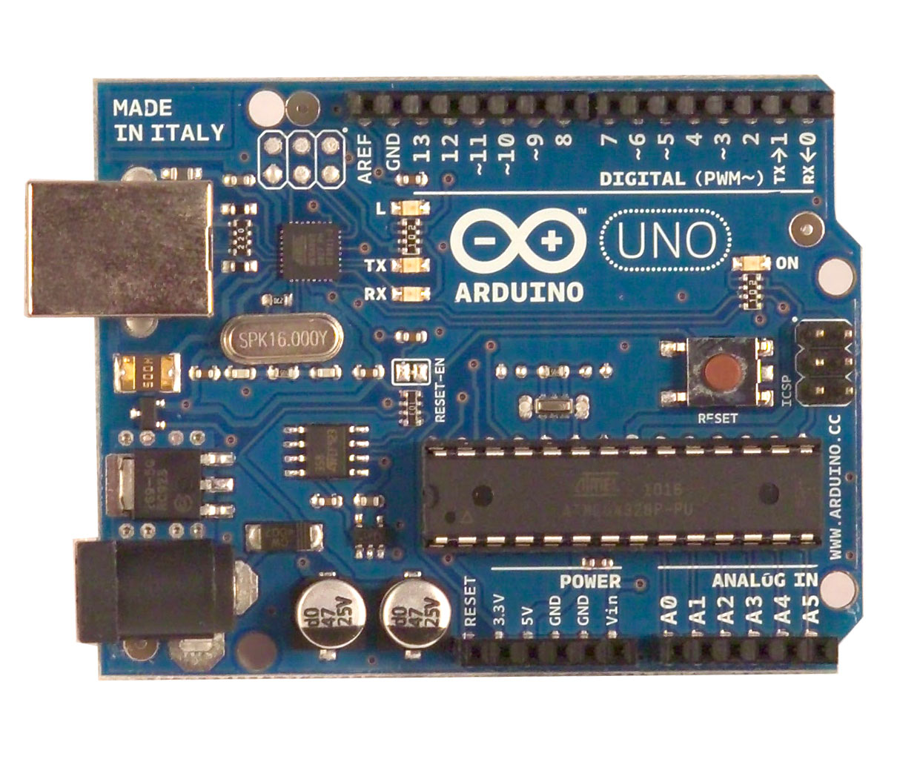

Light-Time-Switch
Button
Pin 9
Gnd
Pin 8
470

Slide 4
Light-Time-Switch
Introducing the button in the program:
#define buttonPin 8
void setup() {
pinMode(buttonPin,INPUT_PULLUP);
// pinMode(buttonPin,INPUT); // set input
// digitalWrite(buttonPin,HIGH); // pull up
}
using it:
int button = digitalRead(buttonPin);

Slide 5
Light-Time-Switch
Introducing the LED in the program:
#define ledPin 9
void setup() {
pinMode(ledPin, OUTPUT);
//more
}
using it:
analogWrite(ledPin,0 );//min brightness
analogWrite(ledPin,255);//max brightness

Slide 6
Light-Time-Switch
Process LED step
(Notation: Finite State Machine)
LED on
initial
LED off
state OFF
button pushed
state ON
10000ms

Slide 7
Light-Time-Switch: full code
/*
Author : Loe Feijs
Date : 20130302
Modified : P.Peters
Date : 20131205
This example shows how to control a LED using a finite state machine. The LED goes on when the button switch is pushed. The LED goes off after 10 seconds.
*/
//connect LED, Button:
#define ledPin 9
#define buttonPin 8

Slide 8
Light-Time-Switch: full code
//FSM states:
#define OFF 0
#define ON 1
int state = OFF; // initial state
int timer = 0;
boolean event = false;
void setup() {
pinMode(ledPin, OUTPUT);
pinMode(buttonPin, INPUT_PULLUP);
}

Slide 9
Light-Time-Switch: full code
void LEDstep(){
int button = digitalRead(buttonPin);
switch (state){
case OFF:
if (button == LOW){
// change state
state = ON;
// state transition actions
timer = 1000; //10 seconds
analogWrite(ledPin,255);//max brightness
}
break;

Slide 10
Light-Time-Switch: full code
case ON:
if (timer <= 0){
// change state
state = OFF;
// state transition actions
analogWrite(ledPin,0);
} else timer--;
break;
}
}

Slide 11
Light-Time-Switch: full code
void loop() {
LEDstep();
delay(10); // one step every 10 ms
}
Arduino CODE

Slide 12

Light-Time-LDR-Fade
Pin 9
470
Pin A0
5V
22k
GND

Slide 13
Light-Time-LDR-Fade
Introducing the LDR in the program:
#define ldrPin A0
void setup() {
pinMode(ldrPin, INPUT);
//more
}
using it:
float avg;
avg = (float)analogRead(ldrPin);

Slide 14
Light-Time-LDR-Fade
Process LED step
(Notation: Finite State Machine)
LED on
LED fades
state ON
state FADING
10000ms
LDRevent
LED off
state OFF
2000ms
initial

Slide 15
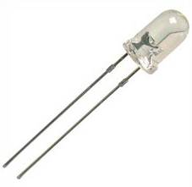
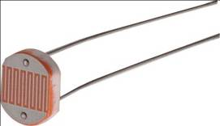
Light-Time-LDR-Fade
Processes LED step, LDR step (Notation: Data Flow Diagram)
LDR step
LED step
set event
ON,
OFF
decrement
avg
LDRevent
state
timer
reset event
Source LDRimage: http://tutorial.cytron.com.my/2011/08/10/project-9-%E2%80%93-analog-sensor-light-detection-using-ldr/
Source LEDimage: http://www.mindsetsonline.co.uk/index.php?cPath=16_560_48

Slide 16
Light-Time-LDR-Fade: full code
/*
(C) Loe Feijs and TU/e 2013. This example shows how a control an LED (LED via 470 Ohm between pin 9 and GND). The light goes on when the environment's bright-ness changes suddenly. The averaged brightness is cal-culated by a moving average with time constant of 20 seconds. The LDR is connect between +5V and pin A0
The LDR has a pull-down resistor of 22k between pin A0 and GND. The LED fades out after 10 seconds. It takes 2 seconds to fade out.
*/
//FSM states:
#define OFF 0
#define ON 1
#define FADING 2

Slide 17
Light-Time-LDR-Fade: full code
//connect LED, LDR:
#define ledPin 9
#define ldrPin A0
int state = OFF;
int timer = 0;
boolean LDRevent = false;
void LEDstep(){
switch (state){

Slide 18
Light-Time-LDR-Fade: full code
case OFF:
if (LDRevent){
state = ON;
timer = 1000; //10000 milliseconds
analogWrite(ledPin,255); //max brightness
}
break;
case ON:
if (timer <= 0){
timer = 200;
state = FADING;
} else timer--;
break;

Slide 19
Light-Time-LDR-Fade: full code
case FADING:
if (timer > 0){
// state internal actions
timer--;
analogWrite(ledPin,10*timer/8);
//fade from 250 to 0 during 2000ms
} else {
state = OFF;
// state transition actions
LDRevent = false;
analogWrite(ledPin,0);
}
break;
}
}

Slide 20
Light-Time-LDR-Fade: full code
float avg;
void setup() {
pinMode(ledPin, OUTPUT);
pinMode(ldrPin, INPUT);
avg = (float)analogRead(ldrPin);
}

Slide 21
Light-Time-LDR-Fade: full code
void LDRstep(){
//LDR from +5V to pin A0, pulldown 22k to GND
int v = analogRead(ldrPin);
avg = 0.9995 * avg + 0.0005* (float)v;
float delta = 20.0;
float dif = (float)v - avg;
if (abs(dif) > delta)
LDRevent = true;
}
exponentially weighted moving average
Time constant 20 seconds
(1/0.0005) * 10ms

Slide 22
Light-Time-LDR-Fade: full code
void loop() {
LDRstep();
LEDstep();
delay(10); // 10 ms delay between steps
}
Arduino Code

Slide 23
Light-Time-LDR-Fade (looking back)
Useful principles:
More parallel processes
Fading LED using PWM

